Slide 1
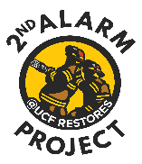
Stronger Together
Building Resilient Relationships
Notes:
KEY POINTS:
This workshop was created by partners and mental health professionals who truly understand the lifestyle of first responders and their families.
We’ve walked this road ourselves:
The late-night worry
The missed holidays
The emotional distance after a tough shift
And the pride, strength, and passion that come with being part of this unique community
This workshop was built with you in mind—because we noticed something important:
There are many resources for first responders…
But far fewer for the people who love them.
As partners, you carry so much of the emotional weight—and you deserve support, too.
Whether you’re new to this lifestyle or have been living it for years, we know how unique and challenging it can be to love someone who runs toward danger.
Our goal is to empower you with:
Tools
Insights
Support
…to help you thrive—not just survive—in your relationship and family life.
BEST PRACTICES: To help build connections and community, we invite each of you to briefly introduce yourselves by sharing:
Your name
How many years have you been with your first responder partner
*Icebreaker question*
To help us make the most of our time together, we kindly ask that you follow these simple guidelines:
Please silence your cell phones.
If you need to take a call, please step outside the room.
Provide directions to restrooms. We’ll be providing short breaks throughout the workshop.
If you’d like to respond or react to something, please raise your hand.
While we value everyone’s input, we may need to gently redirect or pause discussions to ensure we stay on schedule and respect everyone’s time.

Slide 2
Learning Objectives:
1
Understand insights and challenges of first responder community
3
4
5
2
Learn to recognize the signs and impact of stress and trauma on your family
Identify best practices for supporting first responders
Learn communication and coping strategies to build a resilient relationship
Implement self-care practices into your personal lives
6
Recognize the resources available to first responder families
Notes:
KEY POINTS:
The purpose of this workshop is to empower partners who are in a relationship with a first responder.
We hope you’ll leave with practical tools and insights to help you navigate the unique challenges of this lifestyle.
We’ve broken the workshop into several focused section, each addressing a different aspect of life as a first responder partner.
First Responder Roles and Community
Gain insight into what first responders do, how they think, and why that matters at home.
Identifying and Managing Stress
Learn to identify signs and symptoms of stress, understand how it affects both responders and their families, and explore the effects of secondary trauma.
Supporting Your First Responder
Discover best practices for offering emotional support in ways that are meaningful and effective.
Effective Communication
Learn tools to help you connect more deeply and navigate tough conversations with confidence.
Self-Care for Family
Explore strategies for maintaining your own mental, emotional, and physical well-being.
Resources & Build Community
Learn about support networks and resources available to first responder families.
Each section includes evidence-based strategies you can start using right away.

Slide 3
Notes:
KEY POINTS:
This video offers a lighthearted look at life with a first responder.
It is not meant to demean or criticize our partners in any way.
Instead, it highlights some of the real challenges we face in a humorous and relatable way.
BEST PRACTICES:
If the video does not play directly within the PowerPoint slide:
Use the following link to access it ahead of time: www.youtube.com/watch?v=u-wUXdUIJ8M
Consider pulling it up before the workshop begins to ensure a smooth transition.

Slide 4
What does it mean to be a partner to a first responder?
VS.
Notes:
KEY POINTS:
Similarities with Non-First Responder Relationships
Compromise is essential when balancing wants and needs.
Open communication helps prevent feelings of being left out, abandoned, or ignored.
Trust must be the foundation of the relationship.
Unique Differences in First Responder Relationships
Pride in the profession:
First responders are proud of their work, and their partners often share in that pride.
Anxiety over safety:
Worrying about a partner’s safety can affect emotional closeness and day-to-day interactions.
Strong sense of community:
The “blue line” or “red line” family offers support, camaraderie, and shared understanding.
Acceptance of absence:
Long shifts, missed holidays, and unpredictable schedules are part of the lifestyle.
Resilience and dedication:
First responder families often demonstrate exceptional strength, adaptability, and support for one another.
For example, celebrating holidays on any day rather than just allowing for a missed one.
BEST PRACTICES:
Elicit input from participants to foster connection and shared understanding.
Discussion question: “What have you found to be the strengths and challenges of being in a relationship with a first responder so far?”

Slide 5
Law Enforcement Roles and Community
Notes:
KEY POINTS:
In this section, we’ll take a closer look at the world your partner lives in while at work.
We’ll explore the roles, responsibilities, and community of law enforcement.
Understanding their work environment can help you:
Better support your partner
Navigate challenges at home with more empathy and insight
BEST PRACTICES:
Note: The law enforcement community can vary widely depending on:
Leadership style
Department size
Geographic location
Community-police relations
If presenting to experienced partners, consider:
Shortening this section by removing the slides “What do law enforcement professionals do all day?” and the overview of roles.
Adding more discussion or Q&A to draw on their lived experiences

Slide 6
What do law enforcement professionals do all day?
Respond to dispatched calls
Vehicle accidents
Domestic incidents
Crimes against persons
Wellness checks and missing persons
Property and narcotics crimes
Verbal/physical disturbances
Maintain vehicles and weapons
Inspections
report writing
Self-initiated calls
Assist with natural disasters
Required training and education
Defensive tactics
Range qualifications
Emergency vehicle operations
Policy updates
Notes:
KEY POINTS:
On any given shift, officers may respond to:
Vehicle collisions, domestic incidents, wellness checks
Crimes in progress, missing persons, mental health crises
They also handle administrative tasks like:
Report writing, equipment checks, and ongoing training
Some officers are assigned to dispatched calls, while others work in self-initiated units—actively looking for violations or suspicious activity.
During natural disasters (e.g., hurricanes), officers may be required to report to duty, leaving families to manage on their own.
Roles can shift based on:
Assignment, agency needs, or even the time of year
Location-specific demands (especially across different areas in Florida)
New officers go through a Field Training Officer (FTO) period:
They’re mentored and evaluated
This can last weeks to months and may involve rotating shifts, trainers, and locations
BEST PRACTICES:
Emphasize that duties and schedules may change as:
The officer moves between patrol and specialized units
The agency adjusts to meet operational needs (e.g., specialty units taking dispatched calls during high-demand periods)
Encourage flexibility and open communication at home to adapt to these changes

Slide 7
Overview of County Sheriff Ranks
Sheriff (elected position)
Undersheriff
Bureau Chief Commander / Bureau Commander
Major (Division Commander)
Captain (Section / Sector Commander)
Lieutenant
Sergeant
Corporal
Deputy
Deputy First Class / Master Deputy
Court Security Deputy
Reserve Deputy
Notes:
KEY POINTS:
This is a general overview—not all agencies follow the same structure.
Most agencies use a rank system, though titles and responsibilities may vary.
In sheriff’s offices, common ranks include:
Deputy, Sergeant, Lieutenant, and up to Sheriff
Some agencies include classifications like:
Deputy First Class or Master Deputy, which may require:
A certain number of years of service
Community service hours with an approved organization
Court security deputies may:
Not have take-home vehicles
Receive lower pay than patrol deputies
Reserve deputies are sworn officers:
They are unpaid for regular hours
But can work off-duty jobs for pay
BEST PRACTICES:
Note: Hide this slide if it doesn’t apply to the departments represented in your audience.
Helpful context to share:
Some agencies “promote to the road,” meaning promotions start with a return to patrol.
Some roles require testing (e.g., written exams, inbox exercises) to qualify for promotion.
Higher ranks (like Captain) are often appointed by the Sheriff rather than tested.

Slide 8
Overview of City Officer Ranks
Chief (appointed by mayor)
Deputy Chief
Captain
Lieutenant
Sergeant
Corporal
Master Patrol Officer
Officer
Notes:
KEY POINTS:
This is a general overview and may not apply to all city or municipal departments.
Common ranks include:
Officer, Corporal, Sergeant, and Captain
Corporal is often a non-tested classification:
Typically assigned by a Sergeant to someone trusted to lead in their absence
Master Patrol Officer is a classification that may require:
A certain number of years in service
Annual community service hours with an approved organization
BEST PRACTICES:
Note: Hide this slide if it doesn’t apply to the departments represented in your audience.
Helpful context to share:
Some agencies “promote to the road,” meaning promotions begin with a return to patrol duties.
Some positions require testing (e.g., written exams, inbox exercises).
Higher ranks are often appointed by the Chief, especially in leadership roles.

Slide 9
Overview of State Trooper Ranks
Colonel (Commander / Director)
Lieutenant Colonel (Deputy Director)
Major
Captain
Lieutenant
Master Sergeant
Sergeant
Master / Senior / Corporal
Master / Senior / Trooper First Class / Trooper Specialist / Trooper
Notes:
KEY POINTS:
This is a general overview and may not apply to all state-level agencies.
Common ranks include:
Trooper, Trooper First Class, Sergeant, Lieutenant, and beyond
Classifications like Master Trooper, Senior Trooper, or Trooper Specialist often reflect:
Years of service
Additional qualifications or responsibilities
Promotions may be based on:
Testing, time in service, or appointments by leadership
Some roles come with:
Increased responsibility
Different pay scales
Specialized vehicles or equipment
It’s a complex system that varies by agency and can evolve over time
BEST PRACTICES:
Note: Hide this slide if it doesn’t apply to the departments represented in your audience.
Helpful context to share:
Some agencies “promote to the road,” meaning promotions begin with a return to patrol duties
Some positions require testing (e.g., written exams, inbox exercises)
Higher ranks are often appointed by the Colonel or Commander, especially in leadership roles

Slide 10
What to Expect from Your
Law Enforcement Officer (LEO)
Shift work, overtime and off-duty
Hypervigilance
Carryover of work attitudes at home
Unable to readily answer your calls or messages
Responding to calls within a moment's notice
Notes:
KEY POINTS:
The job doesn’t stay at work—it impacts home life in real ways.
Shift Work, Overtime & Off-Duty
Expect rotating shifts, nights, weekends, and holidays.
Overtime may be voluntary or mandatory.
Plans may change at the last minute due to call-ins or staffing needs.
Hypervigilance
Constant alertness is part of the job—and it often follows them home.
You may notice behaviors like:
Sitting facing the door
Scanning crowds
Checking exits
It’s about safety, not paranoia—but it can affect how present they are in public or at home.
Work attitudes can carry into home life:
Authoritative – staying in “operator” mode.
Cynical – doubting the goodness of others.
Protective – especially toward loved ones, which can be complex when children are involved.
How have you seen this play out in your own family?
How do you deal with it?
Limited Communication During Shifts
They may not be able to answer calls or texts.
Responses may be delayed or brief—not because they don’t care, but because they’re busy or emotionally spent.
Subject to Immediate Recall
They may be called in unexpectedly—even during vacations or holidays.
This unpredictability can be frustrating and disruptive to family life.
Reminder: holidays can be celebrated on your own special day if your partner is working.
Make it special for kids, “You’re having two thanksgivings this year!”
If you’ve ever felt overwhelmed or disconnected, you’re not alone.
These are common experiences in first responder families—and understanding them is the first step toward building resilience together.
BEST PRACTICES:
Share personal examples to normalize these challenges:
“Why are you never home?” or “Even when you are, you’re too tired to engage.”
“I never get to face the door in restaurants anymore!”
“Why do my emergencies come second to strangers’?”
Validate participants’ feelings and encourage open discussion.
Emphasize that these dynamics are common—and manageable with communication, empathy, and support.

Slide 11
ViV
Law Enforcement Community
Dark humor to cope with stress
“Suck it up buttercup” mentality
Establishing tight bonds
Substance use
Thin Blue Line Family
“Fix it" mindset
Notes:
KEY POINTS:
The first responder community, especially law enforcement, has unique dynamics that affect both work and home life.
Law enforcement officers (LEOs) are natural problem-solvers, which benefits their work but can create challenges at home.
This mindset may lead them to offer solutions when their partner simply wants to vent.
(Note: Strategies to address this will be covered later.)
Humor is a common coping mechanism among LEOs.
Dark humor may seem inappropriate but often serves as a way to process trauma.
A seemingly off-putting joke might be their way of saying, “That call was hard.”
A lack of humor could signal they need support.
A “suck it up, buttercup” mentality often surrounds mental health in law enforcement.
Many officers hesitate to seek help due to stigma or fear of professional consequences.
Peer support programs and mental health initiatives are emerging to combat this stigma.
Employee Assistance Programs (EAPs) may lack clinicians who understand law enforcement trauma.
There’s also concern about the agency knowing a partner is seeking mental health support.
They form tight bonds with colleagues—like a second family
They may process trauma with peers instead of you—not to shut you out, but because of shared experience.
Alcohol use is often normalized as a coping tool in the first responder community.
The “Thin Blue Line” represents a strong sense of family and support among law enforcement.
This network includes others who understand and share similar experiences.
BEST PRACTICES:
Avoid discussing solutions or strategies on how to manage these points, that will be discussed later.
Highlight the positive aspects of the community—there is real support within the “Thin Blue Line.”
Many organizations, social media groups, businesses, and charities actively support law enforcement families.
When addressing mental health stigma, emphasize that vulnerability and seeking help are signs of strength.
Acknowledge that many departments are working to break down stigma and promote healthier coping strategies.

Slide 12
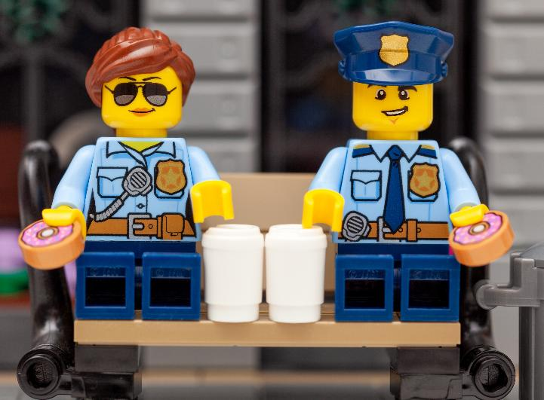
What’s up with law enforcement and donuts?
Notes:
KEY POINTS:
Let’s take a quick, lighthearted break—let’s talk about donuts!
The connection between law enforcement and donuts isn’t just a stereotype.
Historically, donut shops were among the few places open late at night.
They offered coffee, snacks, and a safe place for officers during long shifts.
Officers could take a break, refuel, and stay alert throughout the night.
This relationship also benefited donut shops by deterring late-night robberies.
William Rosenberg, founder of Dunkin’ Donuts, encouraged his shops to welcome police officers, strengthening the bond.
Over time, this practical connection evolved into a fun and enduring tradition.
So, if you’ve ever wondered why cops and donuts go hand-in-hand—now you know!

Slide 13
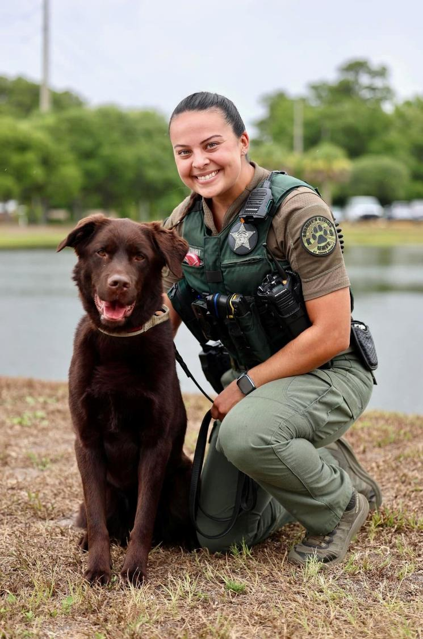
Common Stressors Experienced by First Responders
Exhaustion
Mental and physical
Fear for personal safety
Exposure to hazardous situations
Trauma exposure
Financial strains
Demanding schedules
Working multiple jobs
Mandated overtime
Shift work
Media portrayal
Notes:
KEY POINTS:
Law enforcement is a high-stress profession, but that stress doesn’t always look obvious.
Multiple factors contribute to the pressure officers face:
Exhaustion – Long shifts and constant hypervigilance can wear them down.
Fear for Personal Safety – Officers run toward danger, and their families carry that fear too.
Some partners prefer no visible law enforcement insignia on clothing or vehicles for safety reasons.
Trauma Exposure – While most civilians experience 1–2 traumatic events in a lifetime, LEOs average 3.5 every six months.
Financial Strain – Many officers work second or third jobs to make ends meet.
Risk-taking behaviors like gambling may increase.
Working off-duty can lead to a domino effect: financial stress → less time at home → partner frustration → no time to rest or reset.
Demanding Schedules – Shift work and minimum staffing often mean no time off and being home during odd hours.
Media Scrutiny – Public perception is often shaped by unrealistic portrayals in TV shows and movies.
These portrayals can create false expectations and misunderstandings about the job.
Officers frequently interact with the public in emotionally intense situations, which adds to their stress.
These stressors don’t just affect the officer—they impact the whole family.
You don’t need to fully understand everything your partner experiences at work.
But having insight into their challenges can help you relate with more empathy.
Up next: how to recognize when your first responder may need extra support.

Slide 14
Identifying and Managing Stress
Notes:
KEY POINTS:
In this section, we’re going to talk about something that affects every single one of us—stress.
Whether you're a first responder, a partner, or both, stress is part of the package.
But here’s the good news:
How we understand it, how we manage it, and how we support each other through it—can be the game changer.

Slide 15
What is stress?
Stressors & Hassles
Daily workload (e.g., paperwork, training)
Car breaking down
Relationship issues
Major Life Events
Buying a new house
Having a baby
Transitioning jobs
Notes:
KEY POINTS:
Stress is Normal
It’s a natural part of being human and shows up in both small and big ways.
Daily stressors might include:
Work frustrations (e.g., paperwork, difficult coworkers)
Household or car issues
Conflict with a partner
Major life events can also be stressful—even when they’re positive:
Buying a home
Having a baby
Changing jobs
Going through a divorce
Stress Isn’t Always Bad
It can increase motivation, focus, and productivity.
But when stress builds up without relief or coping tools, it can take a toll on:
Mental and physical health
Relationships
Ability to be present at home or focused at work
Stress is Bi-Directional
Stress at home can affect performance at work.
Stress at work can spill over into home life.
This cycle makes it essential for both partners to understand and manage stress together.
Not All Stressors Are Negative
Even positive changes can disrupt routines and increase pressure.
Any stressor—positive or negative—can impact how we function and connect with others.
BEST PRACTICES:
Keep this slide brief—use it to set the stage for deeper discussion.
Emphasize that everyone experiences stress, but how we manage it makes the difference.
Transition to the next section with: “But where do the bad calls our partners go on fit in?”

Slide 16
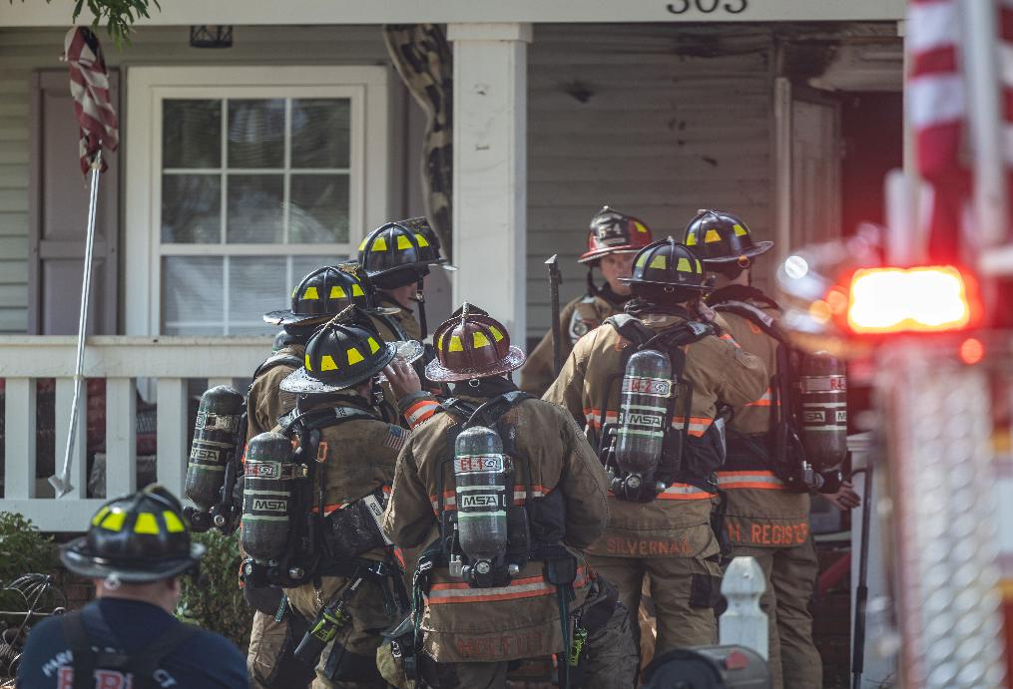
Impact of Calls
Is every call on shift traumatic?
Every person is affected differently by traumatic/stressful events
Most calls will likely not have a long-term negative impact on your first responder
Notes:
KEY POINTS:
Not every call your partner goes on is traumatic
some are routine, others frustrating, and a few may be deeply distressing.
Call volume and severity vary from shift to shift
some days are smooth; others are emotionally or physically taxing.
Every responder experiences calls differently based on their role and personal history.
One person may have performed CPR on a child.
Another may have arrived after the most intense part of the call.
Someone else may have been managing traffic or crowd control.
For example:
One responder may have performed CPR on a child.
Another may have arrived after the most intense part of the call.
Someone else may have been managing traffic or crowd control.
What feels traumatic to one person may not affect another in the same way.
If your partner seems “off” after a shift, it doesn’t necessarily mean they’re traumatized.
Everyone has bad days—but it’s still important to pay attention and check in.
Experiencing a difficult call does not automatically mean they will develop PTSD.
BEST PRACTICES:
Slide transition: So, what is traumatic stress?

Slide 17
What is traumatic stress?
Feels like life is in real danger
Motor vehicle accident
Natural disasters
Entering a burning structure
Physical abuse
Mass violence
Entering an active shooter situation
Notes:
KEY POINTS:
Traumatic stress is a response to life-threatening or overwhelming events.
Emphasize the real danger aspect, this is not just stress, but a survival-level response.
Some may go into a burning structure or an active shooter situation and not experience trauma symptoms though.
BEST PRACTICES:
Use the firefighter image to connect with participants emotionally and visually—ask: “What do you think someone in this situation might be feeling in the moment?”
They could be feeling high levels of stress but also focused and calm because of the experience and/or skills they have.
Slide transition: “How does one actually get a PTSD diagnosis?”

Slide 18
How is Post-Traumatic Stress Disorder (PTSD) diagnosed?
Directly experiencing a traumatic event
Witnessing an event that happens to someone else
Learning about a traumatic event happening to a close friend/family member
Experiencing repeated or extreme exposure to aversive details of a traumatic event
Notes:
KEY POINTS:
You’ve probably heard the term PTSD—Post-Traumatic Stress Disorder—but how does someone actually develop it?
Most, if not all, first responders are exposed to traumatic events during their careers.
However, not all first responders develop PTSD.
The terms “traumatized” and “PTSD” are often used casually on social media, but a true diagnosis requires meeting specific clinical criteria.
Exposure to trauma is the first requirement for a PTSD diagnosis. This can include:
Directly experiencing a traumatic event
Witnessing a traumatic event happening to someone else
Learning that a traumatic event happened to a close friend or family member
Repeated or extreme exposure to aversive details of traumatic events (e.g., through work)
Even hearing about traumatic events from a partner can have an impact
The key is exposure—but exposure alone is not enough.
For a diagnosis of PTSD, there must also be specific symptoms that:
Last for more than one month
Interfere with daily life and functioning
BEST PRACTICES:
Use this slide to clarify that trauma exposure is common, but PTSD is not inevitable.
Emphasize the importance of understanding the clinical criteria for PTSD to avoid overuse or mislabeling.

Slide 19
PTSD Symptoms
Re-experience/Intrusion
Nightmares, flashbacks, reactions to trauma reminders
Avoidance
Memories, thoughts, feelings, external reminders
Cognition & Mood
Negative beliefs, negative mood, withdrawal, depression
Arousal/Reactivity
Anger, reckless behavior, hypervigilance, sleep issues
Notes:
KEY POINTS:
PTSD symptoms fall into four main categories. Understanding these categories can help you recognize when someone might need support.
1. Re-Experiencing / Intrusion
Nightmares or flashbacks
Strong emotional or physical reactions to trauma reminders
Feeling like the event is happening again
2. Avoidance
Avoiding thoughts, feelings, or conversations about the trauma
Steering clear of people, places, or activities that are reminders
Examples:
Taking a different route to avoid a crash site
Refusing to talk about a specific call
Missing work to avoid similar calls
Avoiding children after a pediatric emergency
3. Negative Changes in Mood and Thinking (Cognition & Mood)
Persistent negative thoughts about oneself, others, or the world
Feelings of hopelessness or emotional numbness
Withdrawal from loved ones or activities
Ongoing sadness or depression
4. Arousal and Reactivity
Irritability or angry outbursts
Reckless or self-destructive behavior
Hypervigilance (being constantly on edge)
Sleep disturbances or trouble concentrating
Note: First responders are often hypervigilant by nature, but PTSD-related hypervigilance is typically heightened beyond their normal baseline.
It’s possible your partner may show some of these symptoms after a tough shift. That does not automatically mean they have PTSD. A diagnosis requires a combination of these symptoms, lasting more than a month, and significantly interfering with daily life.
BEST PRACTICES:
Slide Transition: “Now that we understand the symptoms, let’s talk about how to support our partners—and ourselves—when stress becomes overwhelming.”

Slide 20
When should I be worried?
Notes:
KEY POINTS:
So, when should you be concerned about your partner’s mental health?
You know your partner best. If something feels “off” or they just don’t seem like themselves, it’s okay to trust your instincts.
You don’t need to diagnose them—but you can encourage them to talk to a professional.
Early support can make a big difference, even if it’s just a conversation with a counselor or peer support member.
BEST PRACTICES:
Slide transition: “You know your partner! If you’re starting to worry that something seems really off with them, it might be time to refer out to a professional for help. However, in the next couple slides, we’ll share some warning signs and what we call ‘Stress Zones’ to help you identify if mental health care is needed.”
Note: Toward the end of the day, we’ll introduce some options available through RESTORES that can be helpful when you’re concerned but unsure if full treatment is necessary—like the Single Session line.

Slide 21
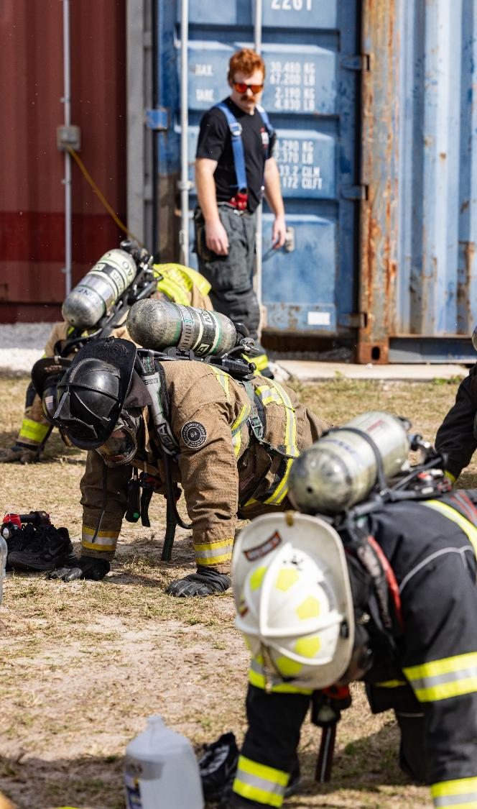
Signs Your First Responder May Be Struggling
Increased irritability, mood swings, or withdrawal
Difficulty sleeping or nightmares
Loss of interest in hobbies and relationships
Increased alcohol or substance use
Expressions of hopelessness or distress
Notes:
KEY POINTS:
Sometimes, the signs that your partner is struggling are subtle. Other times, they’re more obvious.
These are observable behaviors we can see in our first responders that indicate to use they may need professional mental health support.
Be mindful if your partner is acting generally unusual.
Here are some symptoms to keep an eye out for:
You might notice increased irritability, mood swings, or withdrawal.
Be aware of how long these symptoms are lasting at home and the level of severity.
Maybe they’re not sleeping well, or they’re having nightmares about calls.
Watch to see if your first responder is trying to avoid going to sleep, waking up in the middle of the night, maybe even startled easily to noise while sleeping.
They might lose interest in things they used to enjoy—like hobbies, socializing, or even spending time with you and their family.
Your first responder may not want to do things that they used to love anymore or spend time with friends or family.
The opposite could be observed in your partner to act as though everything is okay or use activities as a distraction from memories or intrusive thoughts.
You might also notice an increase in alcohol or substance use.
In the first responder community, drinking is often normalized as a way to deal with the stress of their work.
But there’s a line between having a drink with coworkers and using alcohol to numb their emotions.
Alcohol isn't the only thing that’s used to attempt to cope with stress/trauma. They may be trying to cope with other substances and need professional help.
And finally, you might hear expressions of hopelessness or distress.
If your first responder is expressing that they do not want to plan for the future or expressing thoughts of suicide or self-harm seek immediate help. (911 or 988)

Slide 22
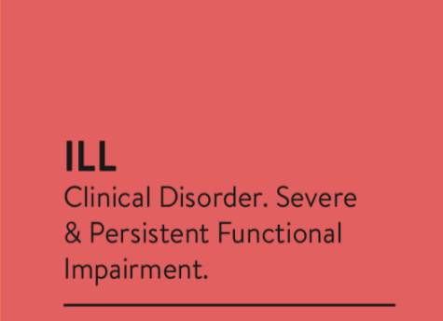
Our goal is to prevent stress injuries when we can and quickly identify and treat them when we can’t.
Notes:
KEY POINTS:
To help gauge how your partner is doing, we use a tool called the Stress Zones—think of it like a color spectrum.
The goal is to help identify when something feels “off” and decide what kind of support might be needed.
You can assess their zone through observation or conversation—and it’s normal for people to move between zones.
Green Zone – Healthy
Your partner is acting like themselves and managing stress effectively.
This is their baseline—not stress-free but coping well.
They’re adapting to challenges in a healthy way.
Yellow Zone – Reacting
Mild to moderate stress that’s noticeable but temporary.
They may show signs like irritability, fatigue, or tension.
Likely to resolve on its own without professional help.
Example: Feeling stressed in traffic but calming down after arriving at work.
Orange Zone – Injured
Stress is persistent and starting to interfere with daily life.
Symptoms may include:
Withdrawal from activities
Trouble sleeping
Difficulty concentrating
Loss of interest in things they used to enjoy
This is the point where professional support is recommended.
Example: Avoiding certain streets, missing work, or avoiding children after a pediatric call.
Red Zone – Ill
A diagnosable mental health condition is likely present (e.g., PTSD, depression, anxiety, substance misuse).
Symptoms are severe, long-lasting, and significantly impair functioning at work and home.
May include suicidal thoughts or behaviors.
Professional treatment is necessary at this stage.
Important Notes
It’s normal to move between the green and yellow zones daily.
If your partner is stuck in the orange or red zone, it’s time to take action.
Link back to PTSD symptoms discussed earlier:
Nightmares
Hypervigilance
Avoidance
Negative mood
Don’t wait until they’re in the red zone—intervene in the orange zone to help them get back on track.
Support options include EAP, UCF RESTORES, or other mental health resources.
BEST PRACTICES:
Prompt participants to follow along in their supplementary materials provided with more details regarding the stress zones.
Use the Stress Zones as a tool to guide conversations and decisions about seeking help.
Think of stress like physical health:
Green/Yellow = a bruise or sprain (manageable)
Orange = a stress fracture (needs attention)
Red = a broken bone or chronic illness (requires treatment)
Early intervention can prevent long-term damage.
Use this information to normalize stress reactions while also highlighting when to seek help.

Slide 23
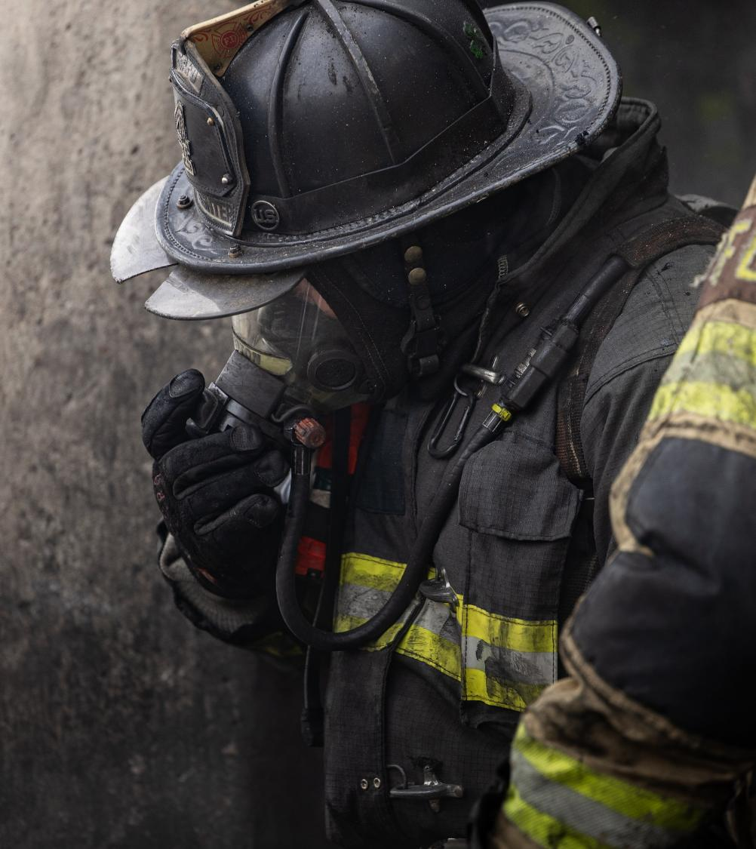
Physical Health Effects Due to Chronic Stress
Chronic fatigue and sleep disturbances
Weakened immune system
Hormone disruption
Increased risk of cardiovascular disease and obesity
Notes:
KEY POINTS:
Stress affects both the mind and the body—it’s not just emotional.
Physical consequences of chronic stress can include:
Fatigue and sleep disturbances
Heart problems and high blood pressure
Weakened immune system, increasing vulnerability to illness
Hormonal imbalances and appetite changes
Increased risk of obesity
Shift work adds to the strain:
Irregular sleep and eating patterns
Exposure to chemicals on the job
Disruption of natural hormone cycles
Recognizing the early signs of stress is key to preventing long-term health issues.
Managing stress is challenging, but awareness of both short- and long-term effects is the first step.
BEST PRACTICES:
Keep this slide brief—use it to reinforce the importance of early stress management.
Emphasize that physical health is closely tied to emotional well-being.
Slide transition: “Next, we’ll continue to discuss how you can support your first responder when they are experiencing these high levels of stress.”

Slide 24
Supporting Your First Responder
Notes:
KEY POINTS:
Transition into slide: Now that we have a solid understanding of stress, what do we do to help our first responders through it?
In this section, we’re going to focus on how to support your first responder—especially when they’re struggling.
We may often want to help our partners, but we’re not always sure how to go about it.
We might worry about saying the wrong thing or making things worse.

Slide 25
The ABCs of Family Support
Allow time and space for your first responder to debrief and decompress
Be emotionally attuned to your partner
Create a supportive and emotionally safe home environment
Notes:
KEY POINTS:
How can we have an overall supportive environment at home?
As a partner, your role can make a big impact on your partner’s wellbeing.
Loved ones provide a sense of stability, emotional grounding, and motivation to cope with job-related challenges.
A strong family support system helps first responders process trauma, prevent burnout, and maintain a healthy work-life balance.
But that doesn’t mean you have to have all the answers.
Allow time and space to debrief and decompress:
Encourage your partner to take time after shift and provide them space as needed.
We may need to provide while they take time to rest.
First responders carry a heavy emotional and mental load from their work.
Their job is stressful, often requiring them to process traumatic events while maintaining professionalism.
This can sometimes lead to emotional withdrawal, fatigue, or frustration.
Being patient and understanding can help them feel supported rather than pressured, allowing them to decompress and process at their own pace.
Be patient with emotional highs and lows.
In some cases, partners may benefit from seeking therapy to maintain emotional balance and develop strategies for managing stress, especially during overwhelming periods.
Be emotionally attuned to your first responder partner:
Not everyone reacts the same when it comes to calls, so some emotions may be stronger than others depending on personal connection
Be mindful of your partner’s emotional state and get to know their “tells” when they are struggling.
Recognize emotional lows: may appear as irritability or withdrawal.
Create a supportive, emotionally safe home environment:
First responders carry a heavy emotional and mental load from their work.
Allow your first responder to talk about the stress and experiences.
Note: if details end up being too much for you to handle, make sure you have your boundaries in place (we’ll discuss this more later)
Try to reduce unnecessary stress at home by fostering a calm and supportive atmosphere.
That can mean ensuring we manage our own emotions as partners and using emotional regulation.
Note: this can be challenging when there is a lot of family at home including children.
Small gestures—like preparing a favorite meal or giving them some time to rest—can make a big difference in their recovery from work stress when things are tough.
BEST PRACTICES:
Optional question: What are some ways you have found that have helped your first responder during emotional lows?
Share examples of strategies for decompressing after shift:
Sitting in the car for a few minutes after arriving home to mentally transition.
Coming into the home in a different entrance than usual (when they need to decompress, they come in the garage or back door rather than the front door) - this signals to the family that they need some time to themselves.
Pausing at the start of the driveway to speak out loud or vent to a consistent object (such as a tree), creating a symbolic space to release stress.
Talking with fellow first responders who understand the nature of the calls and can help process the experience.
Their partner could invite a fellow first responder to talk in the garage, it often signals a mutual need to decompress and support one another. These moments—sometimes jokingly referred to as "solving the world’s problems"—serve as informal but meaningful opportunities to process the day.
These personal rituals help create space between work and home life, supporting emotional regulation and healthier reentry into the family environment.

Slide 26
How to Support Your First Responder
Encourage Communication
Let them share their experiences when they are ready without judgement
Recognize Their Sacrifices
Express appreciation for their hard work and service
Support Their Self-Care
Encourage them to participate in hobbies, exercise, and relaxation
Educate Family Members
Discuss the psychological and physical impact of the job
Notes:
KEY POINTS:
Let’s discuss some specific strategies you can use to support your partner next.
1: Encourage Communication
It’s important to create a space where first responders feel comfortable sharing their experiences, but on their own terms.
Avoid pressuring them to talk about difficult calls or incidents—let them open up when they’re ready.
Instead, let them know you’re available to listen without judgement and provide emotional support when needed.
Listening without judgment: This might mean avoiding reactions to how they acted on a call or how they might feel about a patient or their choices.
In most cases, just listening to your first responder is enough to help them get through the hard times and listen to understand they aren't asking you to fix anything.
2: Recognize Their Sacrifices
First responders make sacrifices daily—long shifts with no sleep, missing family events, and facing dangerous situations.
Acknowledging and appreciating their dedication goes a long way in helping them feel valued.
Simple words of gratitude, leaving a thoughtful note, or celebrating their hard work can have a positive impact on their morale.
This can be something as simple as saying "I appreciate all that you do for our family" and “Thank you for working hard every day."
3: Support Their Self-Care
Encourage first responders to engage in activities that promote relaxation and well-being.
Support them in maintaining hobbies, exercising, or finding ways to de-stress after long shifts.
Their self-care isn’t just about them—it’s also important for us as their loved ones.
4: Educate family members:
Discuss first responder jobs and negative moods at an age-appropriate level with children within the household.
Educate your family, especially your children and other family members, about the realities of the job.
Help them understand that mood swings or time by themselves aren’t personal, and that it’s okay to talk about how they feel too.
BEST PRACTICES:
Optional prompts:
How does your partner feel supported at home?
What does your partner do to support you?

Slide 27
What if my partner won’t talk to me?
Gently check in without pressuring them to talk
Avoid pushing for details if they are resistant
Create consistent opportunities for connection
Encourage them to discuss their emotions over the situation
Pay attention to nonverbal signs of distress
Normalize seeking outside help or peer support
Notes:
KEY POINTS:
Now, what if your partner won’t talk to you? This is a common concern.
Here are some ways to support your first responder when they don’t want to talk:
Gently check in without pressuring them to talk
Your partner may be attempting to protect you by avoiding discussing the tough calls.
Avoid pushing for details if they are resistant
Respect their need for space after tough shifts.
Create consistent opportunities for connection
Shared meals
Walks
Encourage them to talk about the emotions they are feelings rather than the calls themselves
Focus on emotion over the situation.
They may still be processing what happened.
Or they just want to let it go and not dwell on the call.
Pay attention to nonverbal signs of distress
Withdrawal
Irritability
Increased drinking
Normalize seeking outside help or peer support
Your partner might want to talk to someone outside the home who understands the job– like a peer support or chaplain
BEST PRACTICES:
Optional questions:
What are some examples of opportunities for connection with your partner?
How do you handle when you need connection, but your partner needs to be space alone?

Slide 28
Effective Communication
Notes:
KEY POINTS:
In this section, we’re going to focus on something that’s essential in every relationship—communication.
When your partner is a first responder, communication becomes even more important.

Slide 29
Why is it important to learn communication skills?
Difficult conversations...
Are part of being in intimate relationships
It’s not about if...It’s about when…
You want to provide support but are unsure how
Having effective communication tools in your toolbox can make it easier to:
Manage uncomfortable emotions
Get both your and your partner’s needs met
Support your partner
Notes:
KEY POINTS:
Difficult conversations are inevitable in any relationship—especially when one partner is a first responder.
It’s not a question of if these conversations will happen, but when.
Having the right tools can make these conversations less overwhelming and more productive.
Many partners of first responders:
Want to be supportive.
Often feel unsure about what to say.
Worry about saying the wrong thing.
This section provides practical communication tools to help:
Strengthen connection with your partner.
Build confidence in navigating tough conversations.
You’ll learn how to:
Manage your partner’s emotions.
Ensure both of you feel heard.
Support your partner without losing your own voice.
These tools can:
Boost your confidence in hard conversations.
Reduce anxiety and help manage uncomfortable emotions.
Improve active listening, leading to better understanding and validation between partners.
BEST PRACTICES:
Optional Reflection Question: Can you think of a time when you had to have a hard conversation with your partner about their job? → Prompt participants to reflect on how that conversation went for them.

Slide 30
Notes:
BEST PRACTICES:
Start with Engagement:
Ask participants for their initial thoughts and reactions after watching the video.
Share your own personal reflections to help open up the conversation.
Post-Video Reflection Questions:
What role do you feel empathy plays in your relationship with your partner?
Why do you think presence is sometimes more important than saying the right thing?
Technical Note:
If the video does not play within the PowerPoint slide, use this link to access it before the workshop begins:
Link to video: www.youtube.com/watch?v=1Evwgu369Jw&t=2s

Slide 31
Sympathy vs. Empathy
Sympathy
Feeling concern or sorry for someone
Empathy
Understanding what someone else is feeling
Stepping into someone else’s shoes
Notes:
KEY POINTS:
If you're not a first responder, it may be difficult to fully understand your partner’s experiences.
Some experiences you may empathize with, while others may feel unfamiliar, and that’s okay.
You can still use communication tools to help your partner feel validated and supported.
Sympathy:
Feeling sorry for someone without truly connecting to their emotions.
Example: “Sorry you’re stressed. At least you are off for the next couple days.”
Empathy:
Going deeper—stepping into someone else’s shoes and being present with them.
Requires vulnerability, non-judgment, and active listening.
It’s about being with your partner in their experience, even if you don’t fully understand it.
Often described as “walking into the trenches with someone.”
Empathy is the foundation of the communication toolbox we’ll be building.
You don’t need to share the same experience to be empathetic—just be present, open, and willing to listen.
BEST PRACTICES:
Optional Icebreaker Question:
How many of you are also first responders?
Optional Discussion Questions:
What qualities define an empathetic person?
How do you know if someone is showing empathy—what do they do?

Slide 32
Before the conversation...
Ask yourself: What are you comfortable hearing? Communicate this with your partner.
Ask your partner: Are you looking for support or solutions?
Set boundaries: What are some rules you may want to follow to have an effective conversation?
Notes:
KEY POINTS:
1. Ask Yourself: What Are You Comfortable Hearing?
Before tough conversations, reflect on your own emotional boundaries.
Consider what topics might feel too heavy or triggering (e.g., pediatric calls, violence, sex crimes).
It’s okay to have limits—what matters is that you communicate them clearly to your partner.
On the other hand, if you want to hear everything, let your partner know. This can help them feel safe opening up, rather than feeling like they’re burdening you.
Many first responders avoid sharing difficult experiences to protect their partners. If you’re open to hearing them out, they need to hear that from you.
2. Ask Your Partner: Are You Looking for Support or Solutions?
This simple question can transform the tone of a conversation.
Sometimes people just want to vent, not receive advice.
First responders are often “fixers” and may jump to problem-solving, clarifying your needs helps avoid frustration.
Likewise, ask your partner what they need from you in the moment: “Do you want me to just listen, or help you figure something out?”
3. Set Boundaries: What Are Some Rules You May Want to Follow to Have an Effective Conversation?
Establish ground rules for respectful, productive conversations:
Take breaks if emotions run high.
Avoid heavy topics late at night.
Agree on how long breaks should last.
Boundaries help both partners feel safe and respected.
Remember: People aren’t mind readers. Setting expectations ahead of time prevents miscommunication and emotional shutdown.
BEST PRACTICES:
Reflection Prompts: Invite participants to think about:
What kinds of stories or topics would be upsetting for them to hear?
What wouldn’t be upsetting?
Examples: Pediatric calls, sexual assault, death, etc.

Slide 33
Open-Ended Questions
Questions that elicit more elaborate responses than a simple yes/no or one-word answer
Often start with "what, why, when, and how"
Can help gather more information
Allow space for your partner to vent and process feelings
Demonstrate interest in the conversation
Communication Skills
Notes:
KEY POINTS:
Ask Open-Ended Questions
Open-ended questions are a simple but powerful communication tool.
These questions invite more than a yes/no answer and often begin with: What, How, When…
Examples:
“How did that call affect you?”
“What can I do to support you tonight?”
They show genuine interest, give your partner space to share, and help them process their thoughts and emotions.
Be Mindful of How You Ask
Avoid using “why” in ways that may sound accusatory or invalidating:
Instead of “Why did you do that?” try “What made you respond that way?”
Be careful not to:
Interrupt or talk over your partner.
Ask close-ended questions out of impatience or emotional urgency.
Silence is okay—give your partner time and space to respond without rushing them.
Open-Ended Questions Can Bridge Difficult Conversations
Open-ended questions can help open the door to conversations your partner may otherwise avoid.
They create a safe space for vulnerability and connection.
BEST PRACTICES:
Examples of Open-Ended Questions:
“How did LT respond to that call involving the kid?”
“How were you feeling at the start of your shift?”
“What can I do to help you relax this evening?”
“That is tough. How can I best support you right now?” (Note: This last example pairs a validating statement with an open-ended question.)

Slide 34
Reflective Statements
Communication Skills
Identifies the big picture or main theme
Re-phrase statements using your own words
Provides an opportunity for clarification
Helps avoid assumptions, judgments, & breakdowns in communication
Demonstrates active listening
Listening to understand and not to respond
Continues the conversation
Notes:
KEY POINTS:
Reflective statements are another powerful communication tool.
They involve repeating back the essence or main theme of what your partner said, using your own words.
The goal isn’t to repeat their words exactly, but to show that you’re listening, that you understand, and that you’re trying to connect.
For example, saying something like,
“It seems you’re struggling to talk about what you’re feeling,” or
“You’re feeling overwhelmed and just need some space, is that right?”
Reflection is about capturing the “gist” of what your partner is saying. It demonstrates active listening and helps clarify meaning without needing to ask a question.
If your reflection isn’t quite right, your partner has the chance to clarify—this helps avoid assumptions, miscommunication, or judgment.
Reflective statements keep the conversation flowing and reduce the pressure on your partner to explain everything perfectly.
They show that you’re present and engaged.
This skill can be incredibly validating when done well. You can often see it on someone’s face when they feel truly understood.
It feels good to be heard, and reflective statements help create that feeling.
BEST PRACTICES:
No need to include too many examples on this slide—they’ll be covered later.

Slide 35
How to best use reflections…
Reflect emotions and values of what your partner is discussing.
It tells the speaker, “Hey! I know how you feel.”
Don't repeat verbatim what they said, or you could sound like a parrot.
This can cause frustration and feel repetitive.
Notes:
KEY POINTS:
Reflective statements are about identifying and reflecting the emotions and values behind what your partner is saying.
This skill communicates, “Hey! I know how you feel,” and helps your partner feel heard, validated, and emotionally supported.
The goal is not to repeat their words verbatim, doing so can sound robotic or like you’re parroting them, which may feel frustrating or repetitive.
Instead, use your own words to reflect the main theme or emotional tone of what they’re expressing.
Be mindful not to overuse this skill. If every response is a reflection, the conversation can feel stuck or unnatural.
Mix in other tools like open-ended questions to keep things balanced and dynamic.
This might feel a little awkward at first, especially if it’s not a communication style you’re used to, but with practice, it becomes easier and more effective.
BEST PRACTICES:
Encourage participants to try it even if it feels uncomfortable at first—it becomes more natural with practice.
When done well, this skill can make people feel truly understood. You can often see it in their facial expressions when they feel heard.

Slide 36
Reflection Examples
"I’m beat. Shift was nonstop; felt like we didn’t even get a breather. Ran call after call, mostly nonsense, but we got hit with a domestic that went sideways fast. Guy was losing it, yelling, getting in my face while I’m trying to get control of the scene. And of course, I was stuck riding with that one Sergeant again, zero backup and just hovering and nitpicking everything I did. I swear, it’s like babysitting with a badge. I’m over this."
“Definitely sounds like you really had a stressful day.”
“Wow, that does sound like a crazy shift, no wonder you feel exhausted.”
“I can tell that you were furious during that call because you really care about your job.”
“Seems like you had a really tough shift and now you want to decompress, is that right?”
Notes:
KEY POINTS:
Reflective statements are most useful when your partner shares something emotionally heavy or complex
Imagine your partner comes home and says:
"I’m beat. Shift was nonstop; felt like we didn’t even get a breather. Ran call after call, mostly nonsense, but we got hit with a domestic that went sideways fast. Guy was losing it, yelling, getting in my face while I’m trying to get control of the scene. And of course, I was stuck riding with that one Sergeant again, zero backup and just hovering and nitpicking everything I did. I swear, it’s like babysitting with a badge. I’m over this."
In that moment, you might feel overwhelmed, but it’s a great opportunity to use a reflective statement
You could respond with:
“Wow, that does sound like a crazy shift. No wonder you feel exhausted.”
“Seems like you had a really tough day at work and now you want to decompress. Is that right?”
These responses don’t try to fix anything or offer advice—they simply reflect what your partner is feeling
Reflective statements give your partner space to keep talking or take a breath
You can also reflect the emotion behind the words:
“Definitely sounds like you really had a stressful day.”
“I can tell that you were furious during that call because you really care about your job.”
The goal is to show that you’re listening and that you understand
You don’t have to get it perfect—just showing that you’re trying to connect can go a long way
Some people naturally use phrases like “sounds like” before a reflection
Others may reflect with just a few words to keep the conversation moving forward
You have to find what works specifically for you!
BEST PRACTICES:
Encourage participants to use this skill in their own voice and style
Prompt participants to share their own examples of reflections based on the scenario
Offer kind, supportive feedback if their responses need adjustment
Reinforce that the goal is connection, not perfection

Slide 37
“I” Statements
Avoid using “I” statements in the heat of moment. If your voice sounds critical or blaming when using the skill, it may still cause defensiveness.
Be vulnerable! Self-reflect about how you are really feeling, before you have a discussion.
Quick Tips:
Use feeling words like hurt, disappointed, worried, etc.
Communication Skills
When a person feels they are being criticized, even if it’s valid criticism, they will often respond with defensiveness.
“I” Statements allow one to assert their feelings while reducing feelings of blame within their partner.
“I feel emotion when explanation.”
Notes:
KEY POINTS:
When people feel blamed or criticized, they often respond with defensiveness
“I” statements help reduce defensiveness by starting with your own emotions rather than your partner’s actions
“I” statements are a helpful tool for expressing difficult emotions without sounding critical or blaming
Instead of saying,
“You never talk to me,”
Try, “I feel disconnected from you when we don’t check in about our day”
This shifts the focus from your partner’s behavior to your own emotional experience, which opens the door to a more productive conversation
A helpful formula: “I feel [emotion] when [explanation]”
Like empathy, “I” statements require vulnerability
You’re sharing how something is affecting you emotionally, not just pointing out a problem
Avoid using “I” statements in the heat of the moment, when your tone might still sound blaming or defensive
Take a moment to reflect on what you’re really feeling before you speak
Try not to default to “angry” as your emotion—anger is often a surface emotion that covers deeper feelings like hurt, fear, or disappointment
This skill encourages connection and empathy by leading with honesty and vulnerability
Avoid using words like “never” or “always,” which can sound accusatory and escalate tension
BEST PRACTICES:
Encourage participants to reflect on how they can use “I” statements in their own relationships
Remind them that vulnerability is a strength in communication, not a weakness

Slide 38
Normalizing & Validating
Communication Skills
Statements used to...
Convey understanding and empathy
Reduce stigma and shame
Help your partner feel that how they are thinking and feeling makes sense and is likely nOrMAl
Notes:
KEY POINTS:
Sometimes the most supportive thing you can do is let your partner know their feelings are valid and make sense.
This is the essence of normalizing and validating:
“Anyone would feel overwhelmed after a shift like that.”
“It makes sense that you’re frustrated.”
These statements reduce shame and stigma.
They help your partner feel less alone and create a safe space for open communication.
Validation doesn’t mean agreement:
You’re not saying, “It’s okay that you yelled.”
You’re saying, “I understand why you’re upset.”
This distinction helps your partner feel seen and supported.
The idea of “normal” is flexible—what even is normal, anyway?
These statements communicate: “What you’re thinking, feeling, and experiencing is understandable based on what we know.”
Saying something is “likely” normal acknowledges that unless the partner is also a first responder, they may not fully know what’s typical.
BEST PRACTICES:
Note: “Normal” is intentionally spelled funny to emphasize the ambiguity of the term.
Invite the group to reflect on a time when someone validated them.
Ask how that experience felt—validation typically feels really good and reassuring.

Slide 39
How to best use normalizing and validating…
It is important to recognize that we cannot fully understand first responder experiences without being in their position.
Note: You can validate FEELINGS without having personal experience and complete understanding of the situation.
Notes:
KEY POINTS:
Be mindful of the difference between empathy and sympathy.
Avoid trying to normalize or validate in a way that implies you understand exactly what your partner is going through.
If you have never been a first responder, you will not be able to completely understand.
You don’t need to fully understand someone’s experience to validate their emotions.
Example: “I can’t imagine what that was like, but it sounds like it was so scary.”
This is empathy in action.
BEST PRACTICES:
Prompt participants to reflect:
“Think about a time when you were venting to a friend, and they said, ‘I know exactly how you feel,’ then shared an experience that didn’t align with yours.”
This often feels invalidating and can push someone away.
Encourage participants to:
Normalize and validate feelings, thoughts, and experiences.
Let their partner remain the expert on their own job and emotions.

Slide 40
Validation & Normalization Examples
"I’m beat. Shift was nonstop; felt like we didn’t even get a breather. Ran call after call, mostly nonsense, but we got hit with a domestic that went sideways fast. Guy was losing it, yelling, getting in my face while I’m trying to get control of the scene. And of course, I was stuck riding with that one Sergeant again, zero backup and just hovering and nitpicking everything I did. I swear, it’s like babysitting with a badge. I’m over this."
“Anyone would feel angry if they were being nitpicked at while trying to do their job, too.”
“It is definitely frustrating having to work with someone you don’t like.”
“Wow, makes sense why you are so exhausted, that does sound like a crazy shift!”
Notes:
KEY POINTS:
Let’s explore what validation and normalization sound like in real conversations.
Scenario: Your partner comes home and vents about a tough shift:
"I’m beat. Shift was nonstop; felt like we didn’t even get a breather. Ran call after call, mostly nonsense, but we got hit with a domestic that went sideways fast. Guy was losing it, yelling, getting in my face while I’m trying to get control of the scene. And of course, I was stuck riding with that one Sergeant again, zero backup and just hovering and nitpicking everything I did. I swear, it’s like babysitting with a badge. I’m over this."
What you can do here is validate and normalize their feelings:
“Anyone would be angry if they were being nitpicked at while trying to do their job.”
Validation: Acknowledges the emotion and shows they’re not alone in feeling that way.
“It’s definitely frustrating having to work with someone you don’t get along with.”
Normalization: Reflects their experience and shows understanding.
“Wow, makes sense why you’re so exhausted. That does sound like a crazy shift.”
Simple and genuine validation goes a long way.
These statements don’t need to be long or complex—just authentic.
When your partner hears that their feelings are valid and normal, it helps them feel supported.
Use these skills in a way that feels natural to you.
Even something like, “Man, that really sucks,” can be validating if it’s sincere.
BEST PRACTICES:
Prompt participants to share their own examples of validation and normalization.
Offer kind, constructive feedback if their examples miss the mark.

Slide 41
Plan for Level 10 Days
Notes:
KEY POINTS:
Let’s talk about something that can be a game-changer for communication in first responder relationships—creating a Level 10 Day Plan.
A Level 10 Day Plan is a proactive communication tool for especially stressful days.
It’s a plan you and your partner create ahead of time to handle moments when one of you is overwhelmed, drained, or not ready to talk.
The goal is to build a shared understanding of what support looks like on those days.

Slide 42
What is a Level 10 Day Plan?
Partner communicates:
“I had a particularly stressful shift/day; I might be willing to talk about it later but right now I’m exhausted
[and need space].”
Can help set expectations and avoid disappointment
Good crisis response should happen before a crisis occurs
This plan will look different for everyone
Notes:
KEY POINTS:
A Level 10 Day Plan is a communication tool that helps couples navigate especially stressful days—before they happen.
At its core, it communicates: "I had a particularly stressful workday. I might be willing to talk about it later, but right now, I’m exhausted.”
It gives your partner a way to express their need for space without having to explain everything in the moment.
This helps prevent miscommunication, unmet expectations, and disappointment—especially when you’ve been looking forward to reconnecting after a long shift.
The plan should be created in advance, not during a crisis.
Talk about it when things are calm.
Decide together what “Level 10” or “Code Red” means for each of you.
Every couple’s plan will look different:
For some, it might mean watching a show in silence.
It could mean taking a walk alone or agreeing not to talk about work until the next day.
Or playing with the kids without having to talk about anything else.
It’s not about avoiding each other—it’s about creating space to decompress, so you can reconnect in a healthier way when you’re both ready.
This is a skill that helps you support your first responder (or be supported yourself) on particularly tough days.
BEST PRACTICES:
Ask participants:
“Have you ever had one of those days where so much happened, you wanted to talk about it but were just too exhausted?”
“Has your partner ever come home and seemed off, and you weren’t sure if they were upset with you?”
Explain:
That’s what this plan is for.
Sometimes, supporting your partner means not having a conversation right away.
It means giving them space to decompress, process, and regulate their emotions.

Slide 43
Creating a Level 10 Day Plan
Step 1: Determine a code-word (e.g., Level 10, Storm Warning, Pineapple Pizza)
Step 2: Discuss and create a protocol (e.g., have a favorite meal, turn the game on the TV, go for a walk, ask if they want to talk [advice or support])
Step 3: Implement – the plan will only work if you use it
Notes:
KEY POINTS:
Step 1: Choose a Code Word
Pick a phrase that’s easy to say and instantly recognizable.
Examples: “Level 10,” “Storm Warning,” “Pineapple Pizza”
This is your signal: "I'm not okay right now. I need space, support, or a reset.”
It helps avoid miscommunication when emotions are high.
Both partners can use it—this plan is for everyone in the relationship.
Step 2: Create a Personalized Protocol
Talk through what each of your needs on a tough day:
Do they want space or quiet?
Would a favorite meal or show help?
Do they want to be asked if they need advice or just support?
Would time with the kids or a walk help them reset?
Customize it to your family:
Maybe the first responder enters through the back door on hard days.
Maybe the code word is texted on the way home.
If you have kids, decide how to communicate that one parent needs space.
You might even swap chores or routines to support each other.
Step 3: Implement the Plan
A plan only works if you actually use it.
Use it sparingly—save it for truly overwhelming days.
If you notice your partner is struggling, you can gently prompt them:
“Hey, is this maybe a Level 10 kind of day?”
Consider adding an “all-clear” signal to show when it’s okay to reconnect:
Examples: “Green light,” “I’m back,” or a hug.
This isn’t about avoiding each other—it’s about supporting recovery so you can reconnect in a healthier way.
BEST PRACTICES:
Encourage participants to come up with their own code words.
Share examples of customizations:
Back door entry on tough days.
Texting the code word instead of calling.
Adjusting routines with kids or chores.
Ask: “Have you ever had a day where you were too exhausted to talk, even though you wanted to?” “Has your partner ever come home and seemed off, and you weren’t sure what to do?”
Remind them: Sometimes support means giving space to decompress.

Slide 44
Secondary Traumatic Stress
Notes:
KEY POINTS:
Let’s talk about something that often goes unspoken—but is incredibly important for partners of first responders:
Secondary Traumatic Stress (STS).
STS is the emotional distress experienced by those who hear about or witness the trauma their loved ones go through on the job.
You may not have been at the scene of the accident.
You may not have heard the screams or seen the aftermath.
But when your partner shares those stories—or even when they don’t—you can still feel the emotional weight of it.
That emotional impact is what we call Secondary Traumatic Stress.
BEST PRACTICES:
Coming up next, we’ll explore:
1. What exactly STS is
2. Common symptoms
3. Its impact on partners and families
4. And coping strategies to help manage and treat it

Slide 45
Vicarious Trauma vs. Secondary Traumatic Stress
 | Vicarious Trauma | Secondary Traumatic Stress (STS)
How it starts | Slowly, over time | Suddenly, after one difficult event
What causes it | Hearing about the trauma again and again | An intense story or moment
How long it lasts | Can be a long period of time | Often shorter if help is received early on
What it feels like | Starts seeing the world differently– less safe, more negative | PTSD-like symptoms– nightmares, anxiety, hypervigilance
How to treat | Ongoing support, therapy, and time | Often responsive to early intervention
Notes:
Vicarious Trauma vs. Secondary Traumatic Stress –What’s the Difference?
Vicarious Trauma
Gradual onset: Develops over time from repeated exposure to trauma stories.
Cumulative emotional toll from hearing about tough calls again and again.
Can lead to a long-term shift in worldview:
Feeling less safe
Increased anxiety
Emotional exhaustion
May persist even after trauma-related conversations stop.
Can affect relationships, daily functioning, and overall well-being.
Secondary Traumatic Stress (STS)
Sudden onset: Can emerge after a single, intense traumatic story or event.
Triggered by exposure to a partner’s trauma—whether they share the story or not.
Symptoms may resemble PTSD:
Intrusive thoughts
Hypervigilance
Nightmares
Emotional numbness
More immediate and specific in nature.
Often easier to treat if caught early.
Both STS and vicarious trauma are not common, but they are real and valid experiences.
If you’ve ever felt overwhelmed by what your partner goes through, you’re not alone.
With awareness and support, both can be managed—and STS often responds well to early intervention.

Slide 46
Impact of Secondary Traumatic Stress
Emotional strain: worry, anxiety, helplessness, concerns about safety
Mental health effects: depression, vicarious trauma
Parenting challenges and stress: affect how one engages with their children
Burnout and isolation: constantly supporting your partner can lead to emotional exhaustion
Notes:
KEY POINTS:
How STS Can Affect You as a Partner:
Emotional Strain
You may feel constant worry or anxiety, especially when your partner is on shift.
This emotional weight can build up and feel overwhelming.
Mental Health Impact
Over time, you might experience symptoms of anxiety, depression, or even vicarious trauma.
You may feel like you’re carrying part of your partner’s emotional burden.
Parenting Challenges
Stress can spill over into your role as a parent.
You might feel more irritable, tired, or emotionally unavailable.
Often, the non-first responder partner takes on more responsibility at home.
Burnout and Isolation
Constantly supporting your partner can lead to emotional exhaustion.
You may feel isolated—like no one else truly understands what you’re going through.
You can care for yourself while still supporting your partner.
This might include therapy, peer support, or intentional self-care.
Next, we’ll explore strategies to care for yourself and maintain your well-being.

Slide 47
Self-Care for Family Members
Notes:
KEY POINTS:
As the partner of a first responder, you carry a lot—emotionally, mentally, and sometimes physically.
What This Section Covers
The importance of self-care for family members of first responders
Strategies to help you care for yourself in ways that feel realistic and meaningful
Resources available to support your well-being
BEST PRACTICES:
Emphasize that self-care looks different for everyone.
Remind them: "By taking care of yourself, you’re better equipped to support your loved ones—without feeling resentful or overwhelmed.”

Slide 48
Why is self-care so important?
Resiliency – Caring for yourself reduces stress and strengthens your family
Being Your Best Self – You can’t fully support the people you love if you’re mentally and physically drained
You're a Model – Practicing self-care shows your partner and family a healthy approach
You Matter – Your happiness is important, and you are valuable
Notes:
KEY POINTS:
Why is self-care so important?
Resiliency – Caring for yourself reduces stress and strengthens your family
Self-care isn’t just about feeling good—it’s about building resilience.
When you take time to care for yourself, you’re better equipped to handle the emotional ups and downs that come with supporting a first responder.
It also helps create a more stable, supportive environment for your entire family.
Being Your Best Self – You can’t fully support the people you love if you’re mentally and physically drained
You can’t pour from an empty cup.
If you’re constantly running on fumes, it becomes harder to be patient, present, and emotionally available.
Taking care of yourself allows you to show up as your best self—for your partner, your kids, and yourself.
You're a Model – Practicing self-care shows your partner and family a healthy approach
When you prioritize your well-being, you’re setting an example.
You’re showing your partner and your children that it’s okay to take breaks, ask for help, and prioritize mental health.
This helps normalize healthy coping strategies in your home.
You Matter – Your happiness is important, and you are valuable
This is the part we often forget: you matter too.
Your needs, your health, and your happiness are just as important as anyone else’s in your family.
Self-care is a way of honoring your own worth—not just as a partner, but as a person.
BEST PRACTICES:
ANALOGY
Think of life as a long hike with a backpack on your shoulders.
Every stressor, worry, and responsibility is like a rock in your bag.
Over time, the weight builds up.
Eventually, the backpack becomes too heavy to carry—and you can’t help anyone else along the trail.
You have to stop, rest, and take some weight out.
That’s what self-care does—it gives you the strength to keep going.

Slide 49
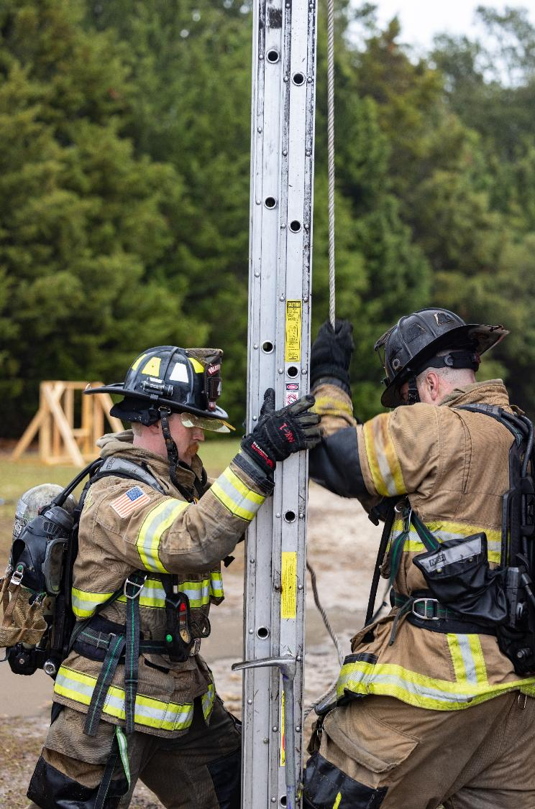
Prioritize Your Own Health
Exercise regularly to relieve tension
Get enough sleep to stay energized and emotionally balanced
Be mindful of your own emotions and stress levels
Practice emotional regulation
Seek therapy from trained professionals
Self-Care Strategies
Notes:
KEY POINTS:
Supporting a first responder comes with unique emotional challenges—long hours, unpredictability, and the emotional weight of their work.
While you’re focused on caring for your partner, it’s just as important to care for your own mental and emotional well-being.
Exercise – Move Your Body to Release Tension
Exercise doesn’t have to mean an hour at the gym.
It can be simple and doable:
Stretch while watching TV.
Walk up and down the stairs during commercial breaks.
Do push-ups at the kitchen counter.
The goal is to move your body and release built-up tension in small, consistent ways.
Sleep – Recharge Your Mind and Body
Lack of sleep makes everything harder—emotionally and physically.
Aim for 7–9 hours of quality sleep and try to keep a consistent routine.
If your partner works night shifts, create your own sleep environment:
Use blackout curtains, white noise machines, or eye masks.
Rest is essential for emotional regulation and daily resilience.
Be mindful of your own emotions and stress levels
Start by checking in with yourself regularly: “How am I really doing today?”
If you’re feeling overwhelmed, anxious, or emotionally drained, that’s a sign to pause and take care of you.
Your emotions are signals—often pointing to unmet needs. Don’t ignore them.
Mindfulness and meditation are powerful tools to manage stress and stay grounded.
Even just a few minutes of deep breathing or a guided meditation can help you reset.
Emotional Regulation – Reset When You Feel Flooded
When emotions feel overwhelming, pause and reset:
Take a walk, stretch, or breathe deeply.
Try grounding techniques like the 5 senses method (name something you can see, hear, touch, smell, and taste).
Use the 5-second rule—count backwards from 5 to calm your nervous system before reacting.
Apps like Headspace or Calm are great for people with busy schedules.
Seek Therapy or Support
Therapy isn’t just for when things fall apart—it can help you build resilience, set boundaries, and feel more in control.
UCF RESTORES offers resources tailored to first responder families.
Support groups can also be a powerful way to connect with others who truly understand your experience.
Taking care of your mental health helps you show up as your best self—for your partner, your family, and yourself.
Do what works for you. Self-care should feel restorative and will be unique to your needs.
BEST PRATICES:
Discussion question: what does self-care look for you?

Slide 50
Stay Connected
Self-Care Strategies
Spend time with people who uplift you by leaning on close friends, family, or faith-based communities
Engage in hobbies or activities with others that bring you joy
Join support groups for families of first responders to share experiences and utilize resources and guidance
Don’t hesitate to ask for help when overwhelmed
Notes:
KEY POINTS:
Being the partner of a first responder can sometimes feel isolating.
Long shifts, unpredictable schedules, and the emotional toll of the job can make it hard to stay connected—not just to your partner, but to others in your life.
That’s why building and maintaining a strong support system is essential for your well-being.
Spend Time with People Who Uplift You
Surround yourself with people who bring you joy and help you feel seen—friends, family, parenting groups, or faith communities.
Even small moments of connection—a coffee date, a phone call, a walk—can help relieve stress and remind you that you’re not alone.
Don’t hesitate to reach out. A simple conversation can make a big difference.
Engage in Hobbies or Activities That Bring You Joy
Having interests outside of your partner’s career helps you maintain your own identity.
Whether it’s gardening, painting, reading, or walking—do something that’s just for you.
These activities help you recharge and give you something to look forward to.
Prioritizing your happiness is not selfish—it’s self-care.
Join Support Groups for First Responder Families
Connecting with others who truly understand your experience can be incredibly validating.
Support groups—online or in person—offer a space to share, learn, and feel understood.
Consider looking into local or national organizations that offer resources and community for first responder families.
Don’t Hesitate to Ask for Help
It’s okay to admit when you’re struggling.
Reaching out to a friend, therapist, or peer support group is a sign of strength—not weakness.
You don’t have to carry everything on your own.
Staying connected is a vital part of self-care.
By nurturing relationships, engaging in meaningful activities, and seeking support when needed, you build a strong foundation for emotional resilience.
Remember: you are not alone in this journey. Lean on your community and take care of yourself just as much as you care for your loved one.
BEST PRACTICES:
Share personal examples of how you stay connected to others and build community
Prompt participants to share what networks they are a part of.
Encourage participants to connect with the other partners in the workshop.

Slide 51
Share the Load
Self-Care Strategies
Household responsibilities
Communication & support
Work-life balance
Family & relationship tasks
Notes:
KEY POINTS:
Supporting a first responder can feel like a full-time job.
But here’s the truth: you don’t have to carry everything on your own.
Sharing responsibilities at home is one of the most practical and powerful ways to protect your own well-being and strengthen your relationship.
Household Responsibilities
Divide daily chores based on each person’s strengths or availability.
Maybe one of you handles bedtime while the other does dishes.
Alternate cooking nights or take full ownership of recurring tasks like grocery shopping or paying bills.
In first responder families, this won’t always be 50/50 every day
Some weeks, you may carry more of the load, and other weeks your partner can step in more.
The key is flexibility and teamwork.
Communication & Support
Schedule a monthly check-in to talk about what’s working and what’s not.
Discuss stress levels, routines, and any adjustments needed.
If your schedules don’t align, use tools like:
A whiteboard in a shared space
A shared digital calendar
Sticky notes or even quick “I love you” messages
And don’t underestimate the power of gratitude.
A simple “thank you” for folding laundry or handling bedtime can go a long way.
Self-Care & Work-Life Balance
Set boundaries around work, when possible, like a cut-off time for work-related calls or texts.
Schedule personal time weekly, even if it’s just an hour to decompress.
Offer your partner time to unwind too, take the kids out, handle dinner, or give them space to enjoy a hobby.
Family & Relationship Time
Put a weekly family or date night on the calendar, something consistent and enjoyable.
Block out 30–60 minutes each week for uninterrupted time together, no phones, no distractions.
When you’re home, be present. Silence notifications and give your full attention to your loved ones.
Sharing the load isn’t just about getting things done, it’s about building a stronger, more balanced partnership.
When you work together, communicate openly, and support each other’s needs, you create a home that feels safe, connected, and sustainable for both of you.
BEST PRACTICES:
Ask the participants:
“What are some of your favorite forms of self-care?”
“How do you are your partner deal with division of labor in the home?”
“What are some ways that work for you and your partner/family to spend quality time together?”

Slide 52
Main Take Aways
First responders face unique stressors that need thoughtful support
Recognizing signs of stress helps prevent burnout and builds trust
Empathy and open communication strengthen your relationship
Trauma can affect both you and your partner
Prioritize your self-care—it's essential for a resilient family
Notes:
KEY POINTS:
Let’s wrap up with a few key takeaways.
First responders live in a fast-paced, high-stress world—and their partners carry a unique emotional load because of it.
One of the most powerful things you can do is recognize signs of stress in your partner early. That awareness allows you to offer support and help prevent burnout.
Empathy and communication are essential. Tools like reflective listening, “I” statements, and Level 10 Day Plans can strengthen your connection.
And remember—trauma can affect you, too. Your self-care isn’t optional; it’s essential.
Whether it’s therapy, rest, connection, or simply asking for help, taking care of yourself is one of the best ways to care for your family.
BEST PRACTICES:
Optional reflection questions:
“What is one thing you learned today?”
“How will you implement it in your own unique family?”

Slide 53
UCF RESTORES offers a single session consultation option to help first responders develop crucial tools and a personalized plan for managing stress in this time of heightened demand.
It is a 60-minute confidential one-on-one session with one of RESTORES’ first responder competent mental health clinicians, offered at no cost. Virtual appointments are available Monday through Friday, 9 a.m. to 5 p.m.
(407) 823-1657
Notes:
KEY POINTS:
No risk single session to help first responders develop tools and personalized plans for managing stress.
No cost
Completed in-person or via telehealth
First responder community aware licensed therapists
Does not touch insurance or employee assistance program (EAP)
BEST PRACTICES:
Emphasize partners can use this line if it is related to the stress of their first responders work or how it affects their family.

Slide 54
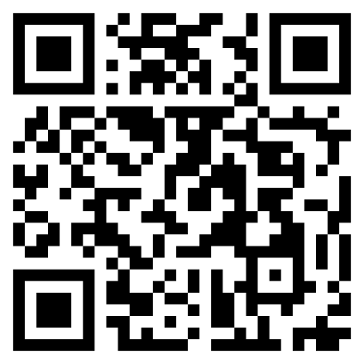
Trauma Management Therapy (TMT)
TMT Intensive Outpatient Program
Single Session Consultation Program
Virtual Reality Treatment
Scan to access the UCF RESTORES website for more information!
Notes:
KEY POINTS:
All programs at UCF RESTORES are at no cost & are confidential.
Briefly review treatments available
UCF RESTORES treat first responders and their families, active-duty military, and veterans completing trauma treatment

Slide 55
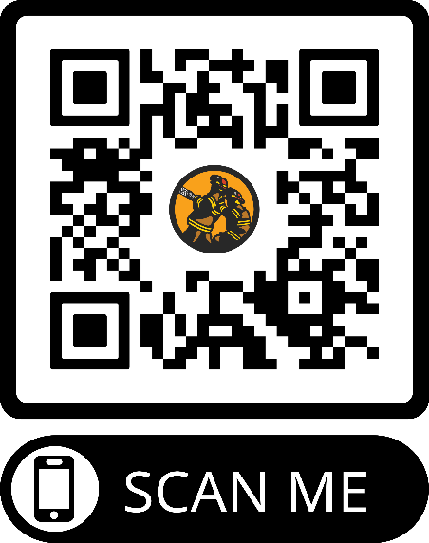
What 2nd Alarm Offers:
Peer Support Teams
K-9 Programs
Agency-wide Education and Awareness Initiatives
Outpatient Counseling Services
Inpatient/Residential Services
Resources for Retirees
Critical Incident Outreach
Resources for Leadership
Chaplaincy Programs
Resources for Clinicians
For Support Call: 850-480-9314
to download our app!
Notes:
The 2nd Alarm Project is a nonprofit organization that offers comprehensive, evidence-based resiliency programs and services to support the mental health of first responders.
Encourage group to download app
Easy access to services and resources.

Slide 56
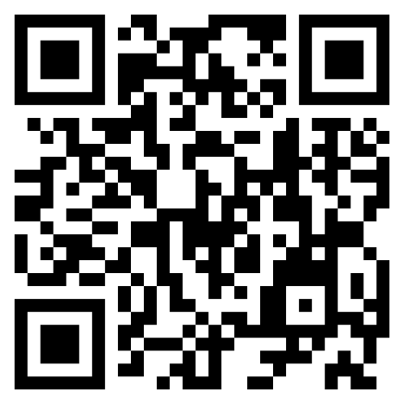
Goldline Rescue
Find a peer support provider, mental health clinician, or a chaplain who understands the first responder community
Blueline Rescue
Redline Rescue
Crisis & Suicide Hotline: 988
Notes:
KEY POINTS:
Redline/Blueline/Goldline Rescue are websites to find…
Certified peer supporters
Vetted first responder competent clinicians
Redline – FIRE
Blueline – LEO
Goldline – Dispatch
The crisis and suicide hotline are 988.
This line can be texted or called
Conversation is confidential
If needed, call 911
BEST PRACTICES:
Show Redline Rescue website and navigate through finding a clinician or peer support.
Share sometimes first responders want to speak to a firefighter peer support but to someone outside their department.
Due to smaller departments
To ensure rumors do not spread around their department

Slide 57
Questions?
Notes:
BEST PRACTICES:
Encourage other partners to answer questions or offer real-life examples of how their family has handled similar situations.
This not only builds community but also helps others feel seen, supported, and less alone in their experiences.

Slide 58
Thank you!
Call for support: 407-823-3910
Notes:
KEY POINTS:
Thank you for showing up—not just for your partner, but for yourself.
If you or your family needs support, please reach out to UCF RESTORES.

