Slide 1

Education
Course Chapters - Slides

Slide 2
1. Objectives and Awareness Level Training Overview
Education

Slide 3


Slide 4
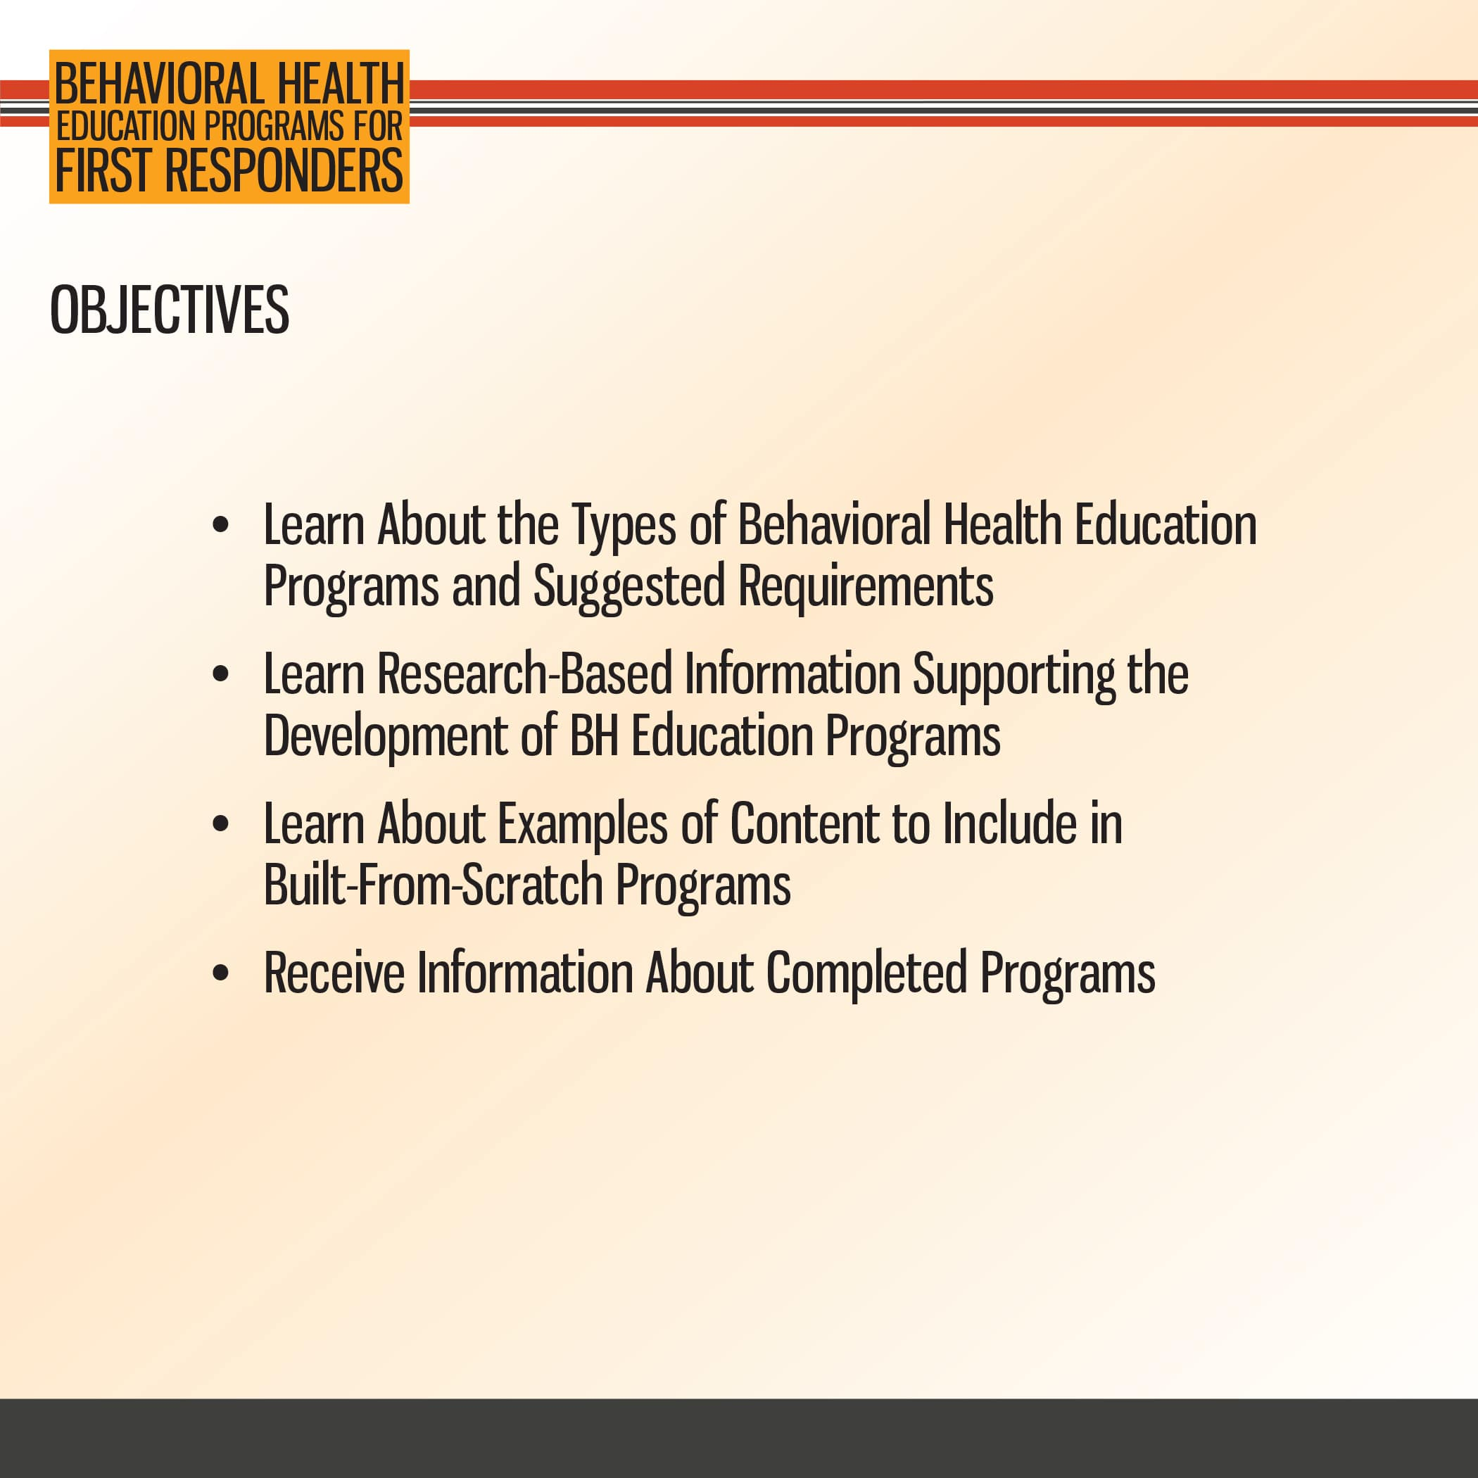

Slide 5
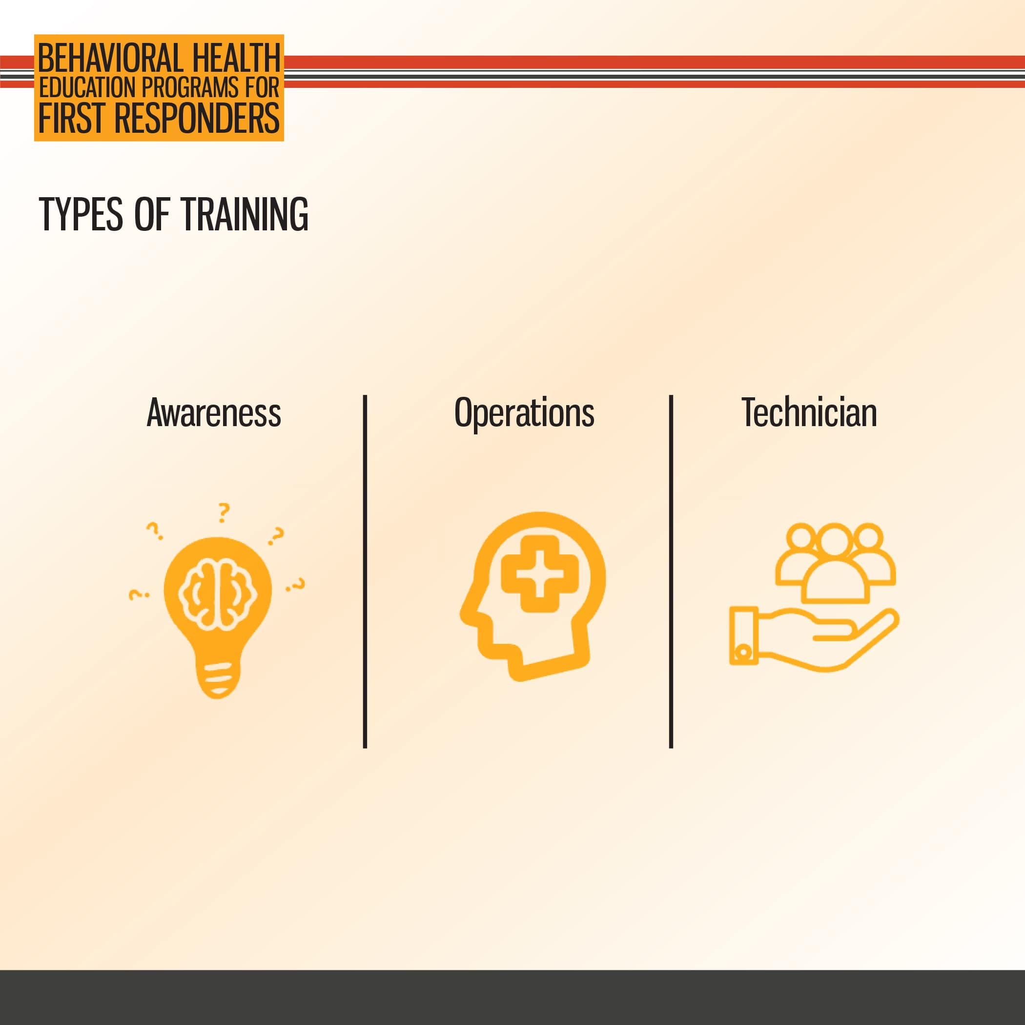

Slide 6
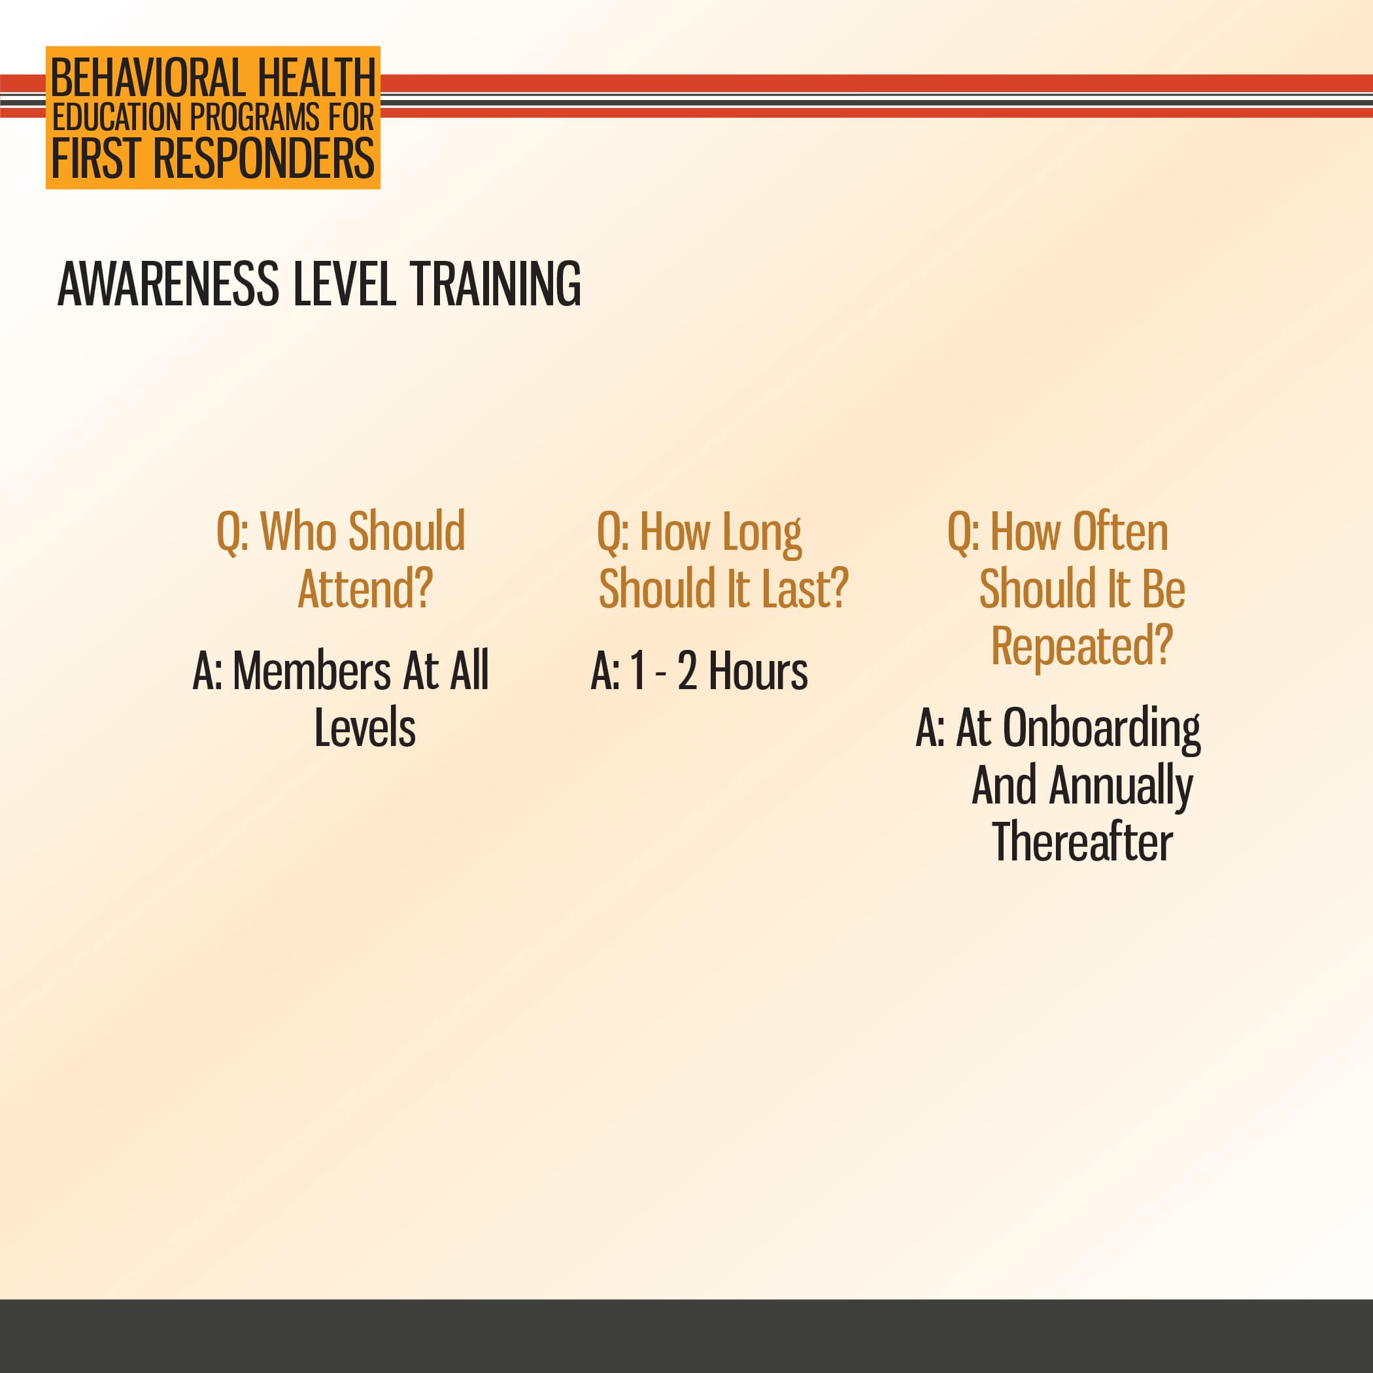

Slide 7


Slide 8


Slide 9
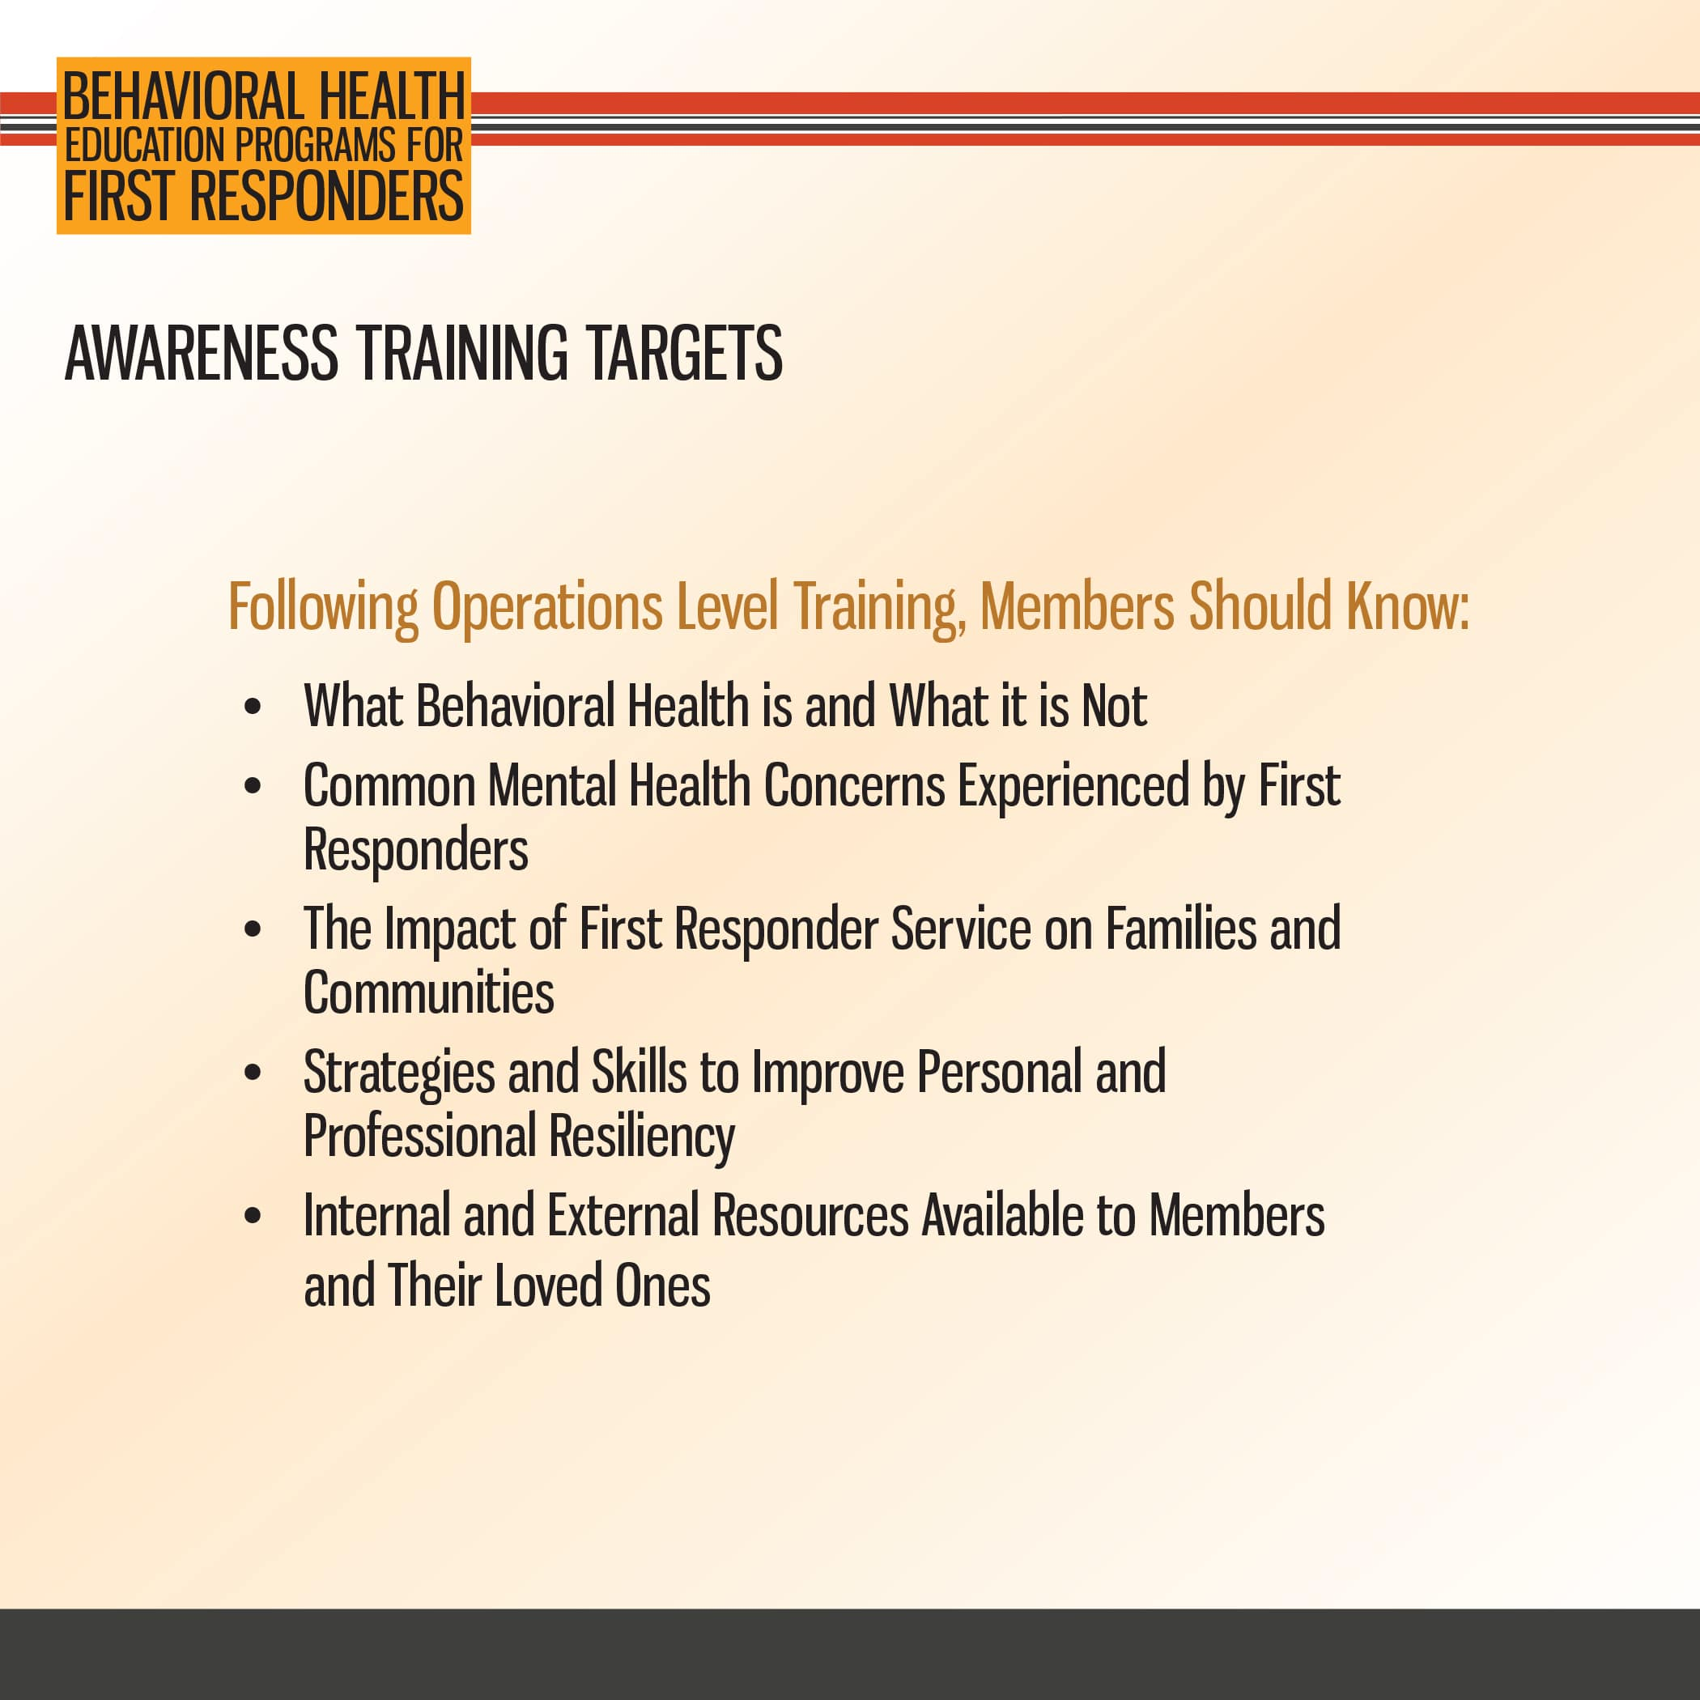

Slide 10
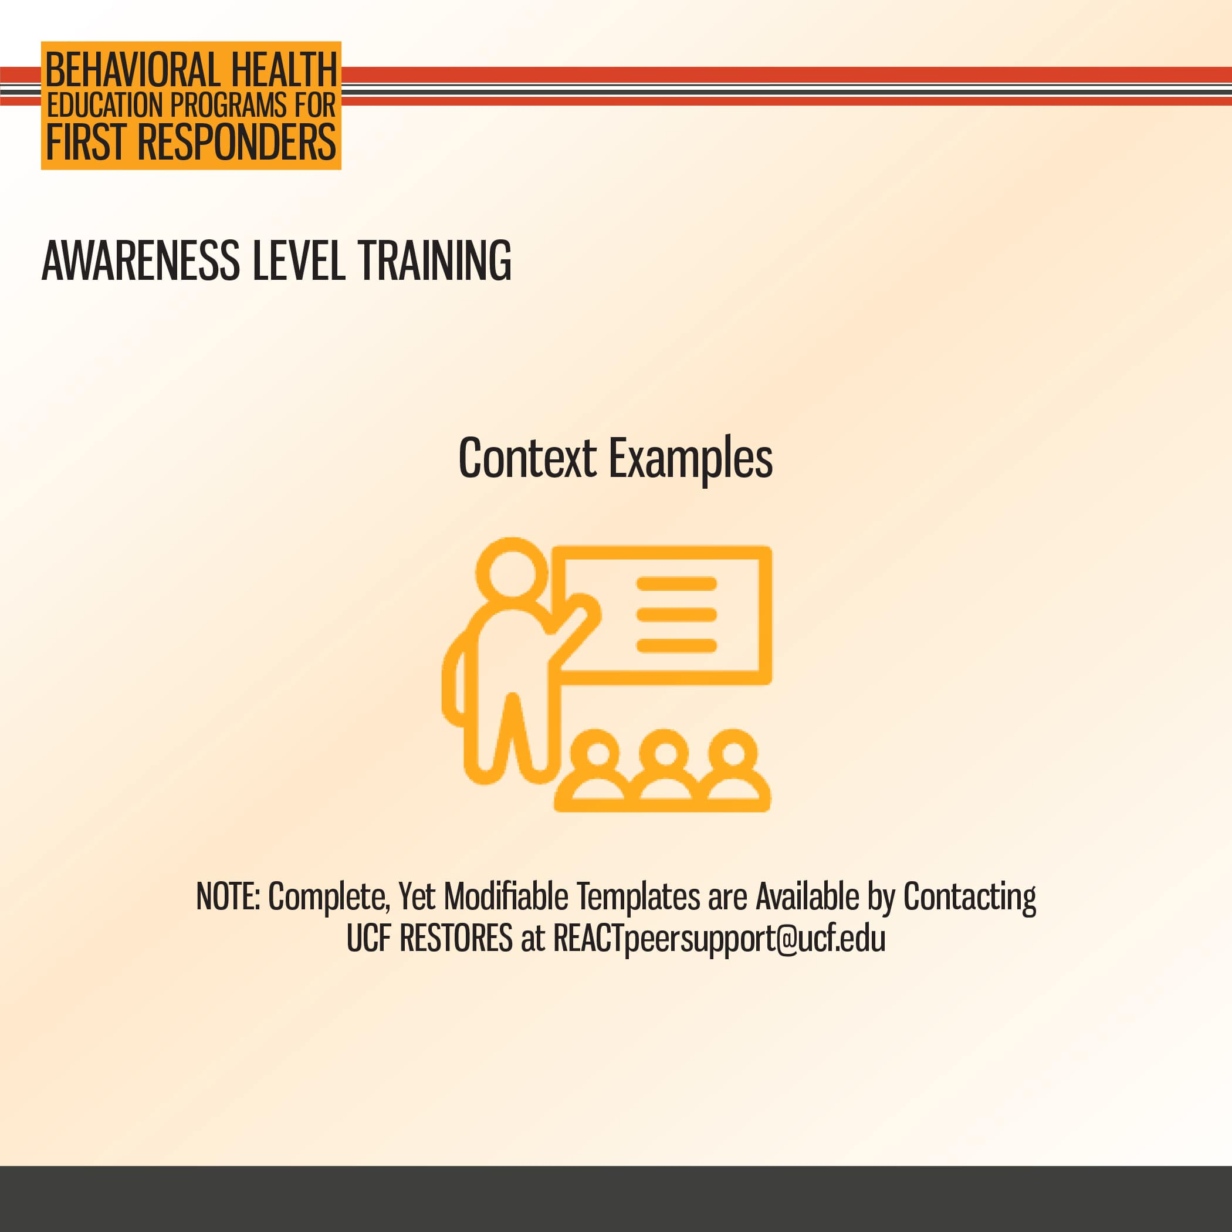

Slide 11
2. Operations Level Training Overview
Education

Slide 12
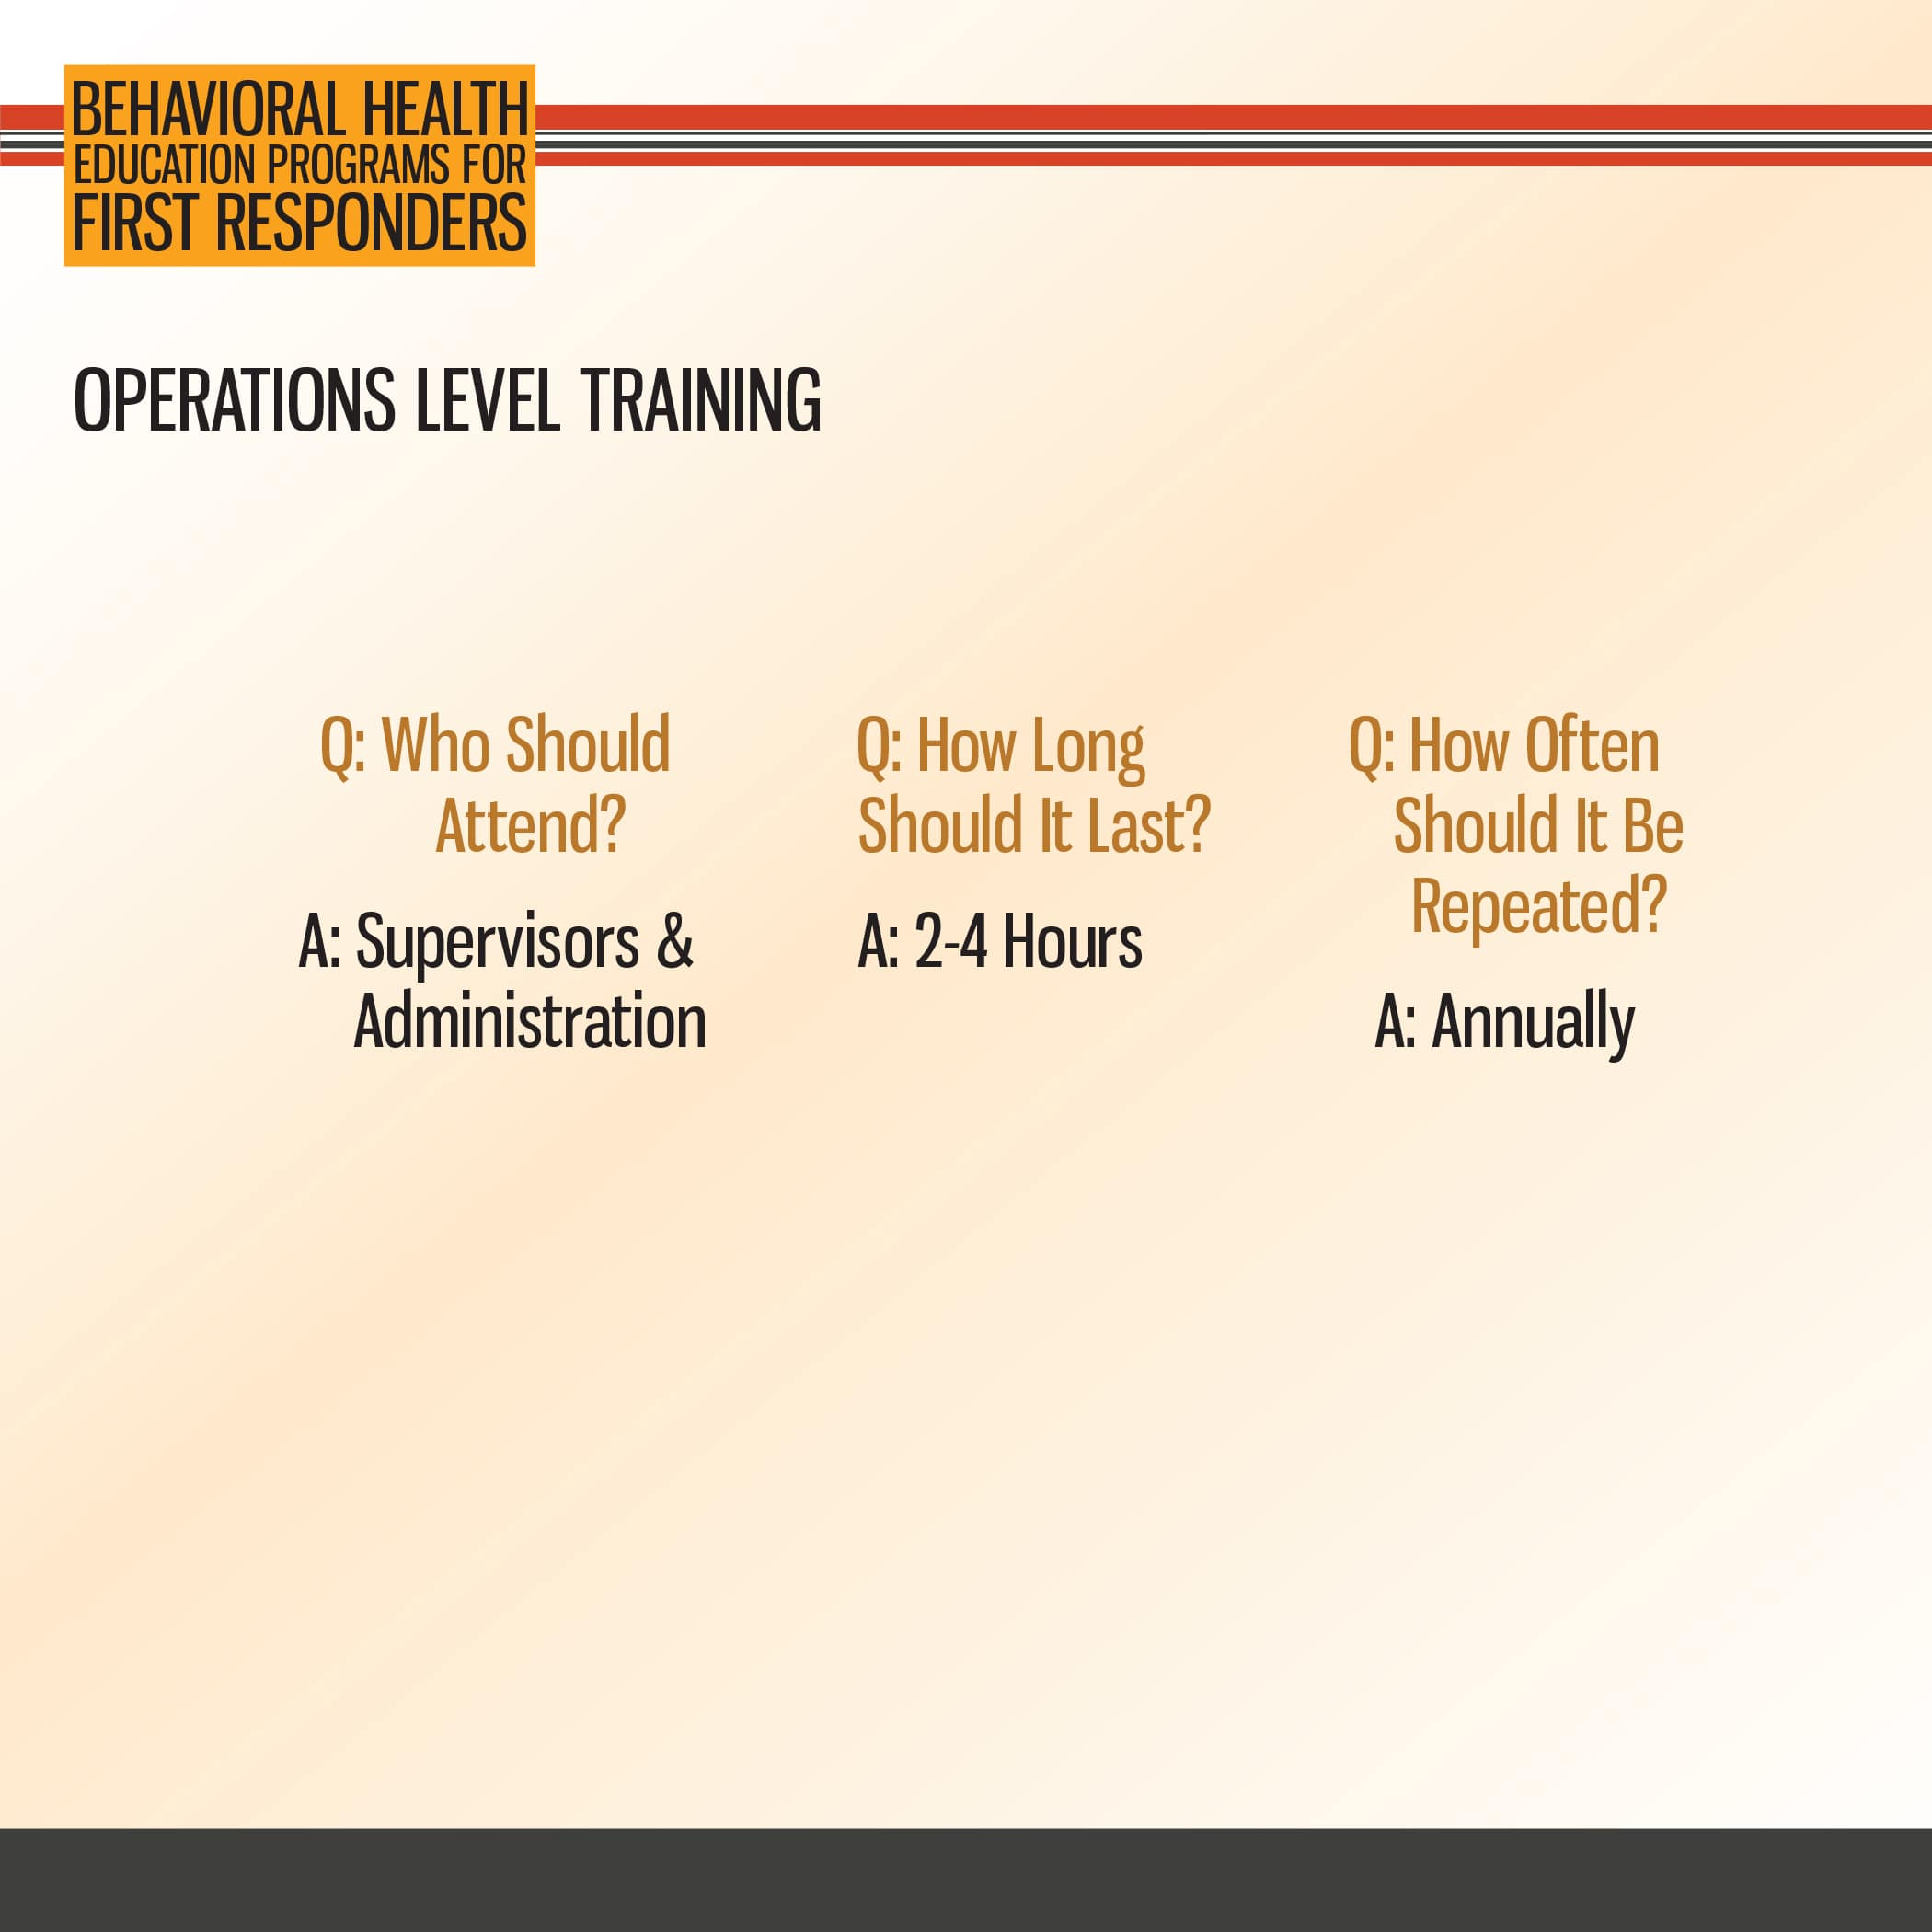

Slide 13


Slide 14


Slide 15
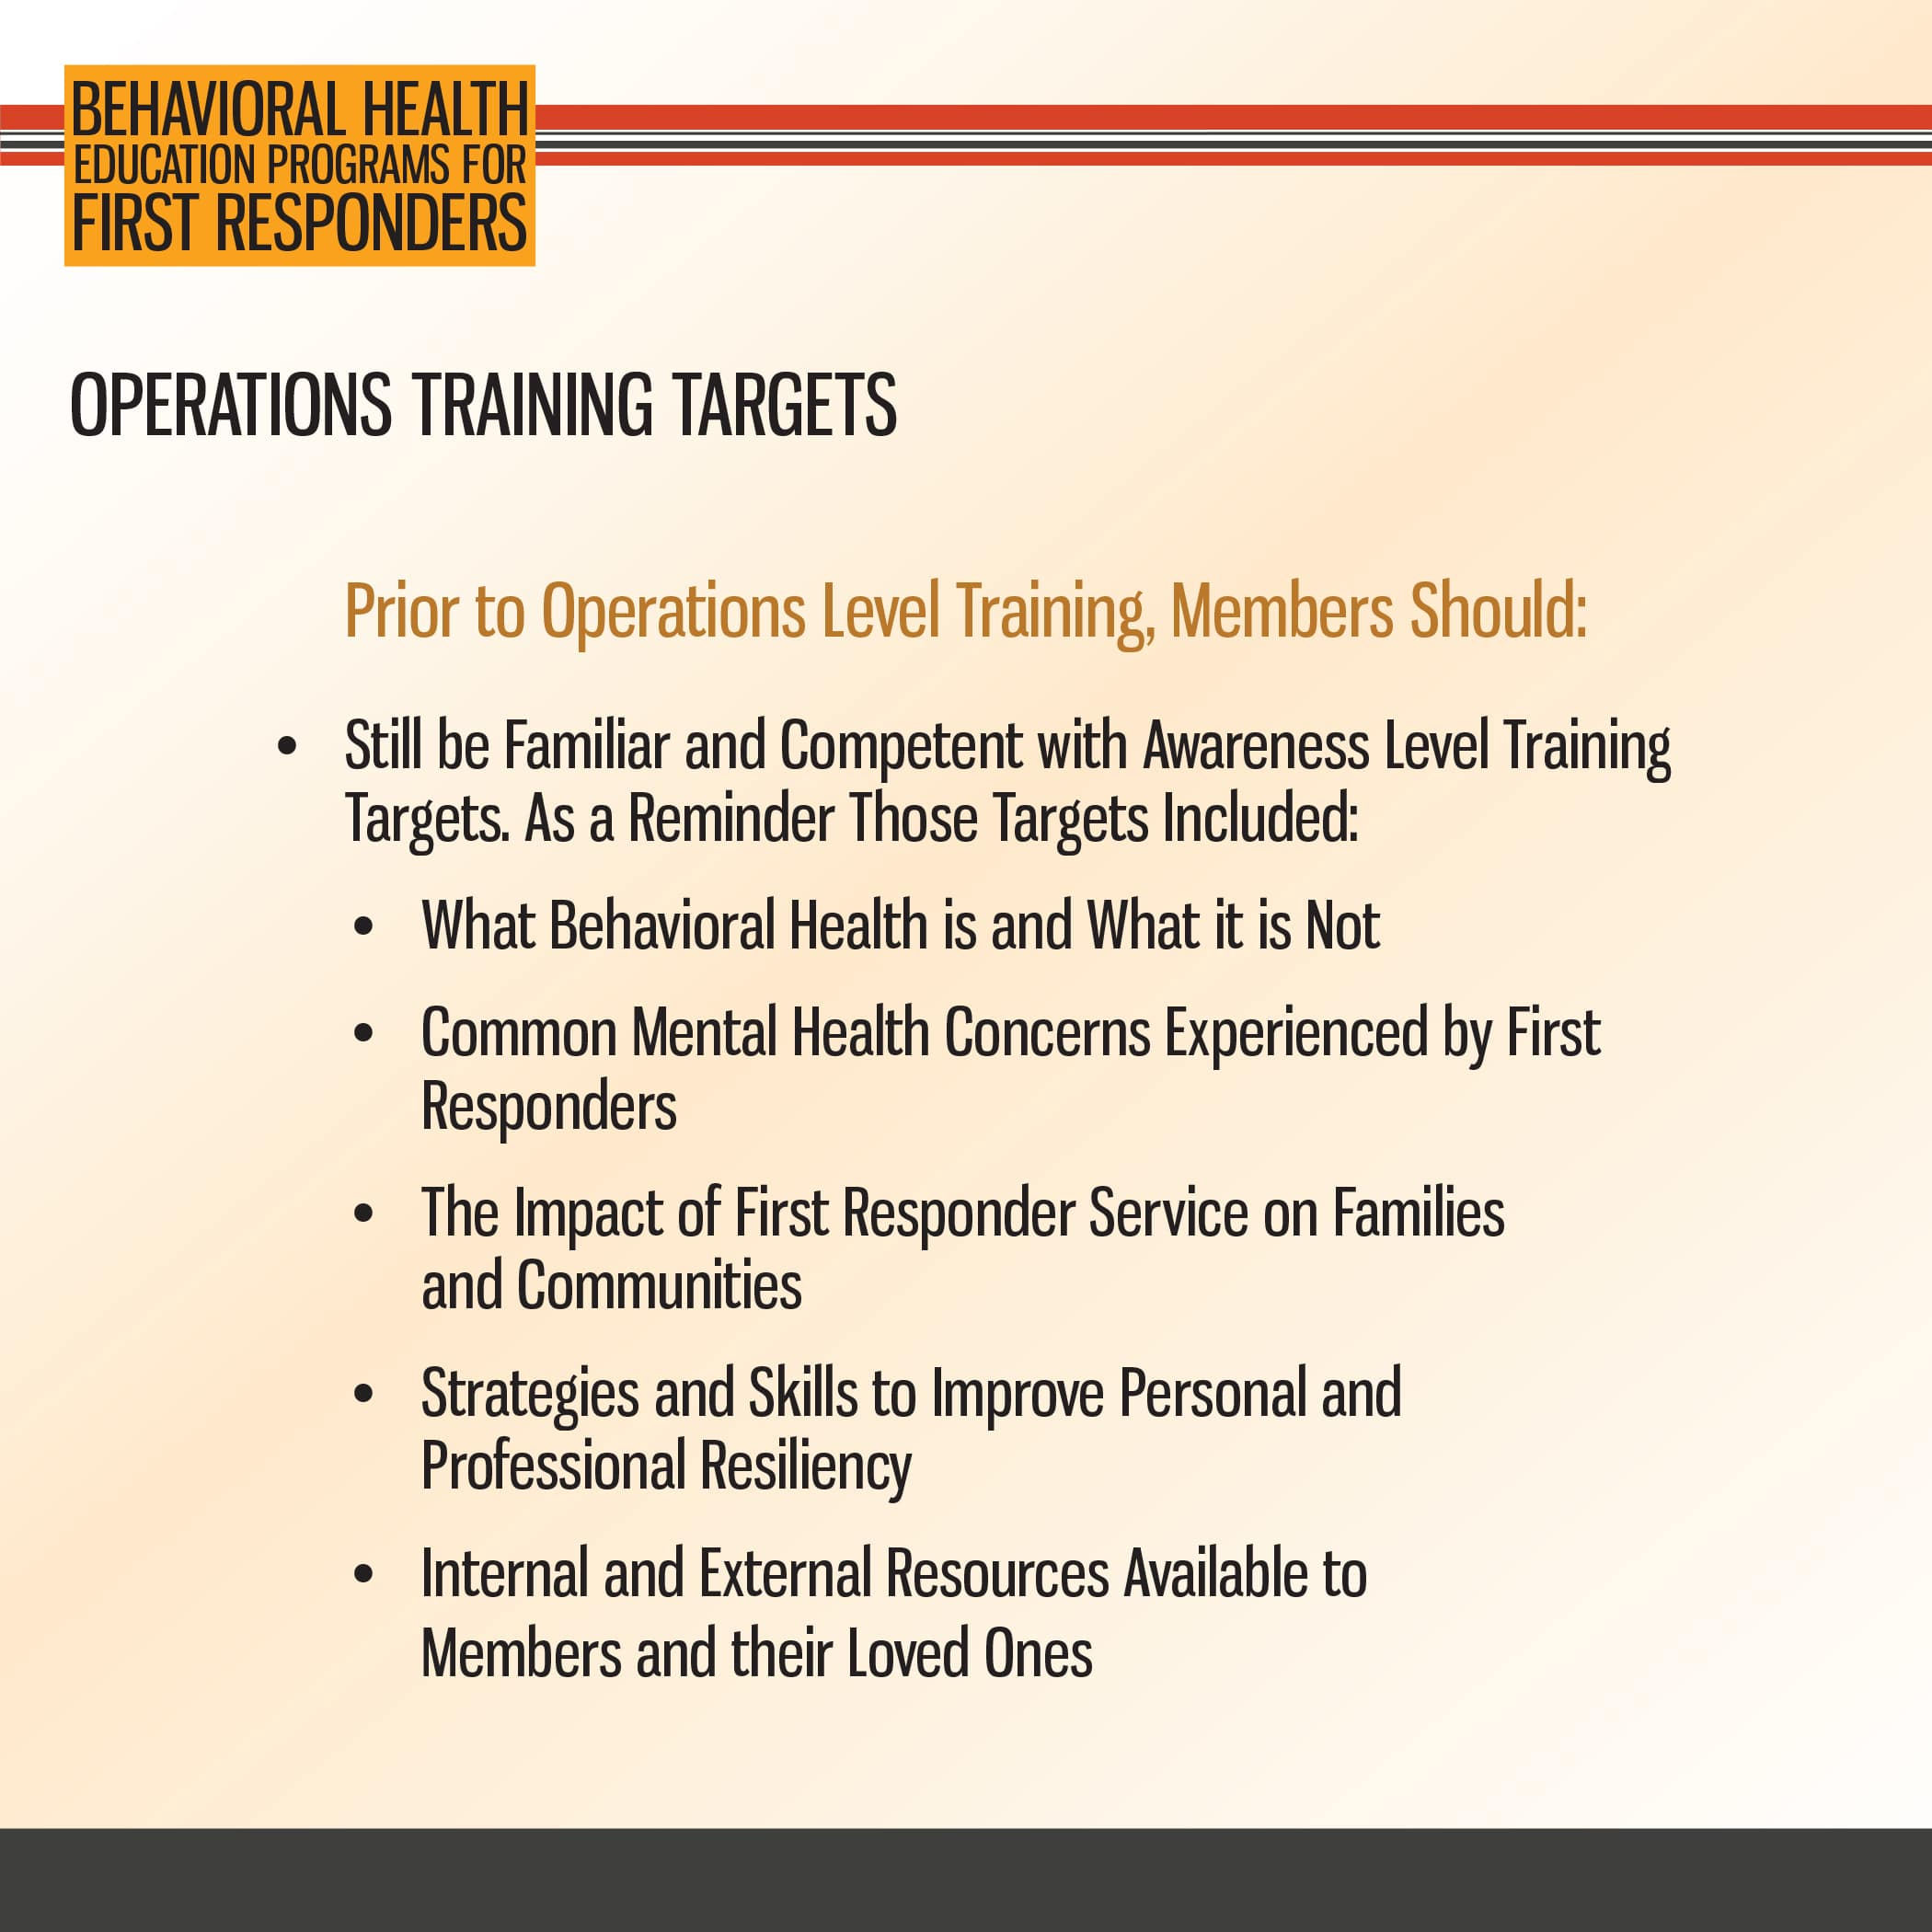

Slide 16


Slide 17
3. Technician Level Training Overview
Education

Slide 18
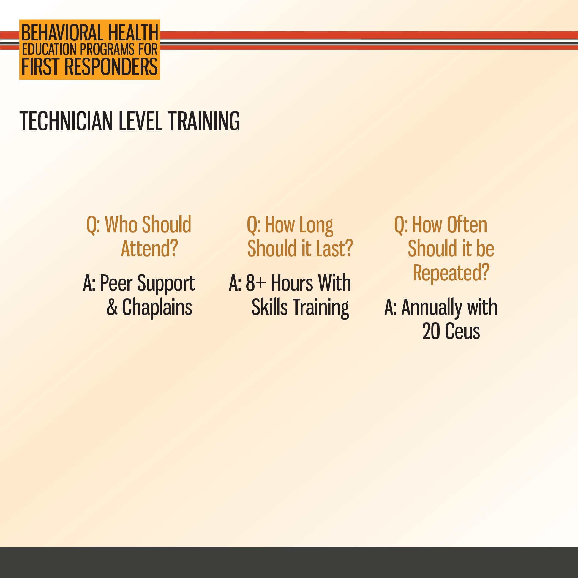

Slide 19
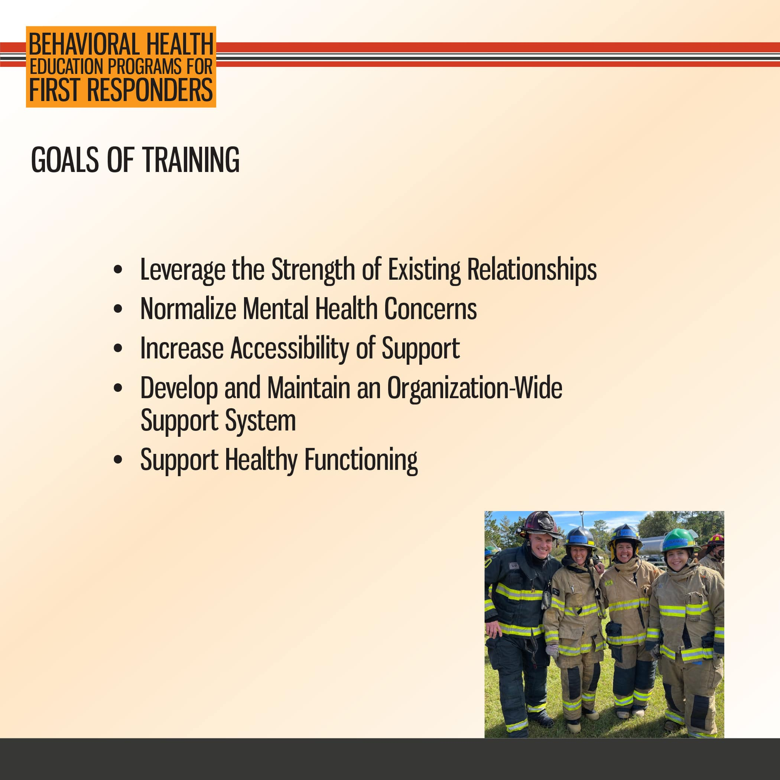

Slide 20


Slide 21
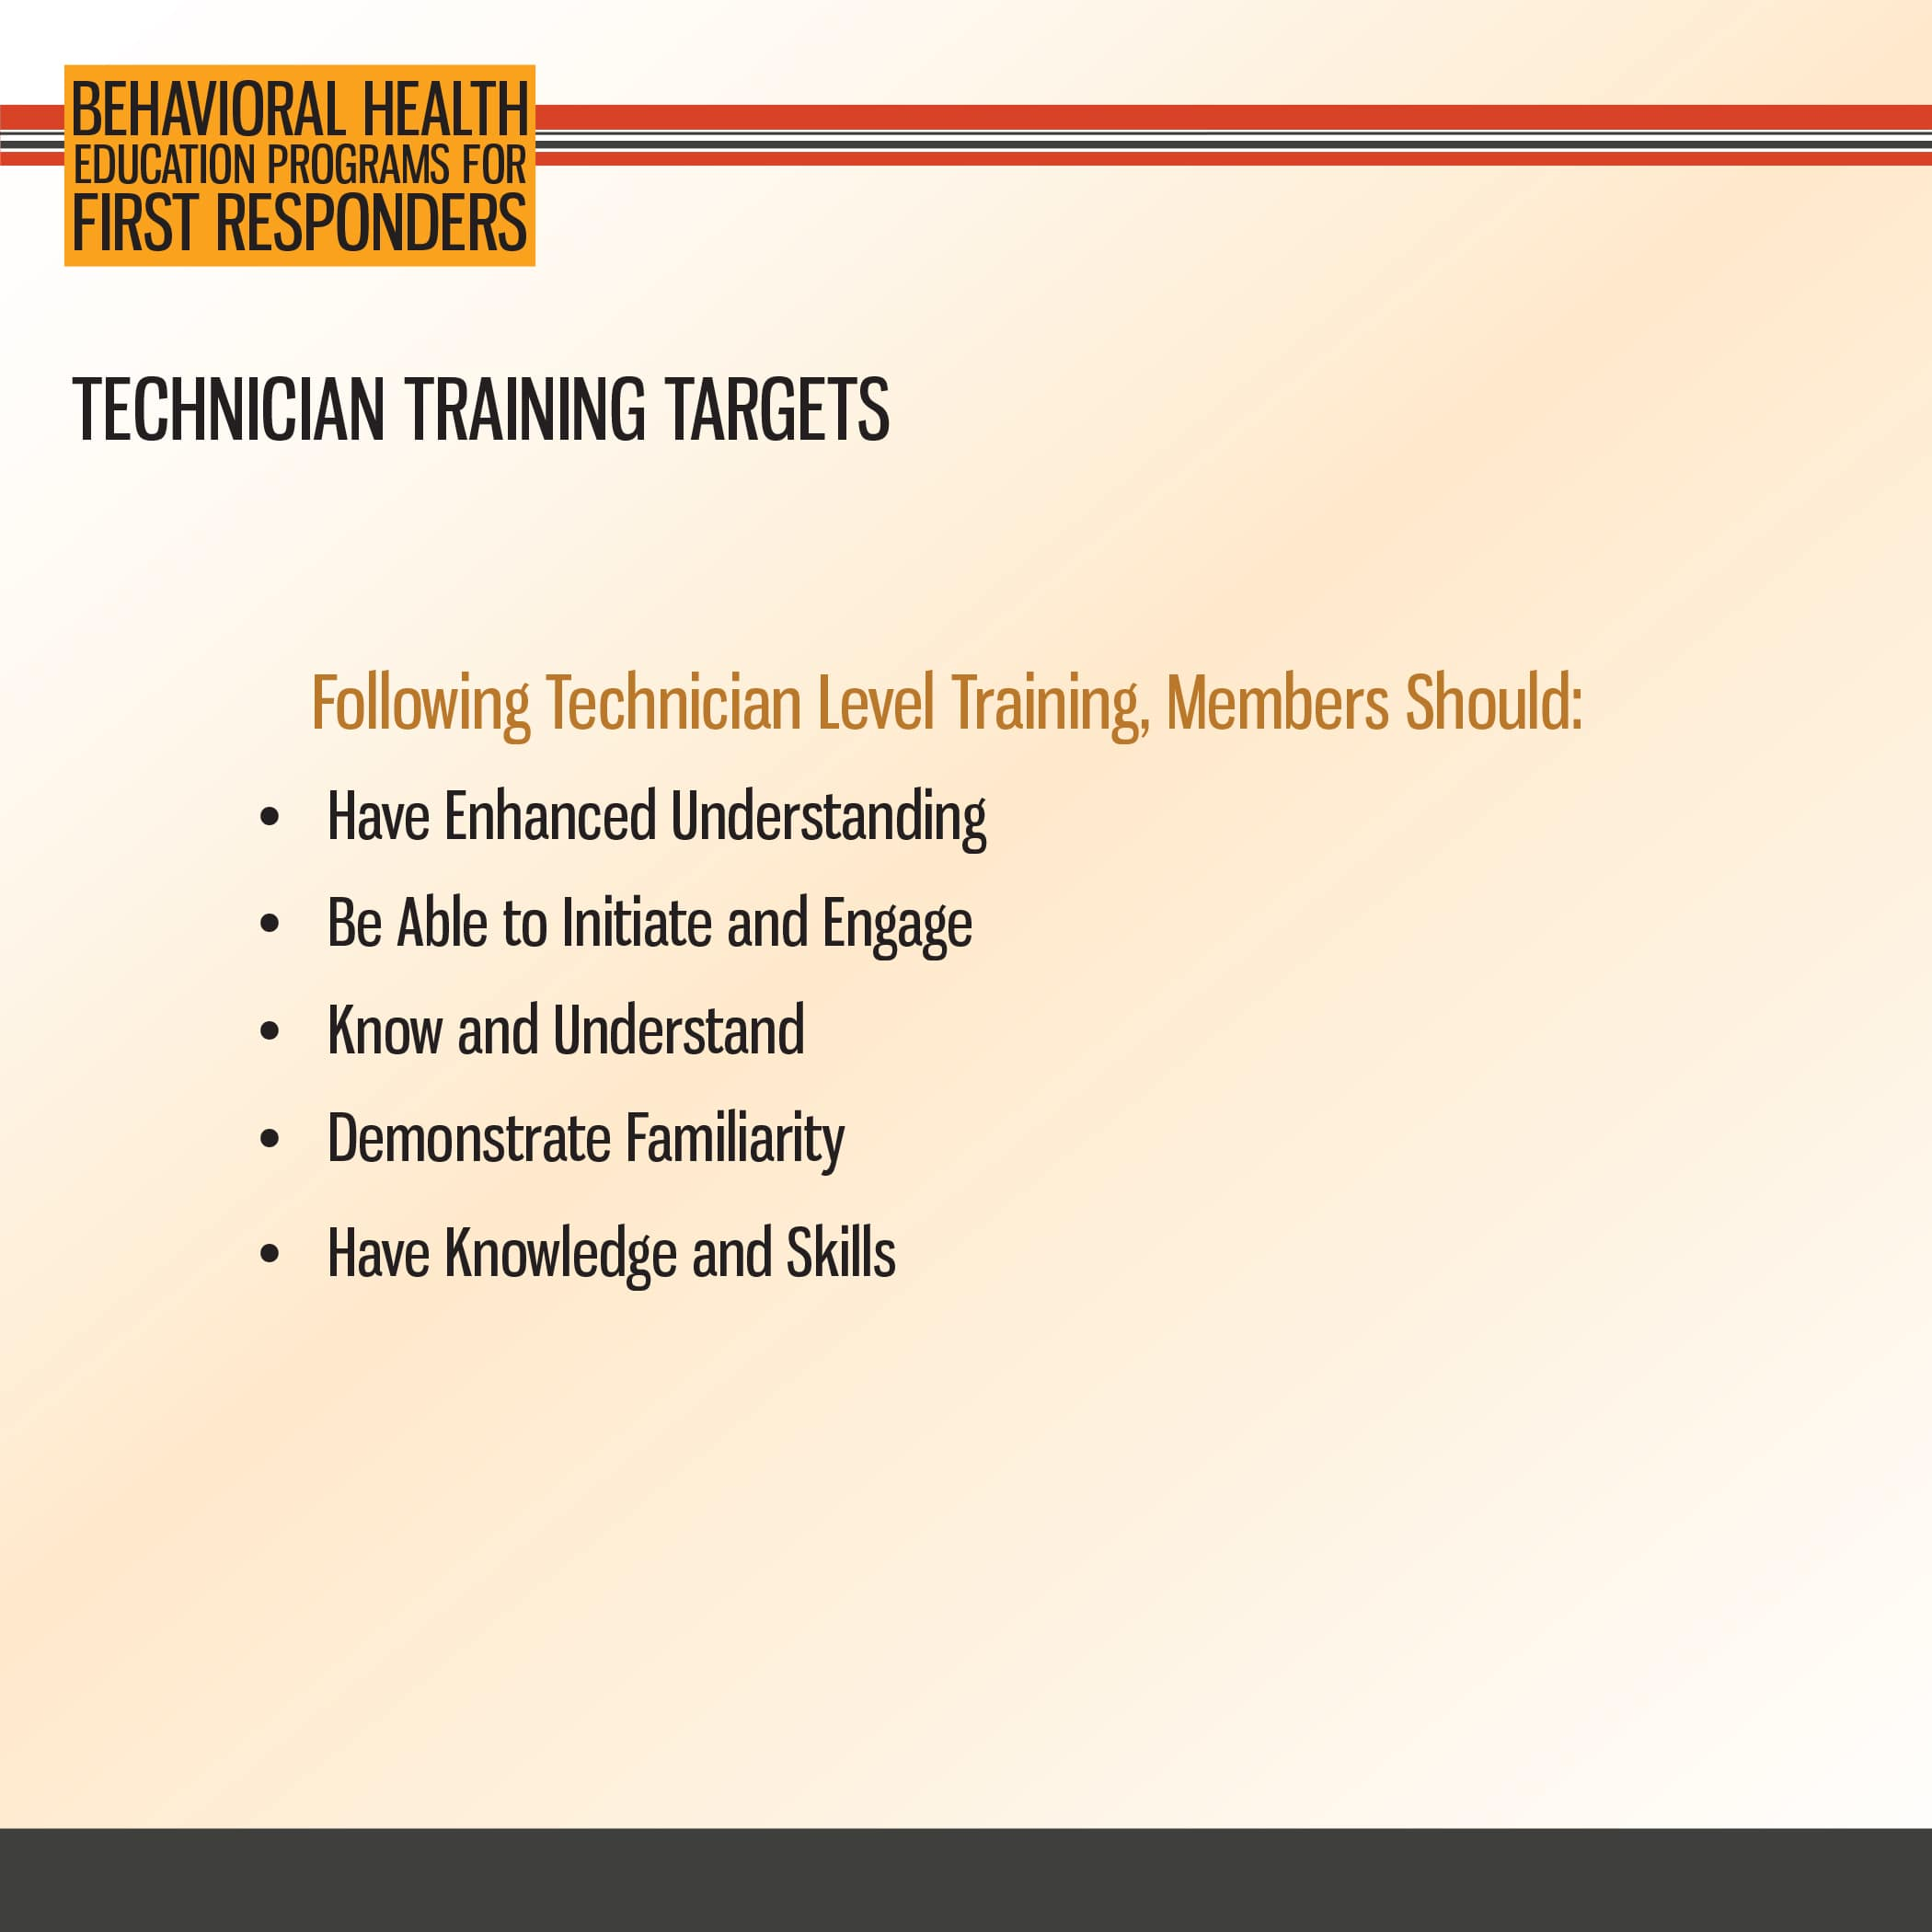

Slide 22
