Slide 1

Family Support
Course Chapters - Slides

Slide 2
1. Challenges And Best Practice
Family Support

Slide 3


Slide 4
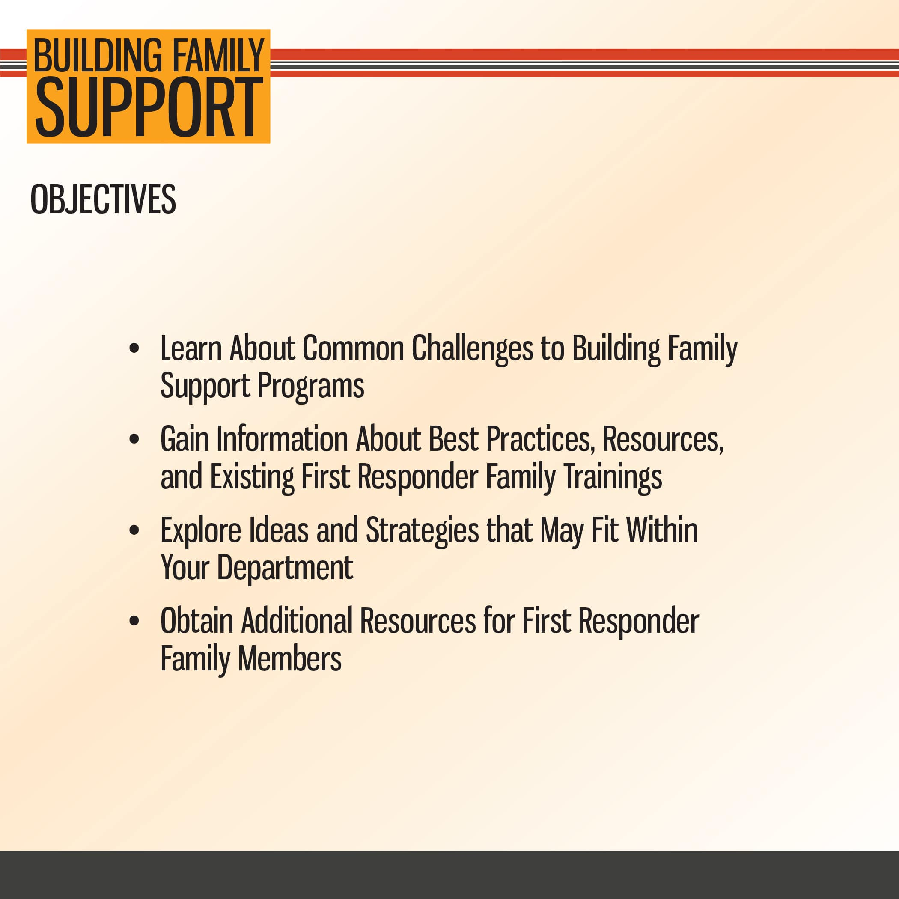

Slide 5
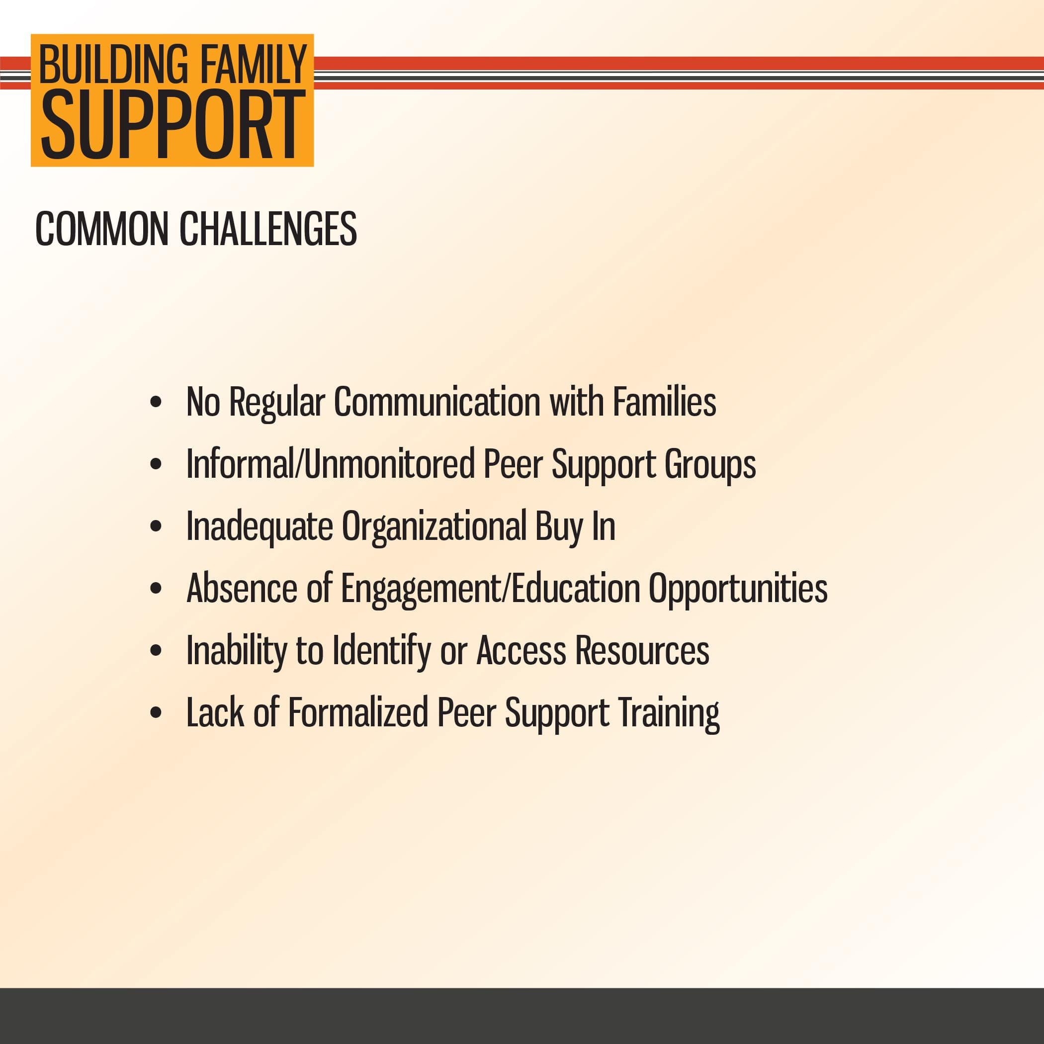

Slide 6
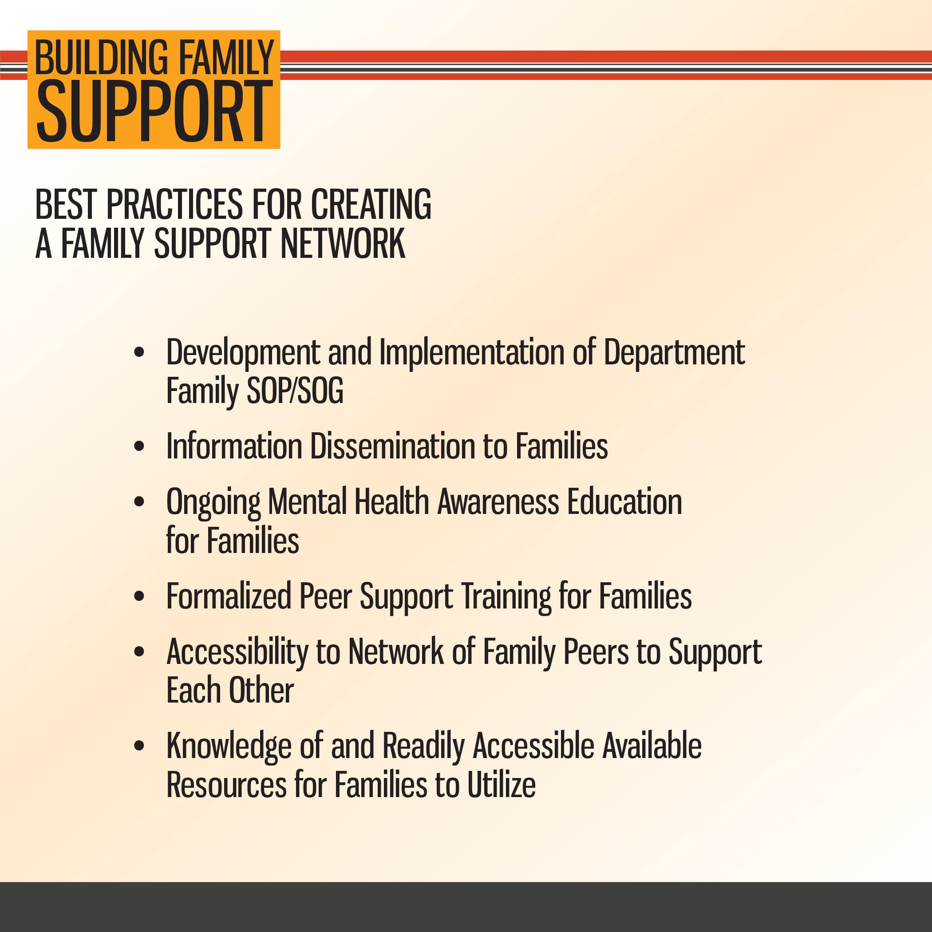

Slide 7
2. Policies And Training
Family Support

Slide 8
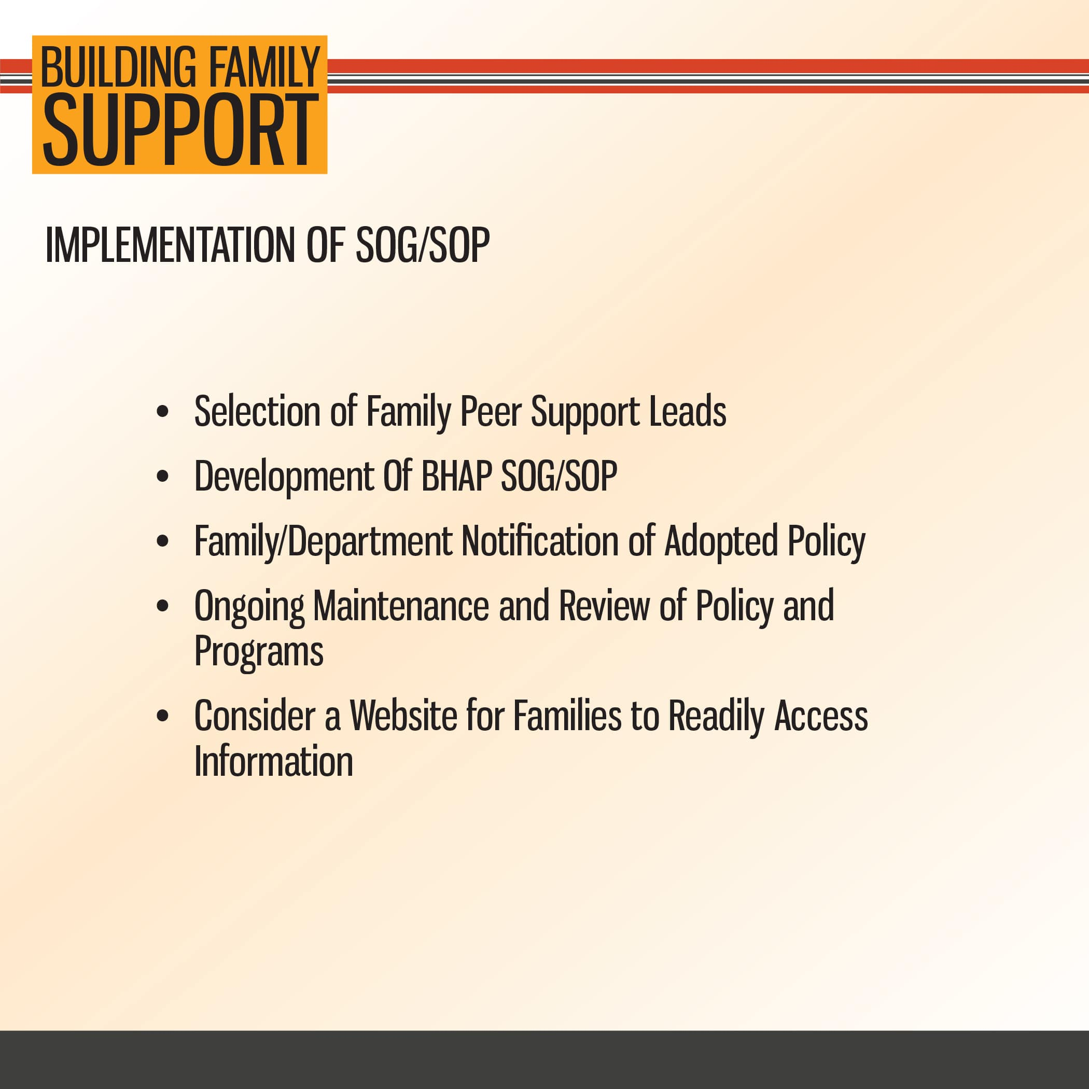

Slide 9
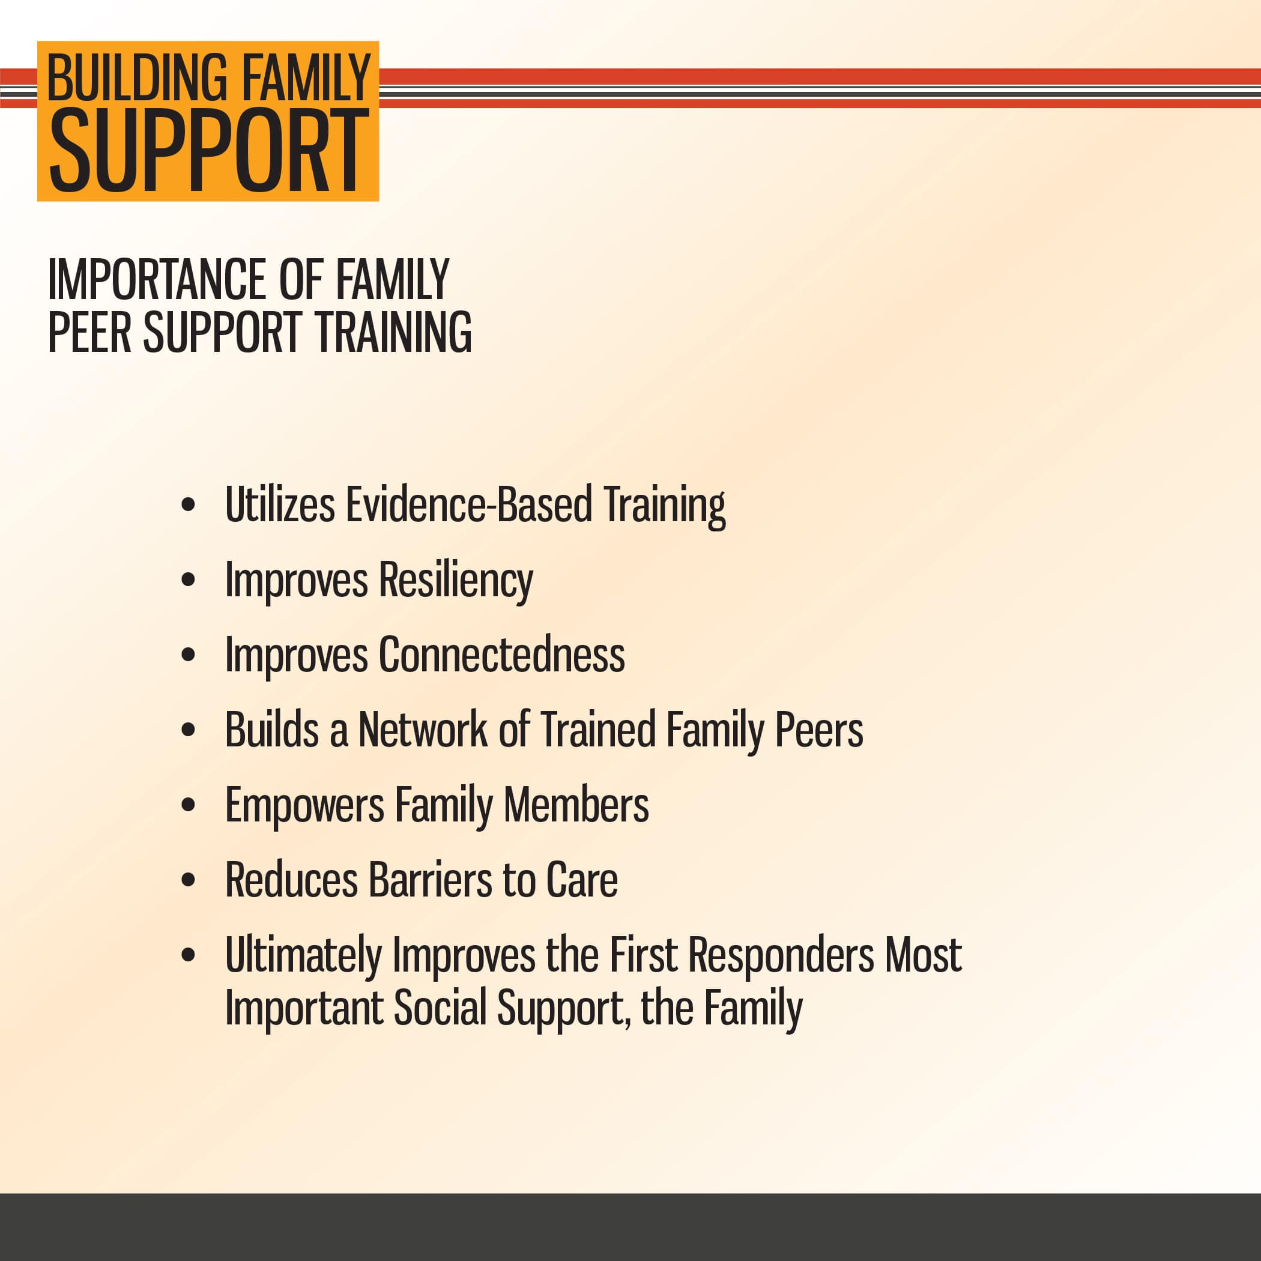

Slide 10
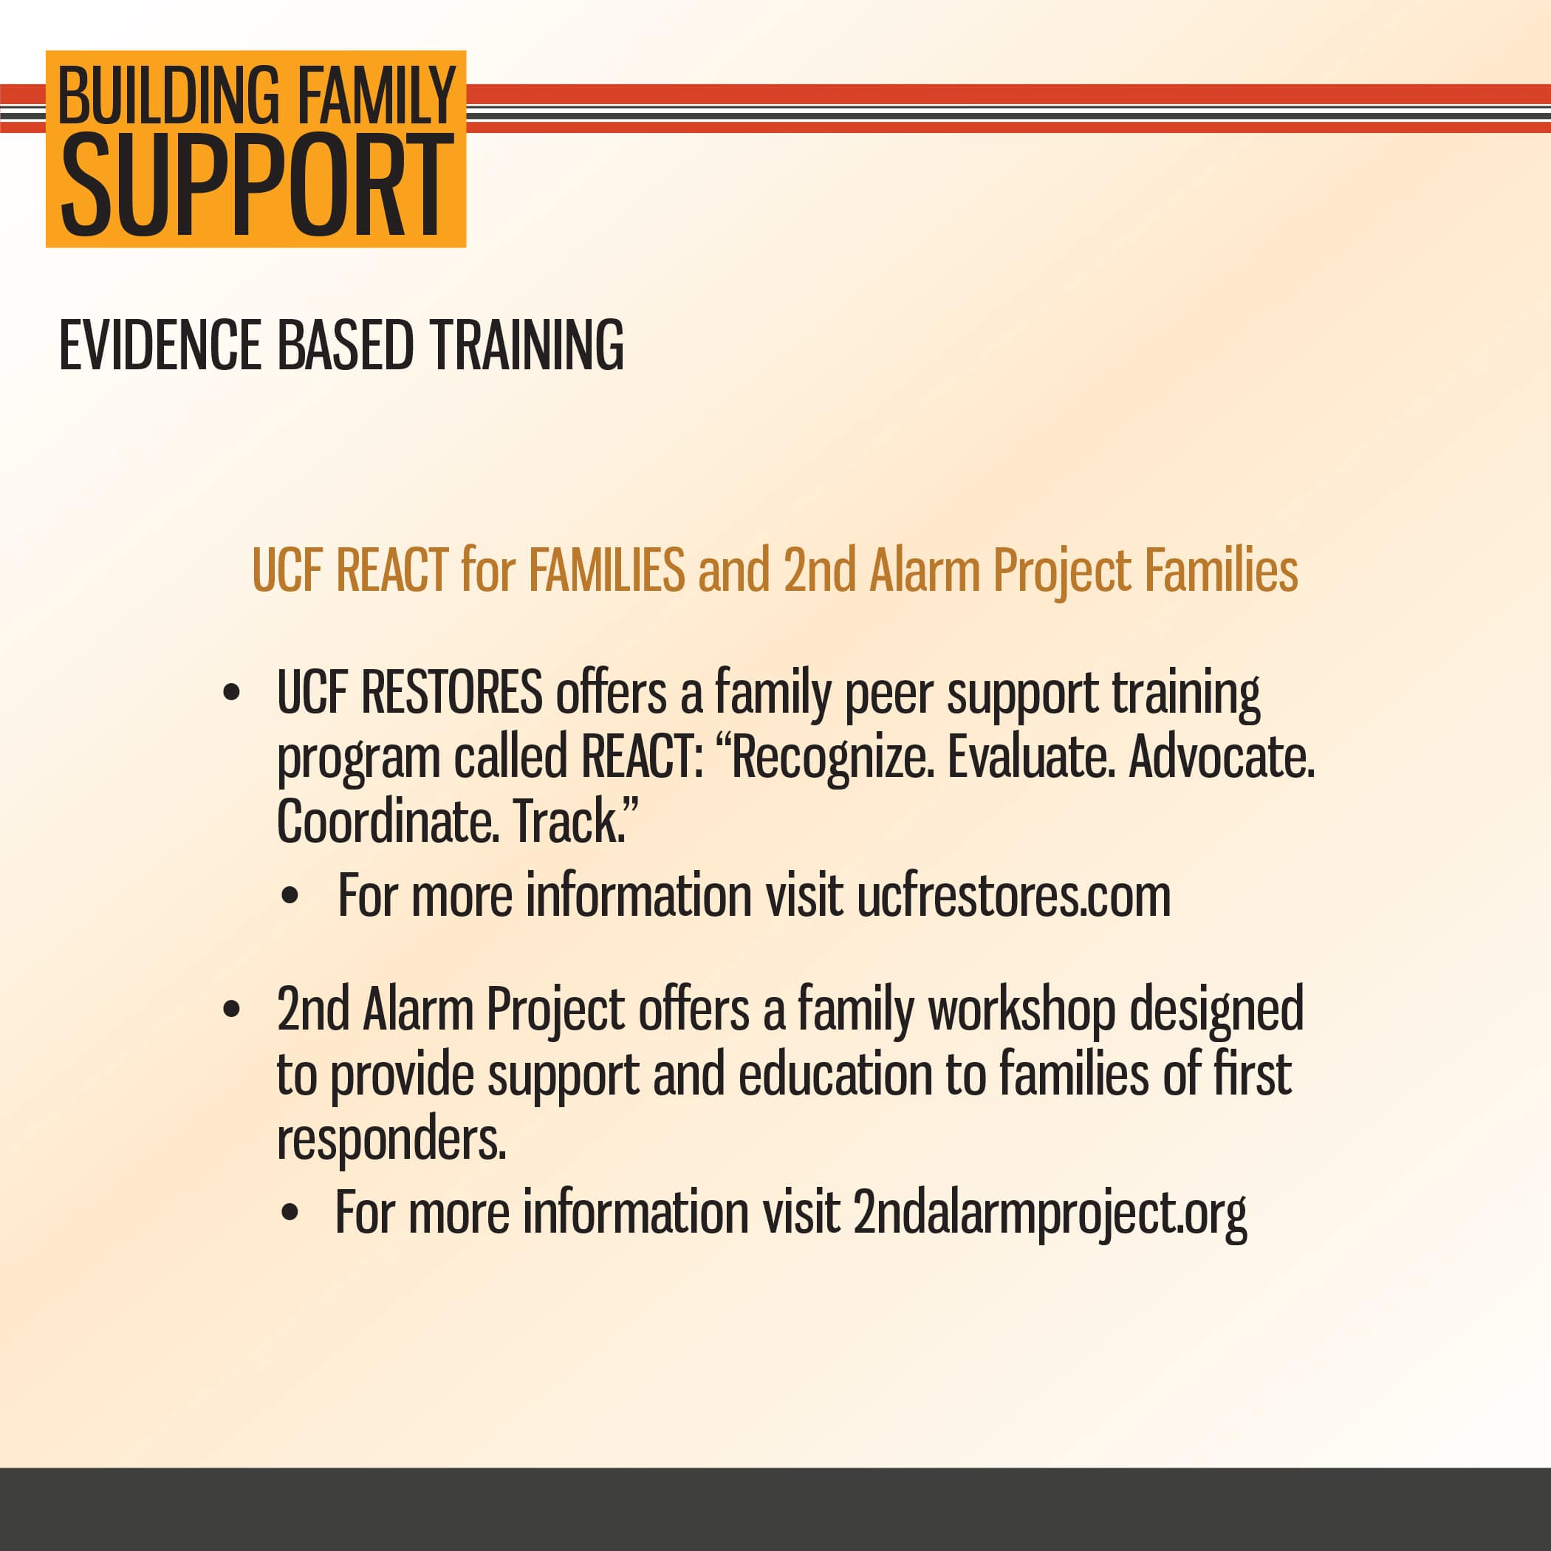

Slide 11
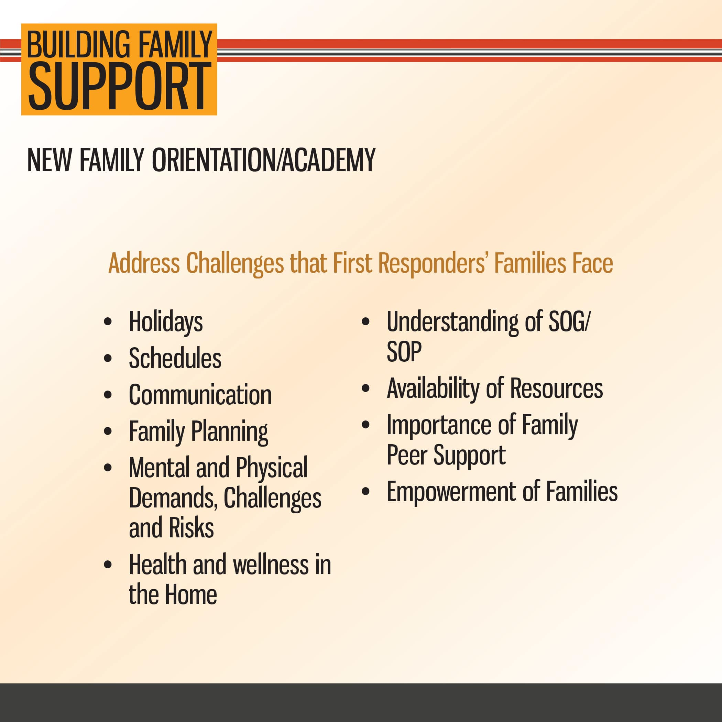

Slide 12
3. Additional Resources
Family Support

Slide 13
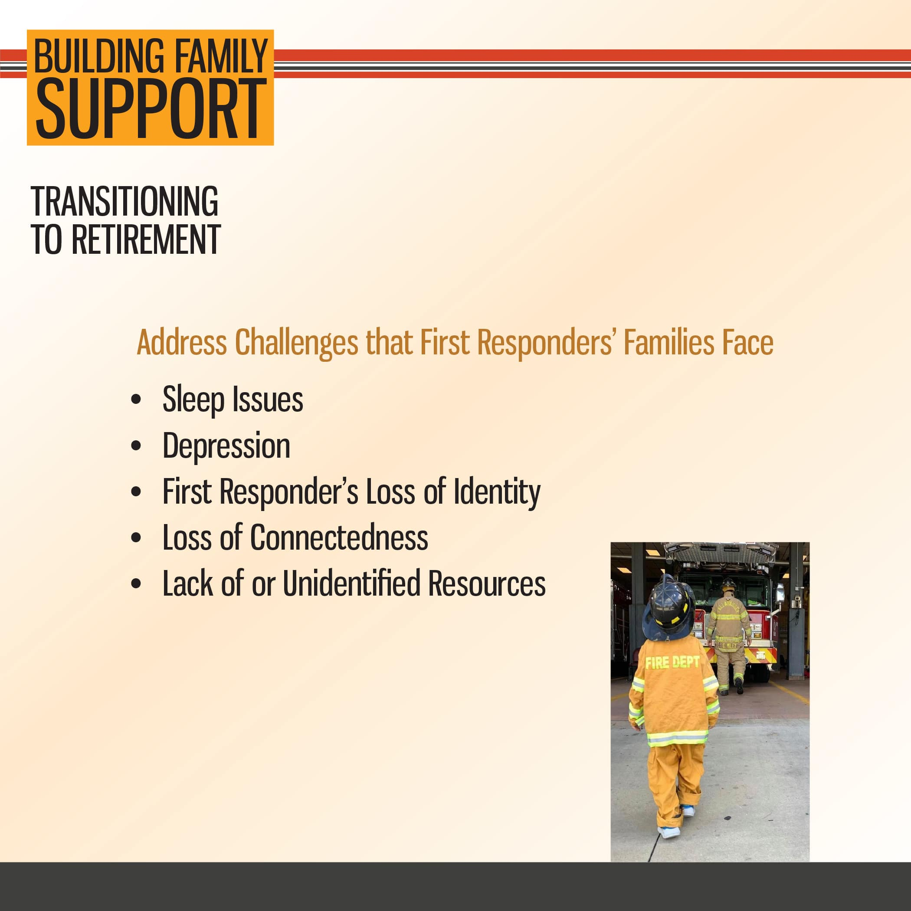

Slide 14
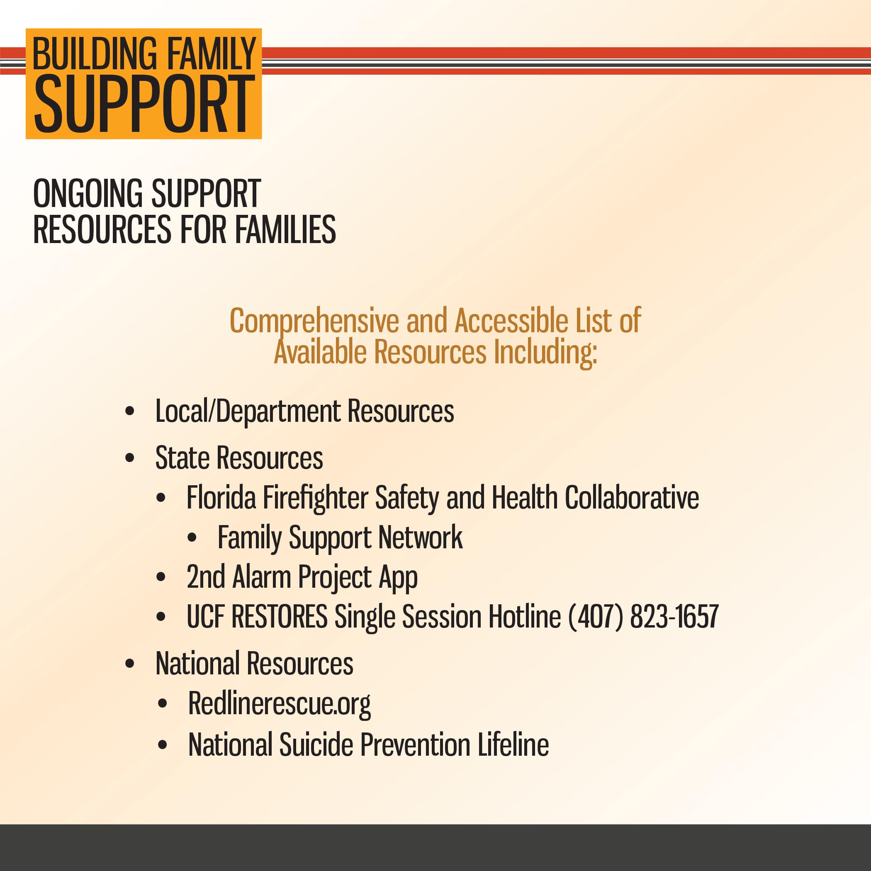

Slide 15
