Slide 1

Inpatient
Course Chapters - Slides

Slide 2
1. Behavioral Health Overview
Inpatient

Slide 3


Slide 4
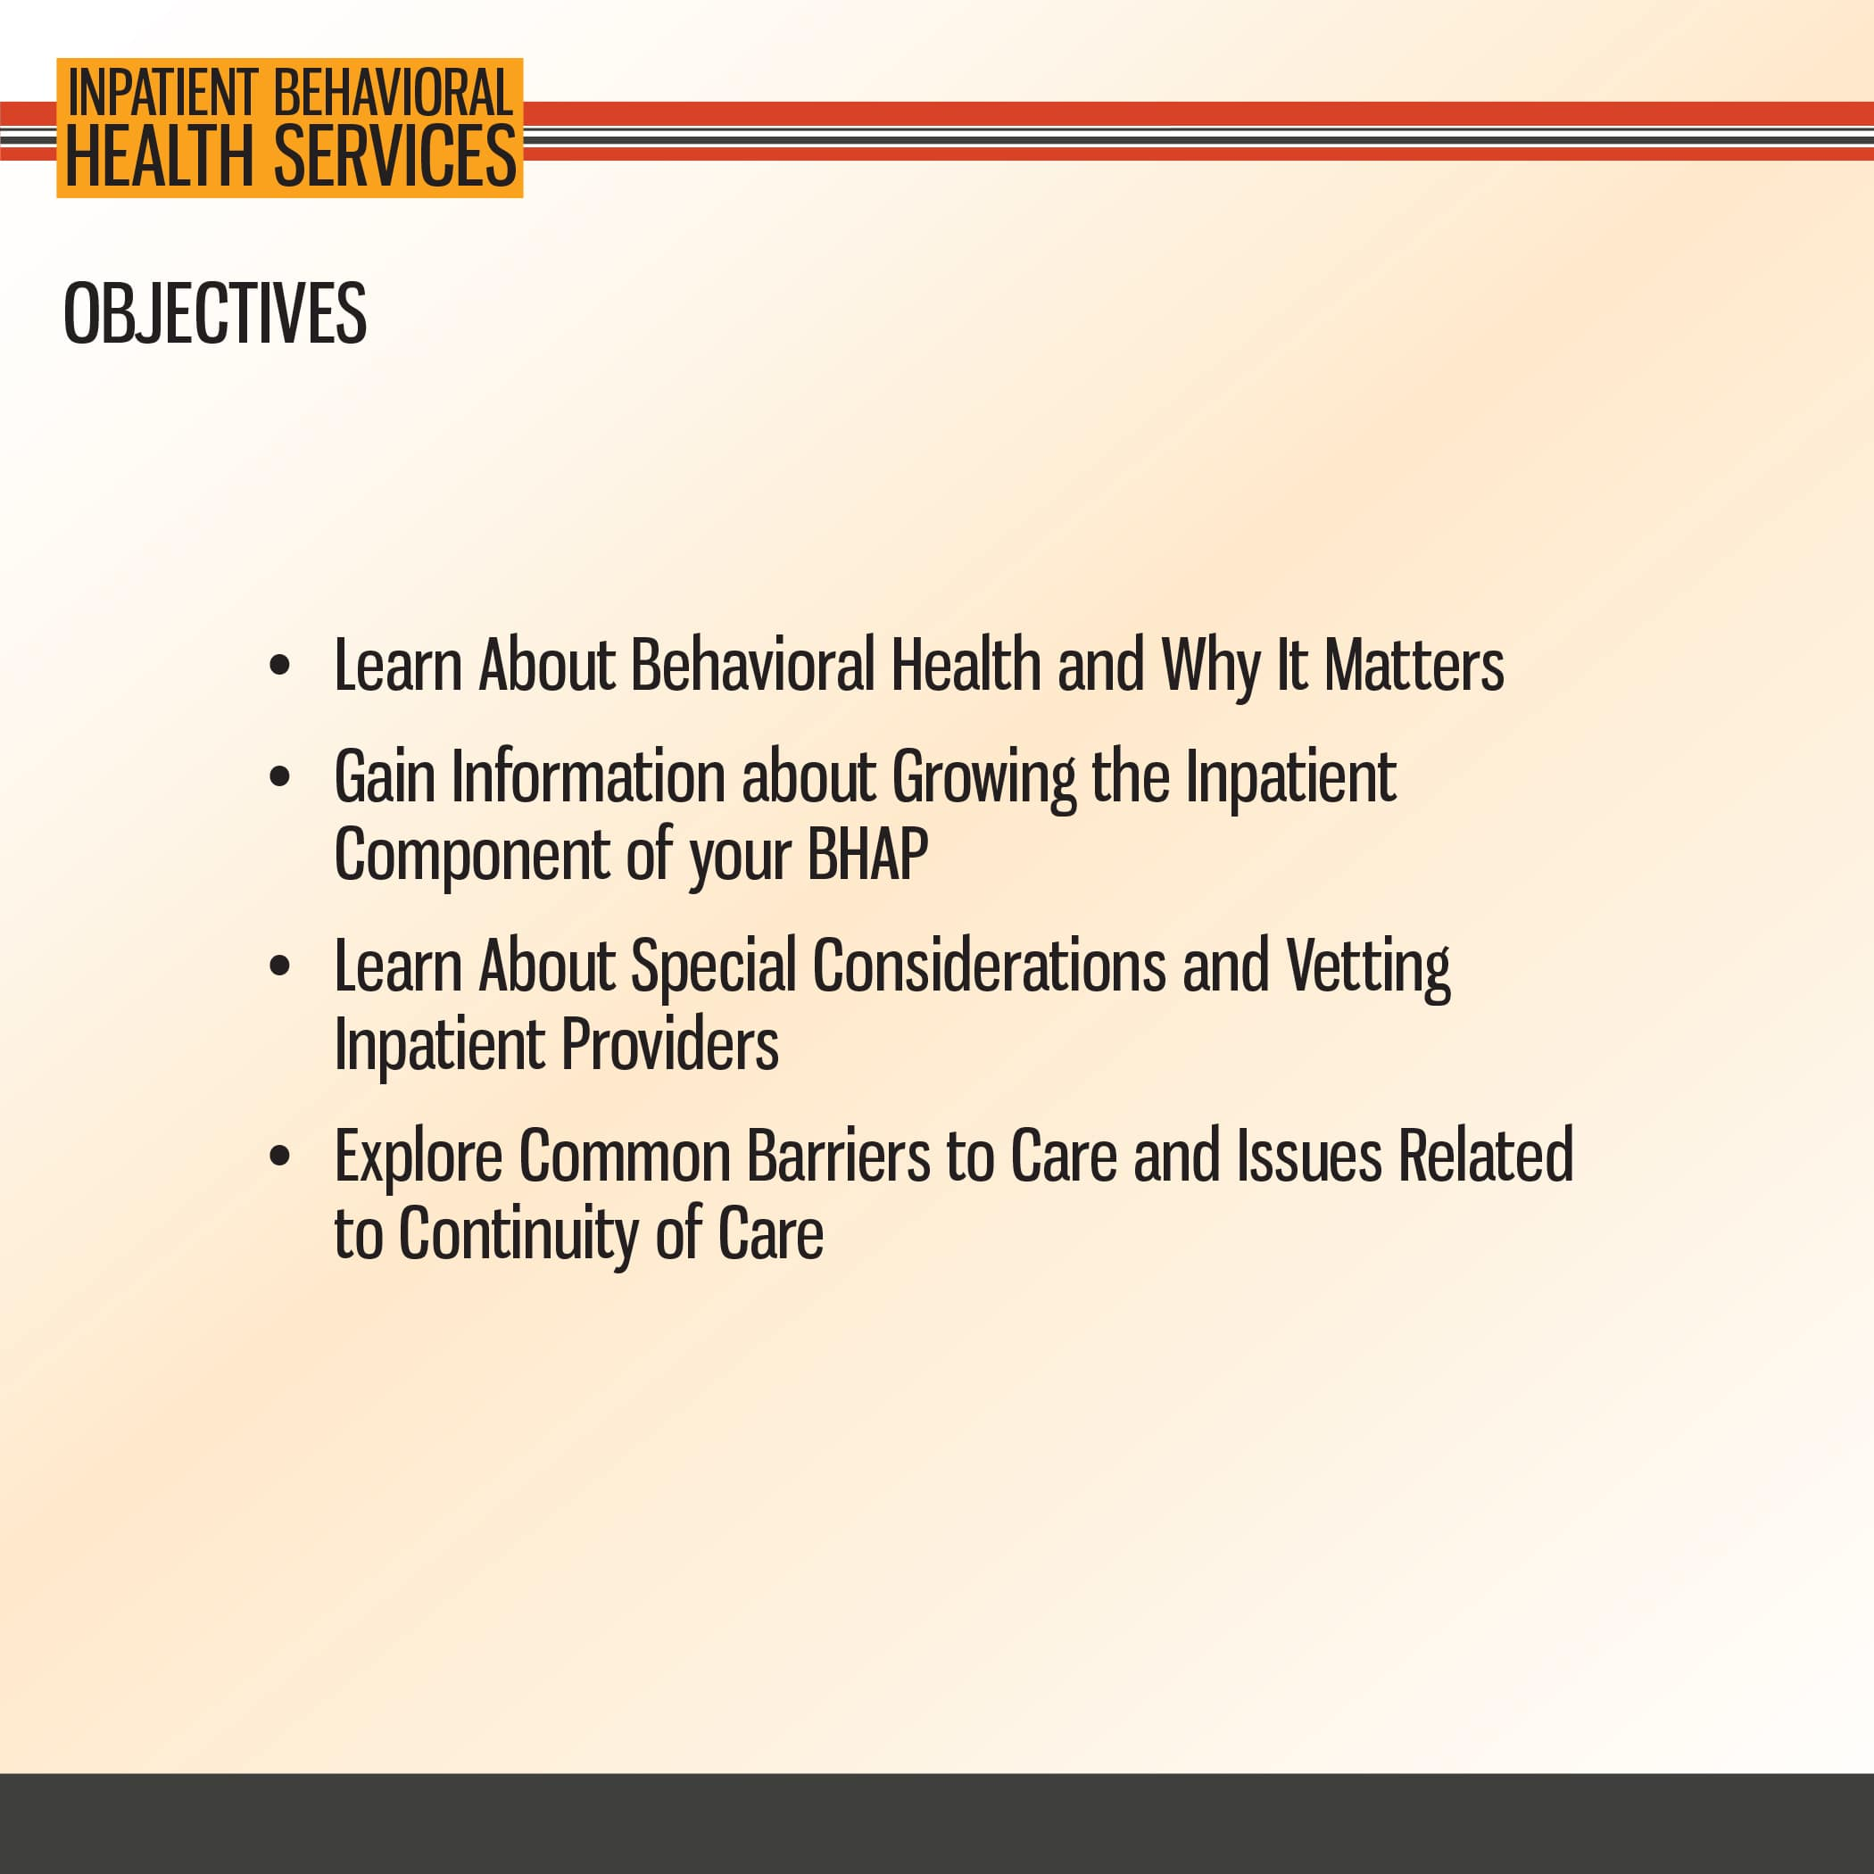

Slide 5
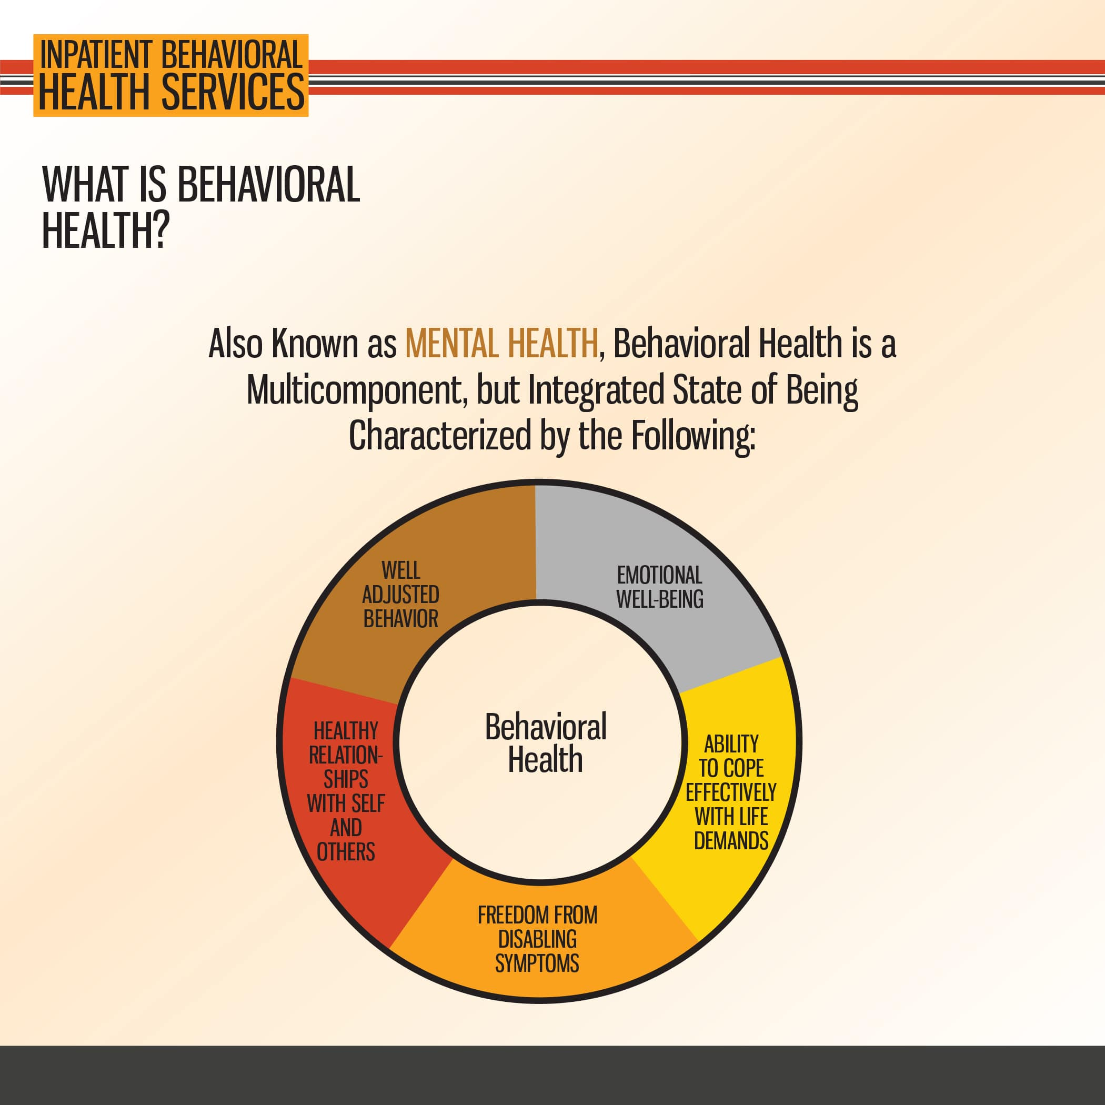

Slide 6
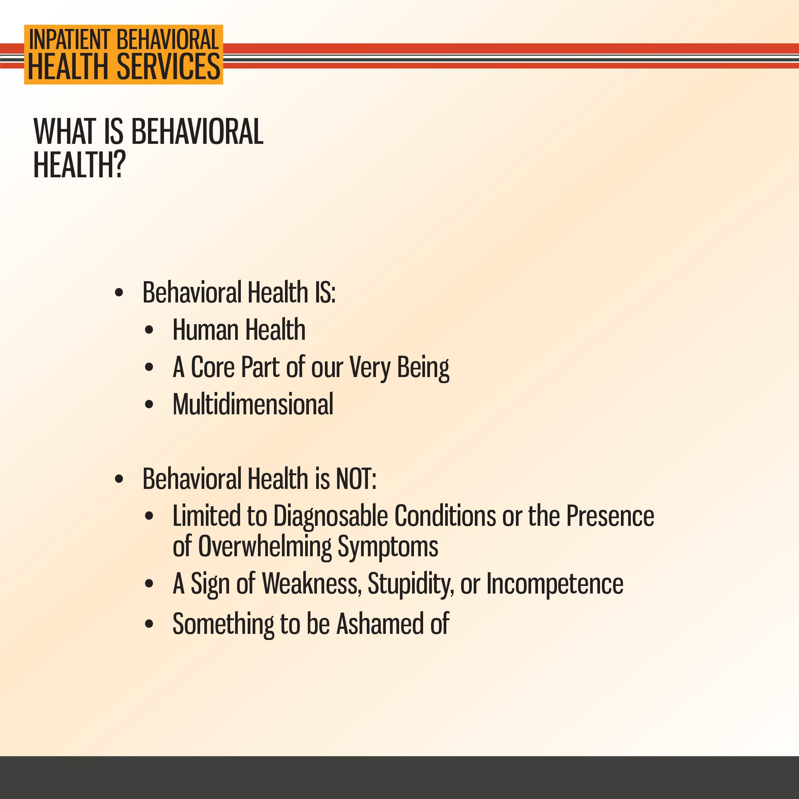

Slide 7
2. BHAP Framework
Inpatient

Slide 8


Slide 9
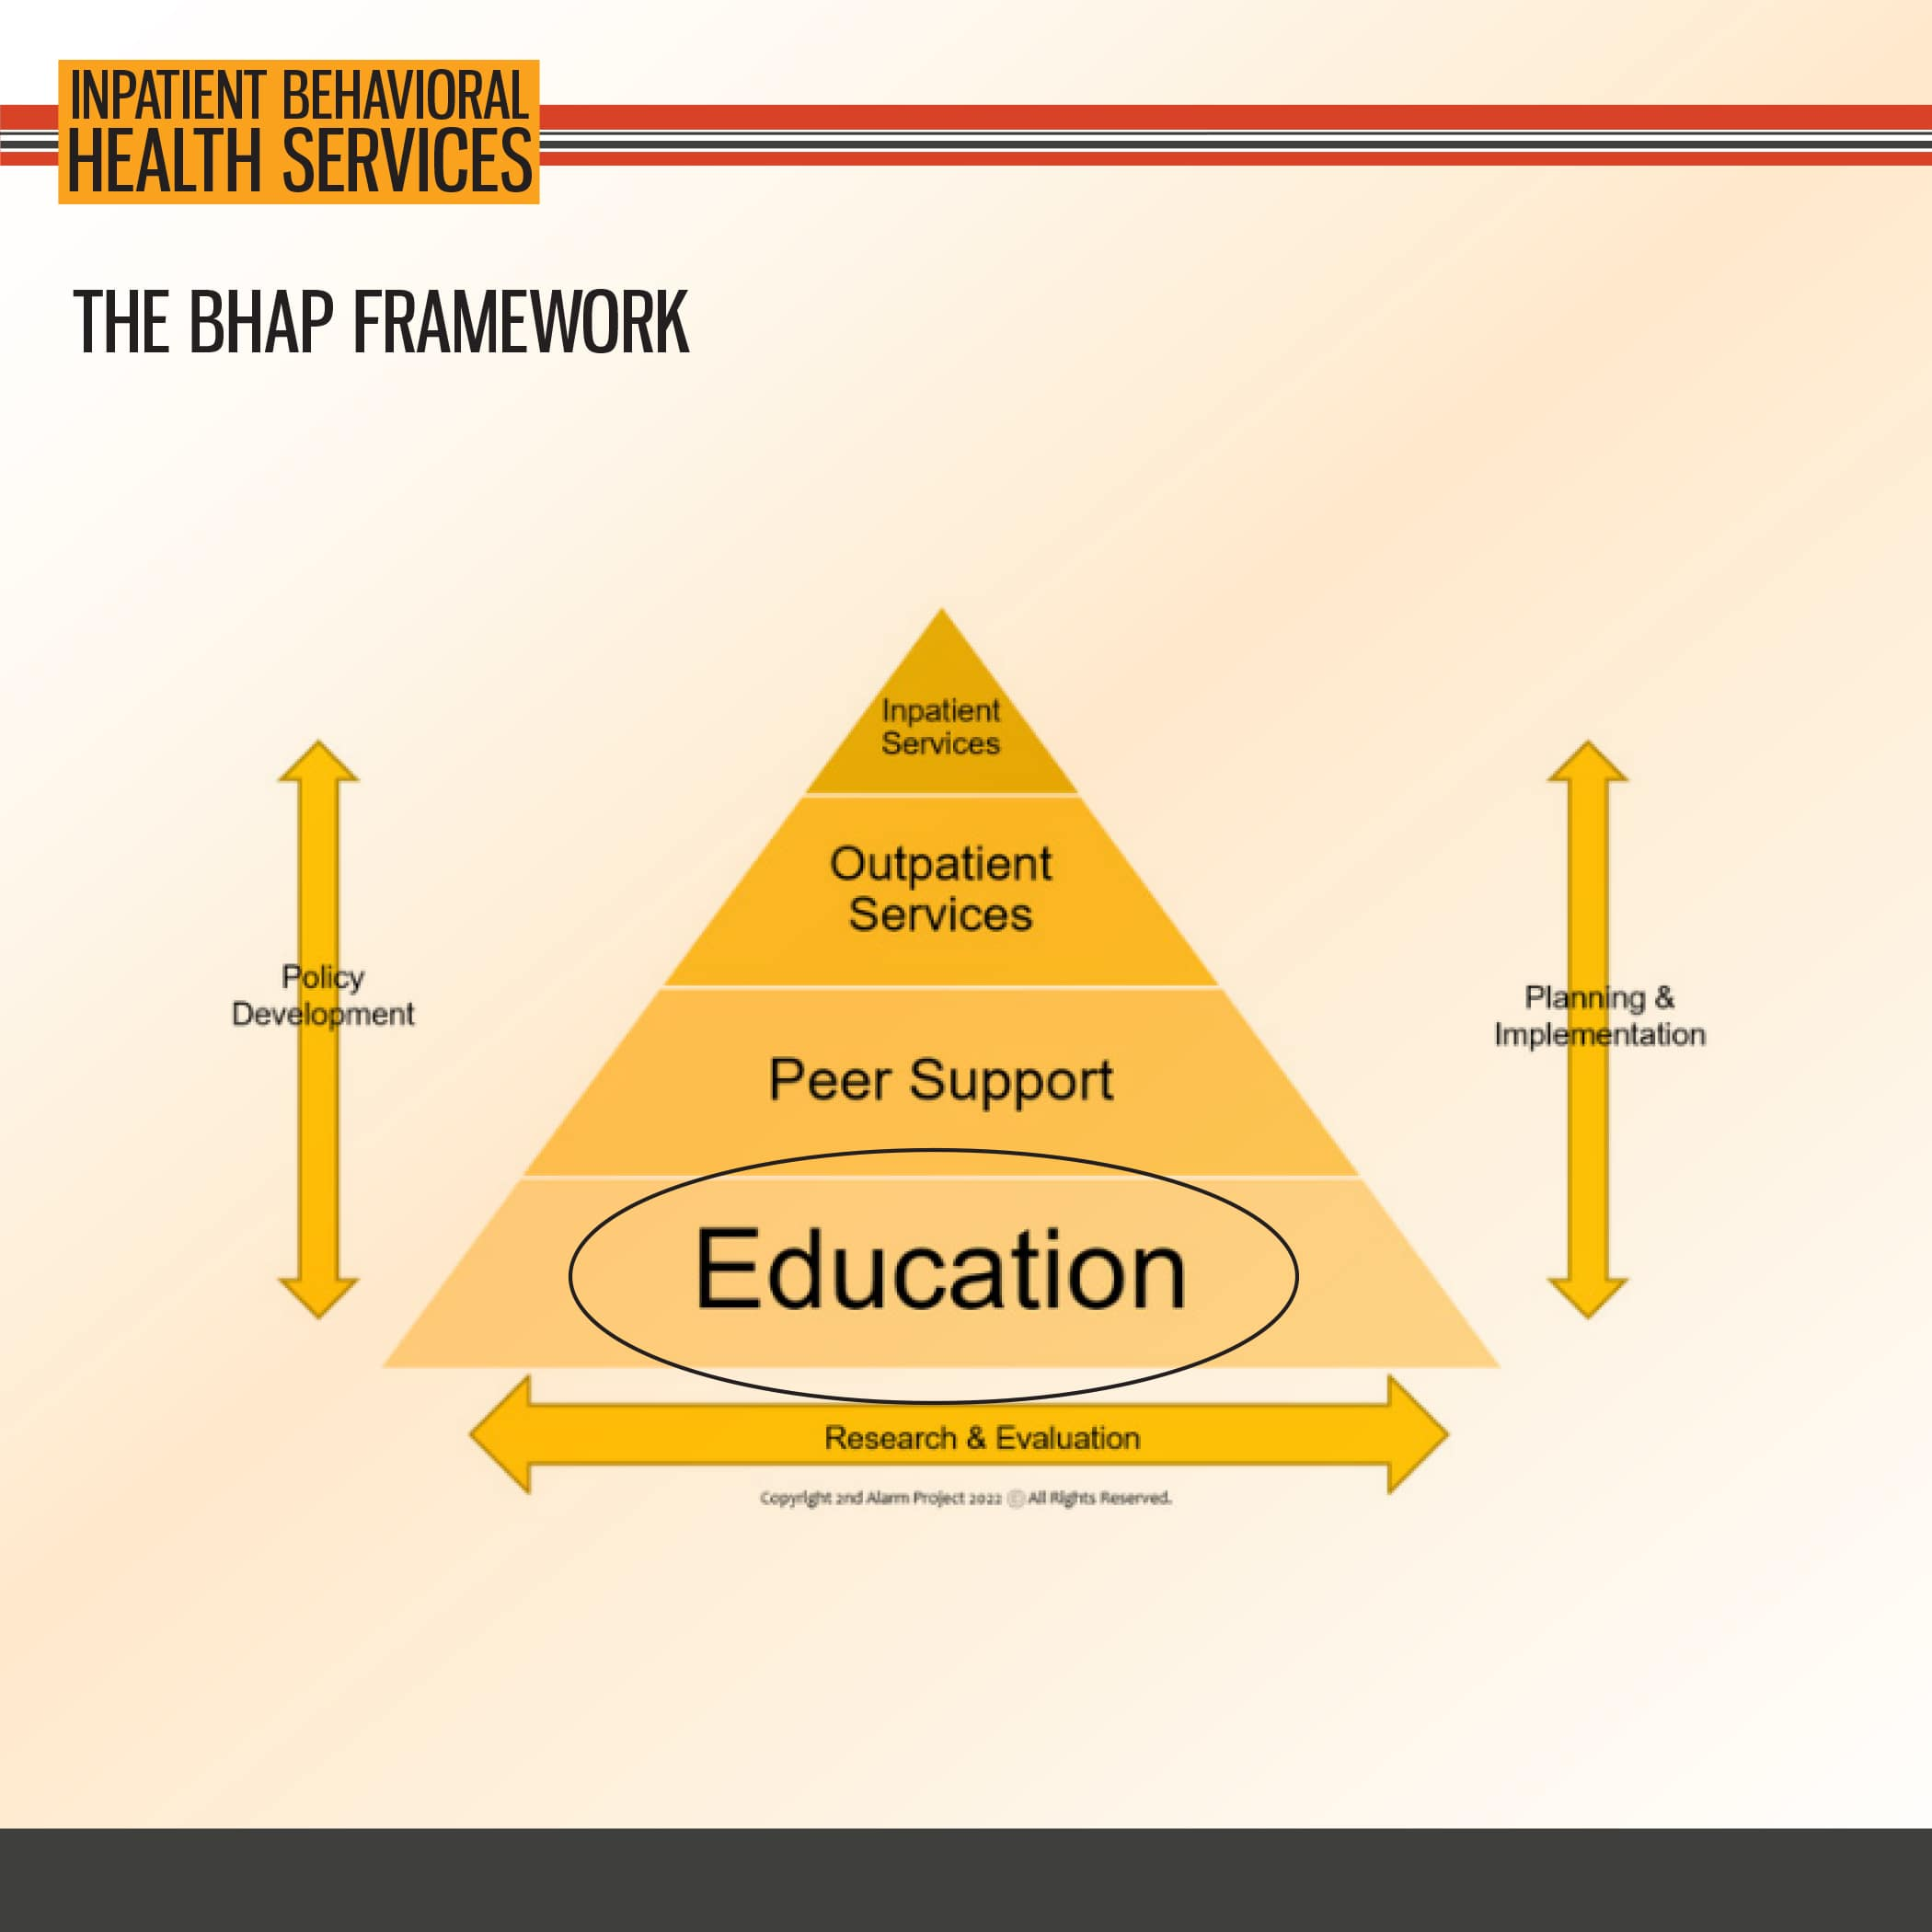

Slide 10


Slide 11


Slide 12


Slide 13


Slide 14
3. Inpatient Services Specifics
Inpatient

Slide 15
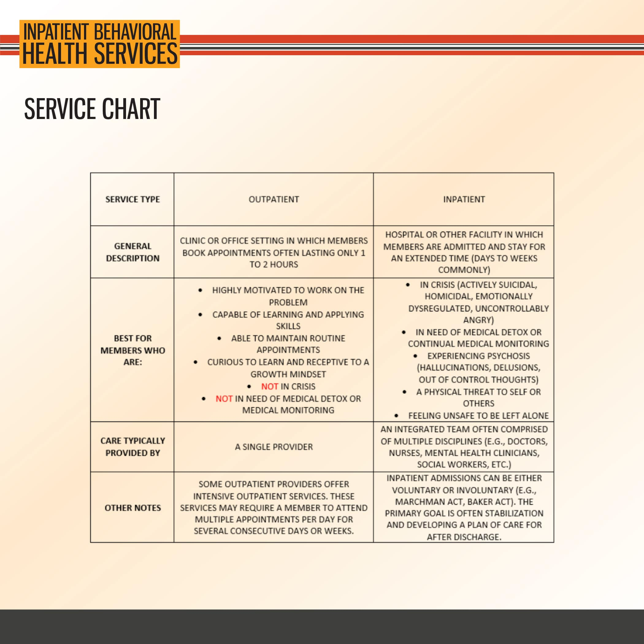

Slide 16
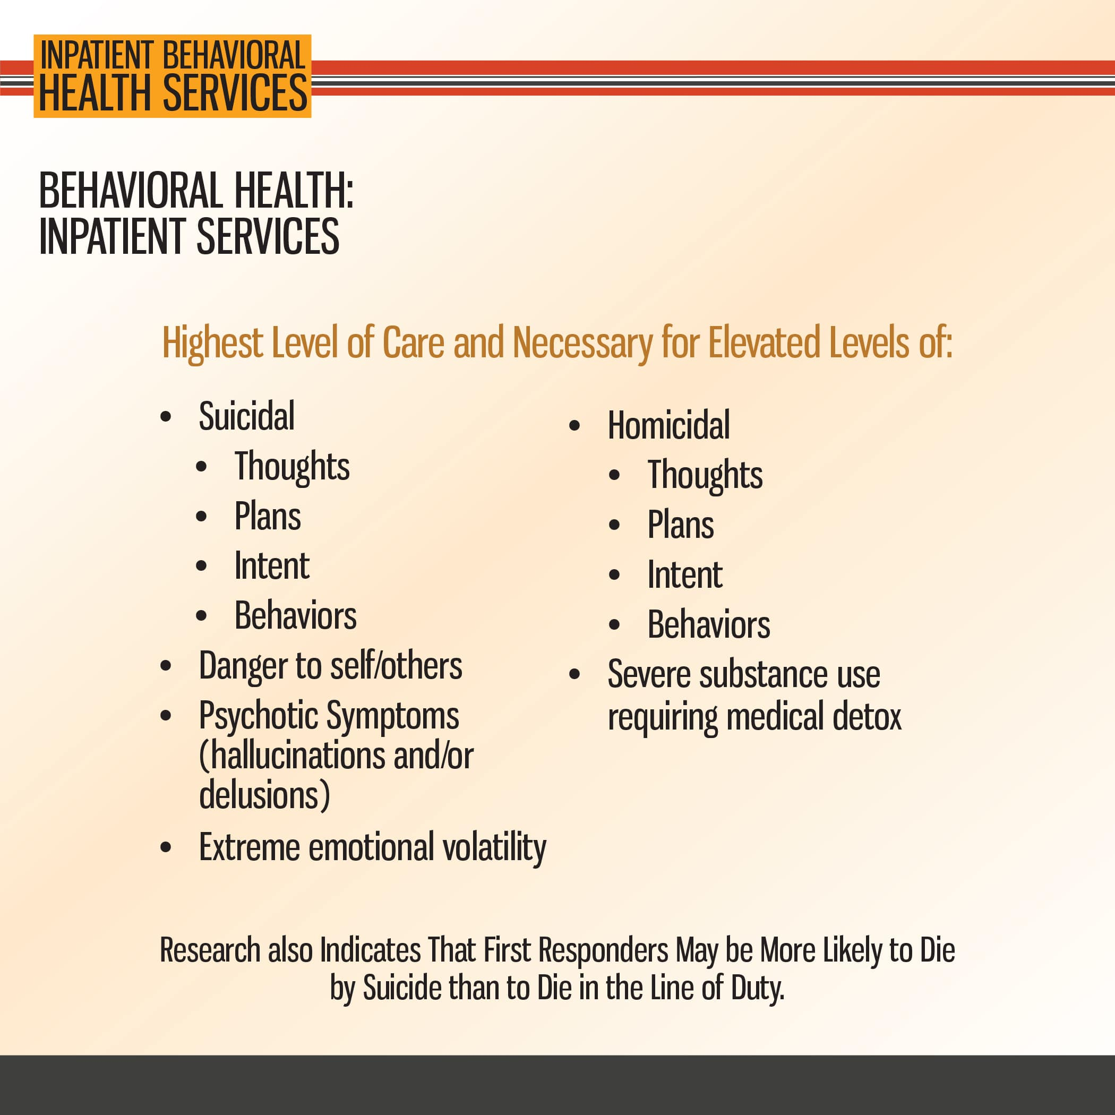

Slide 17


Slide 18
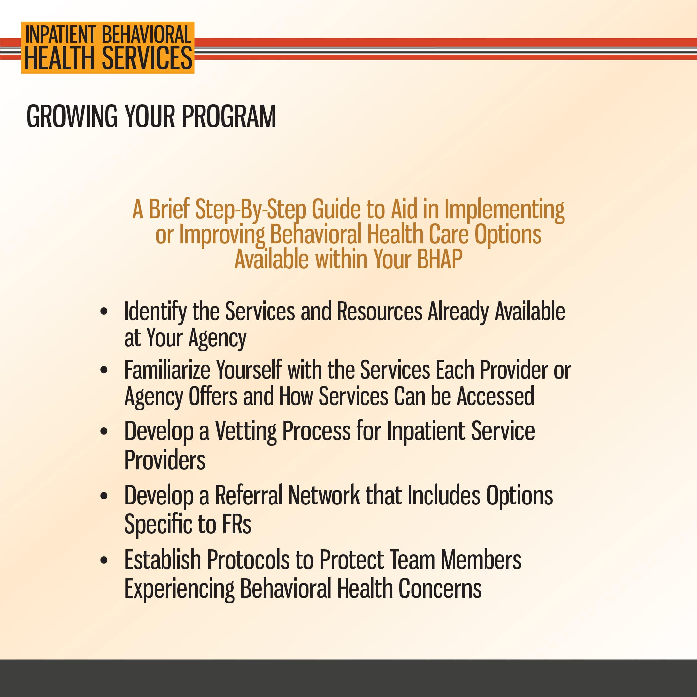

Slide 19


Slide 20
4. Special Considerations
Inpatient

Slide 21
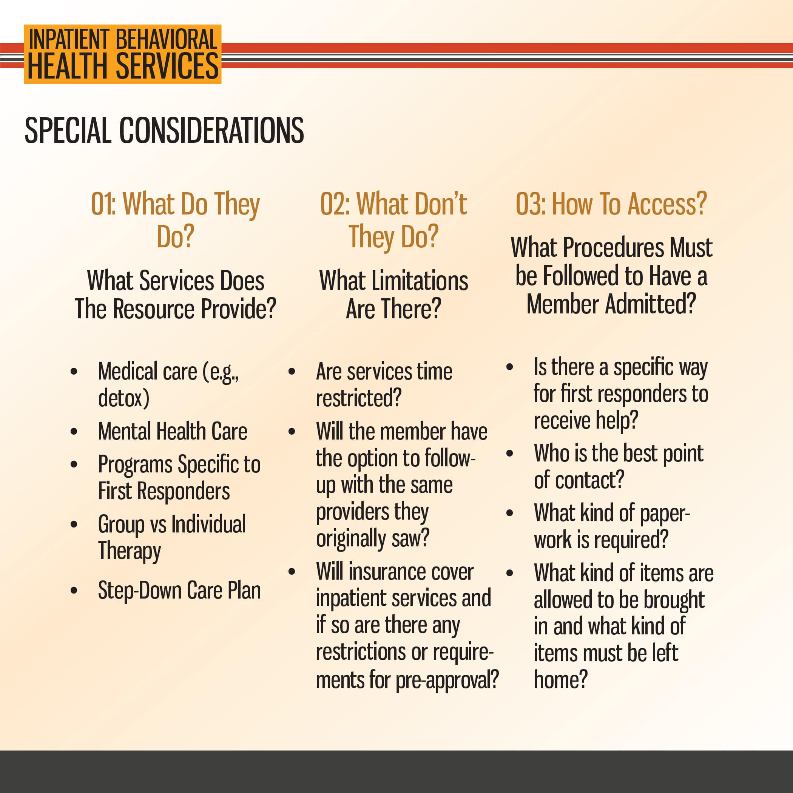

Slide 22
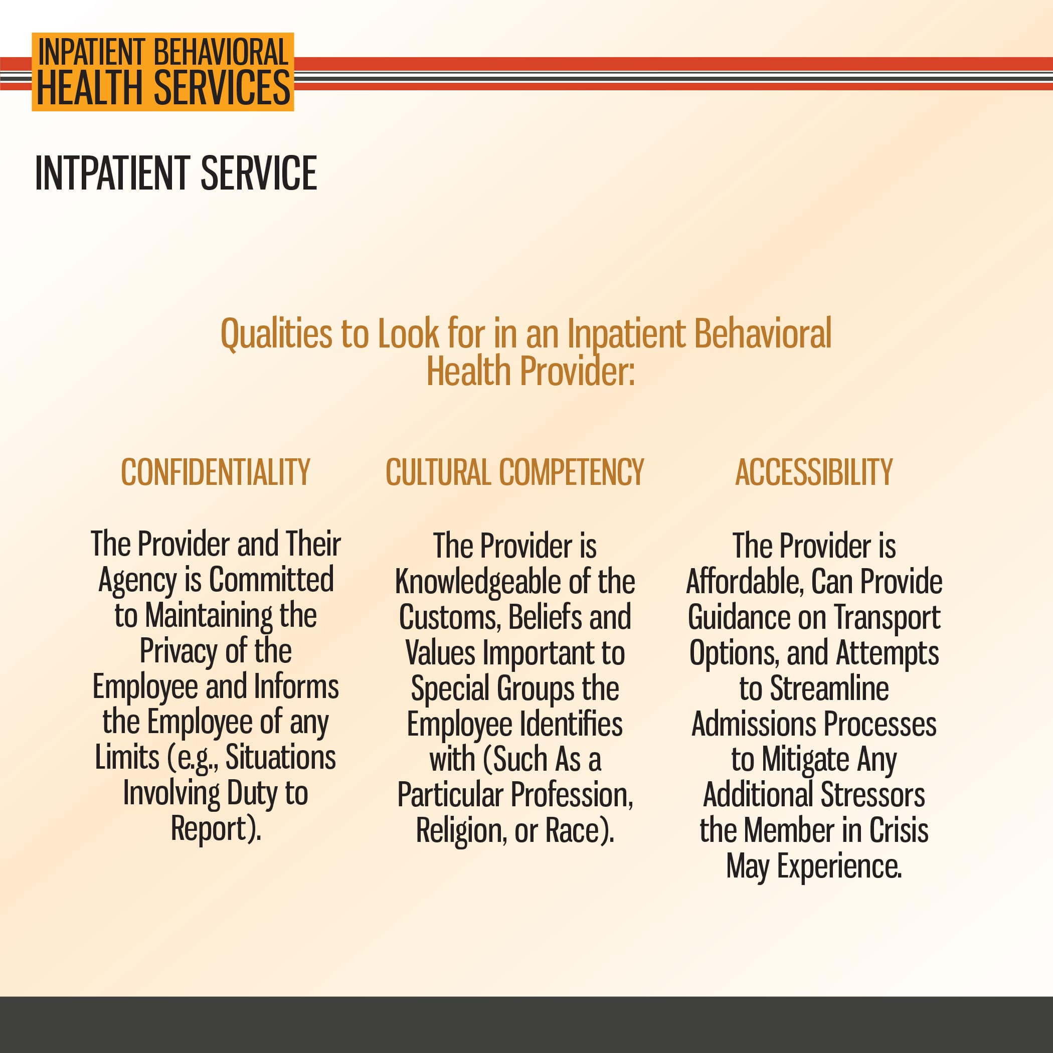

Slide 23
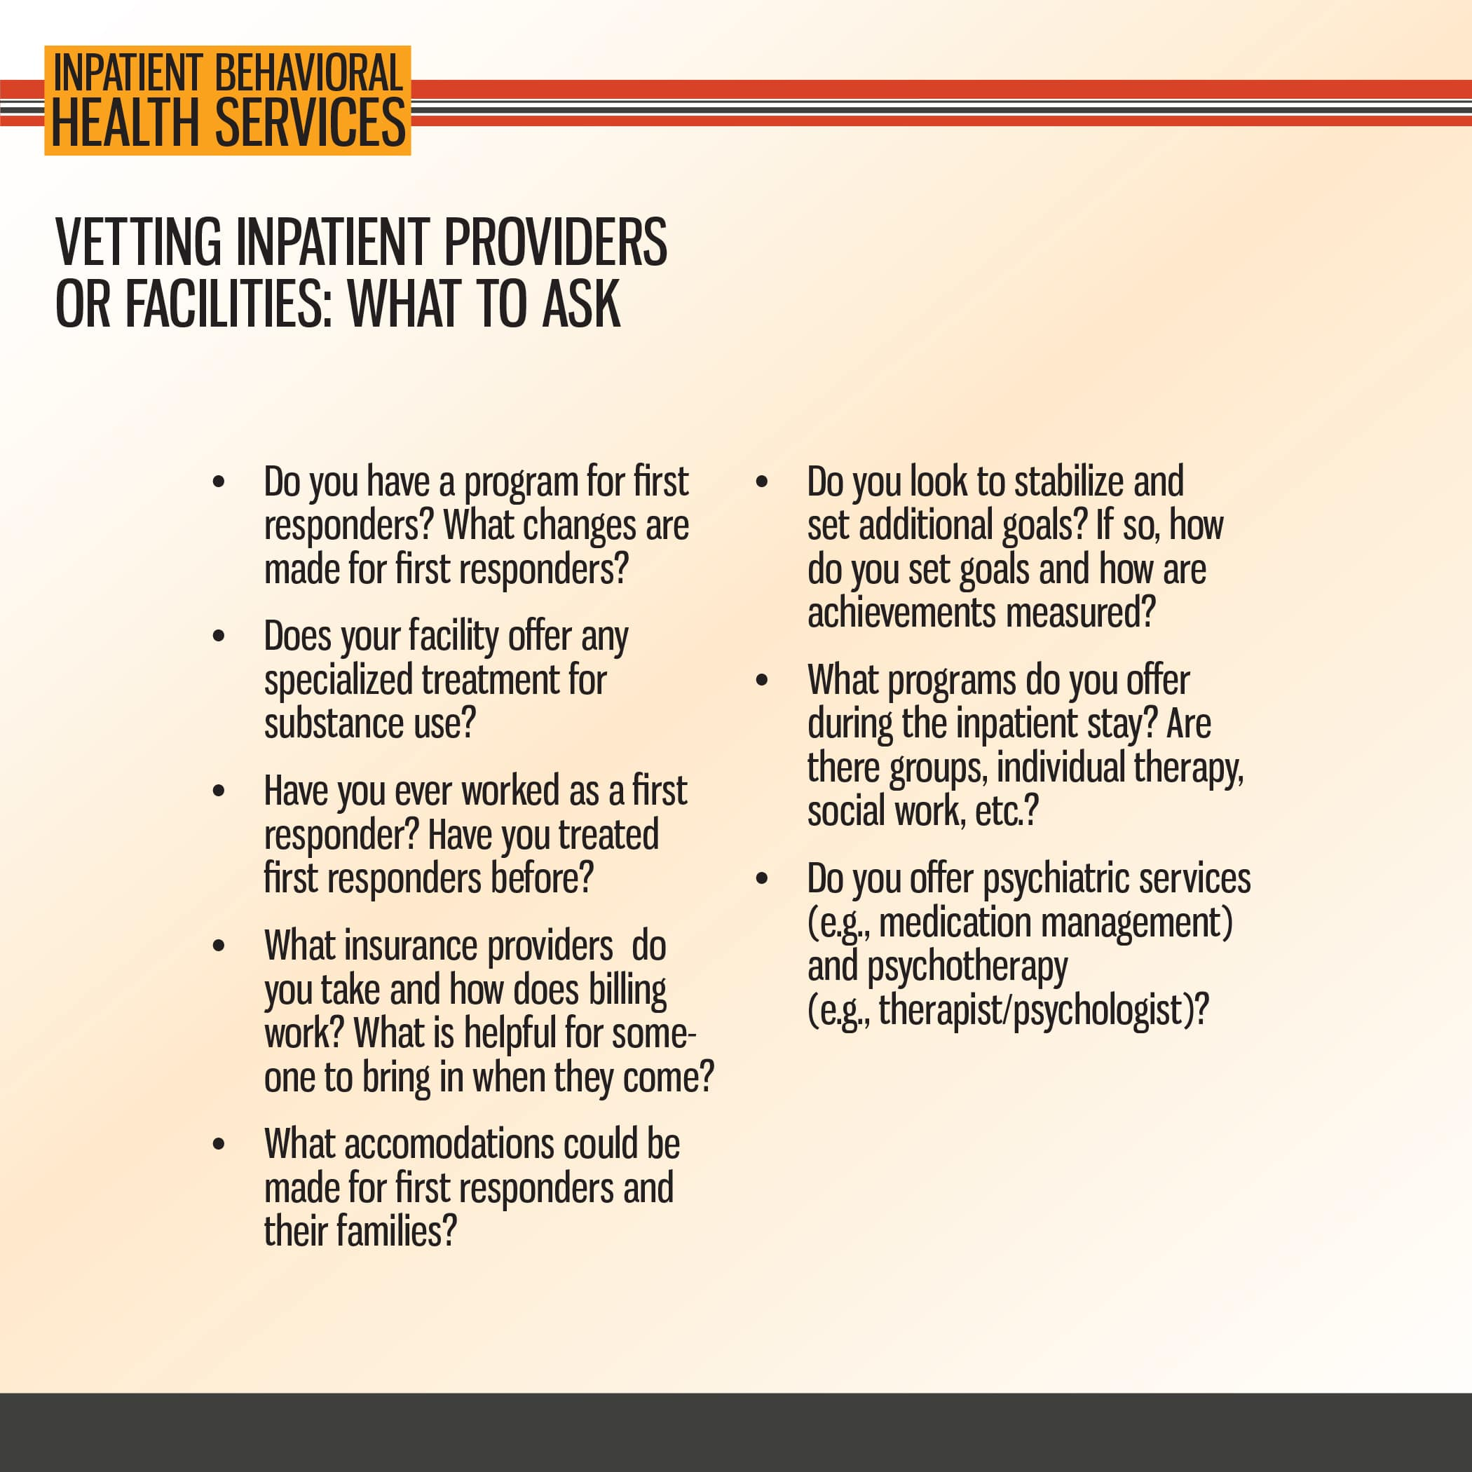

Slide 24
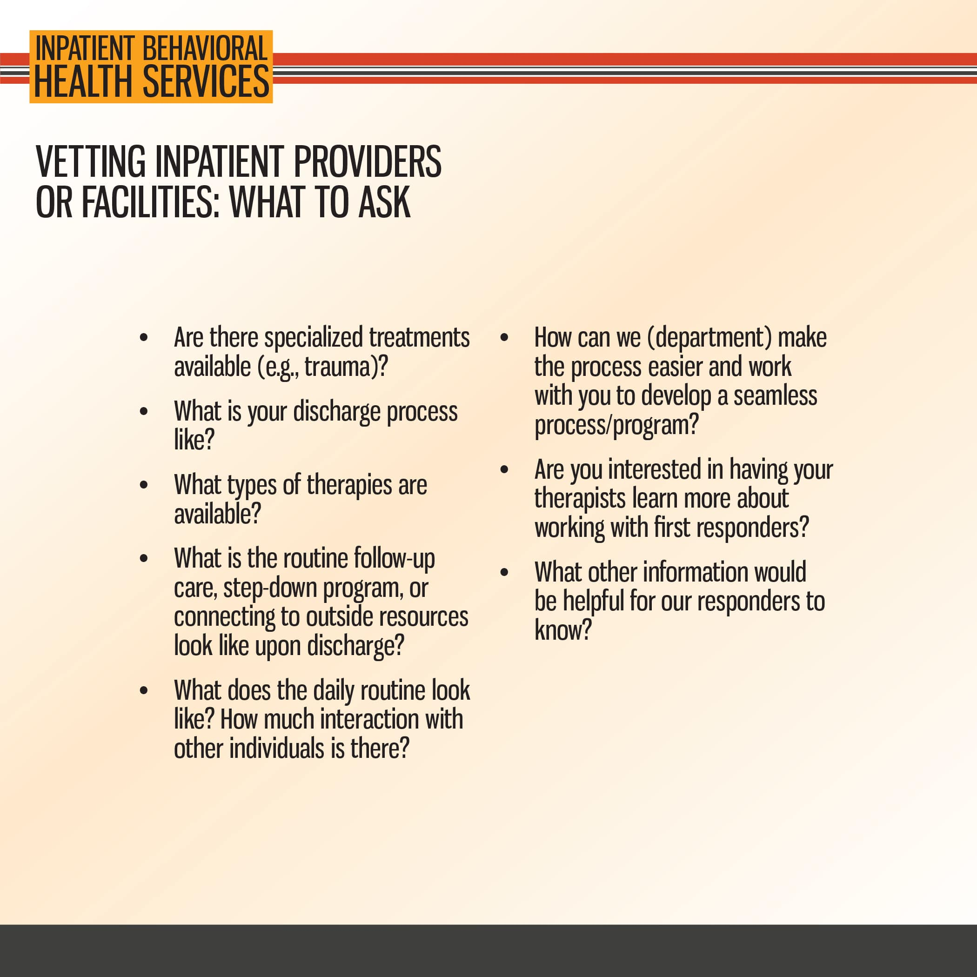

Slide 25
5. Barriers and Continuity of Care
Inpatient

Slide 26


Slide 27


Slide 28


Slide 29
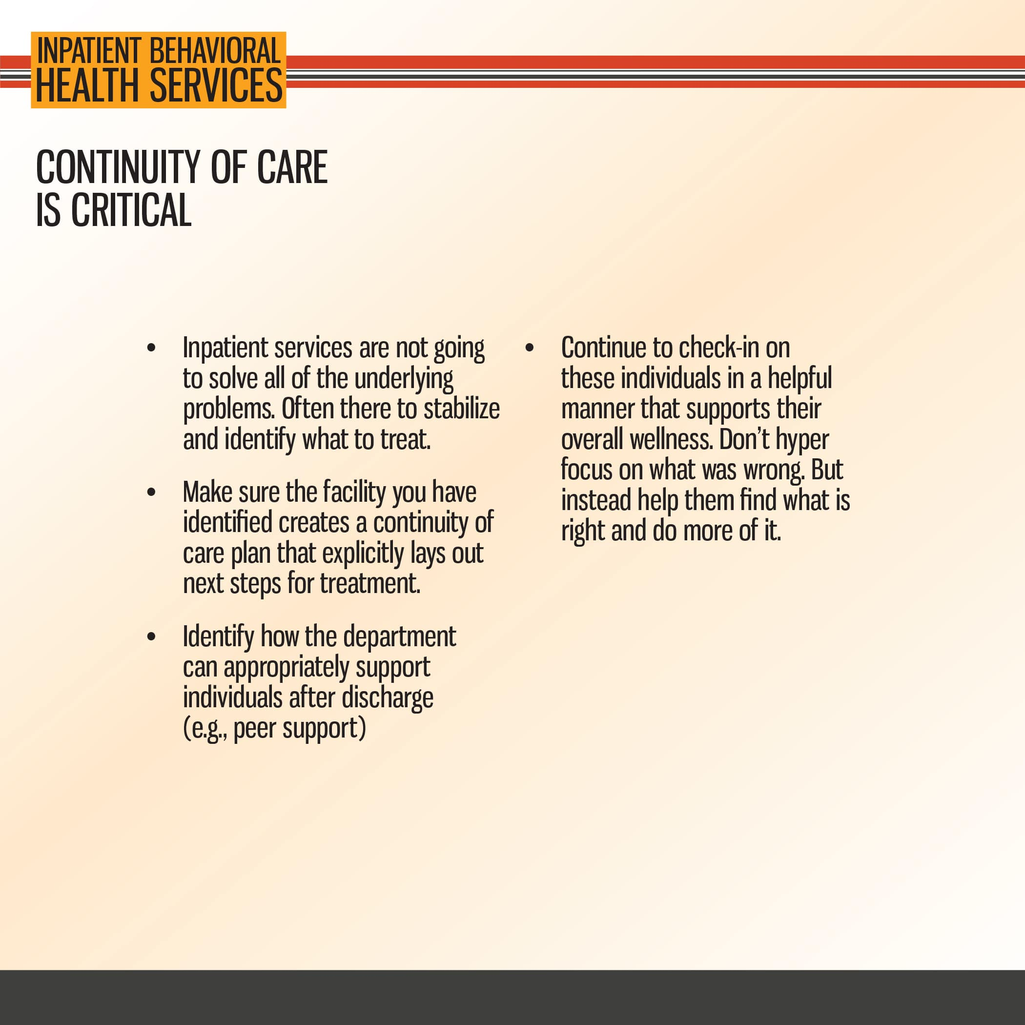

Slide 30


