Slide 1

Peer Support
Course Chapters - Slides

Slide 2
1. Building a Peer Support Team
Peer Support

Slide 3


Slide 4
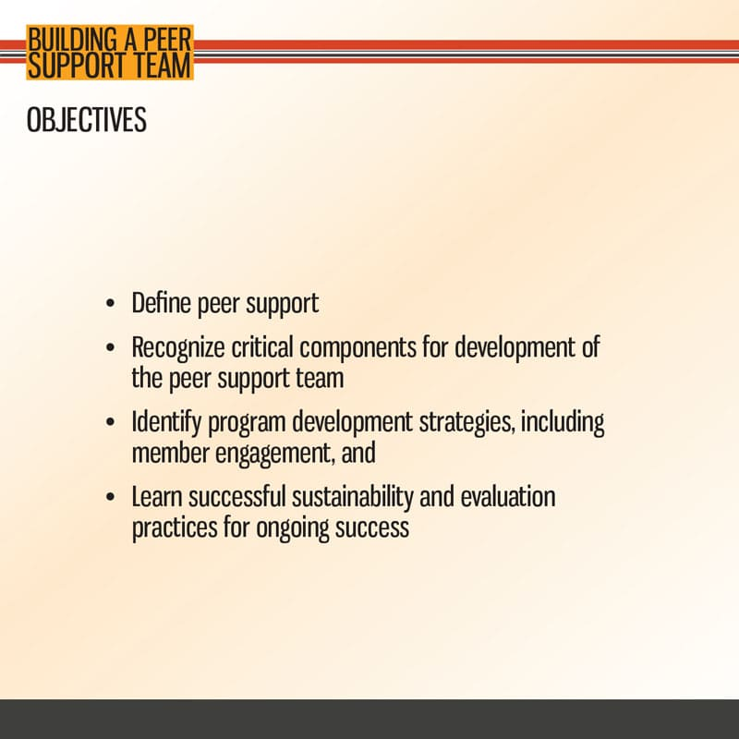

Slide 5


Slide 6
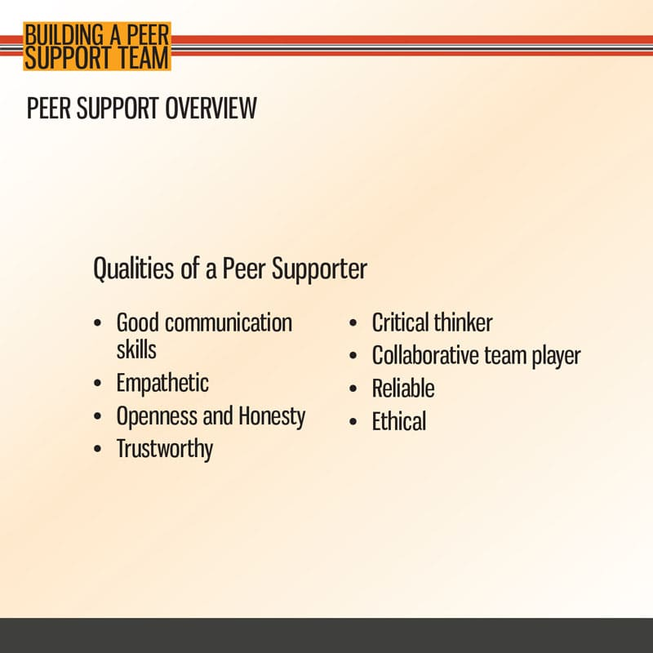

Slide 7


Slide 8
2. Peer Support Team Development
Peer Support

Slide 9
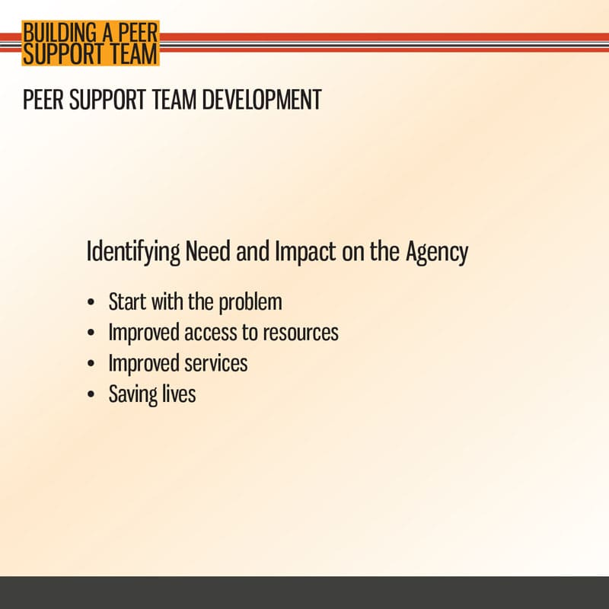

Slide 10
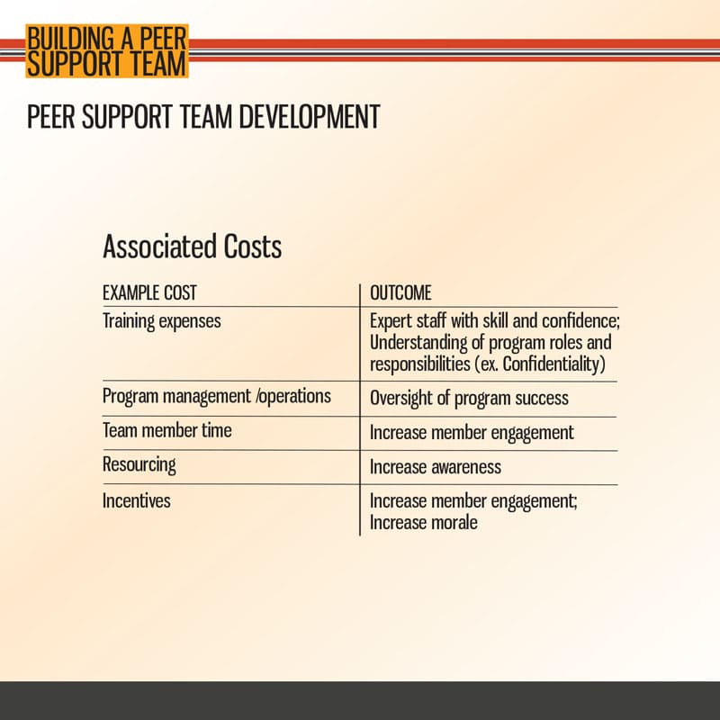

Slide 11
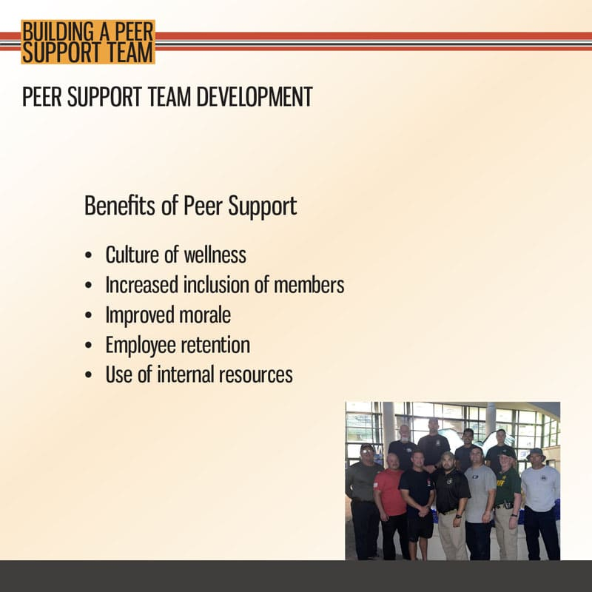

Slide 12
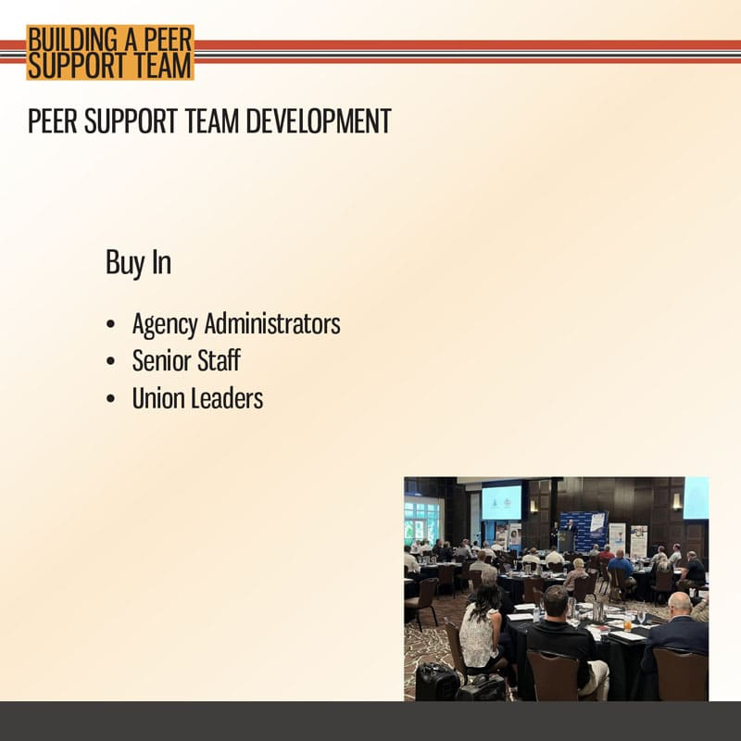

Slide 13
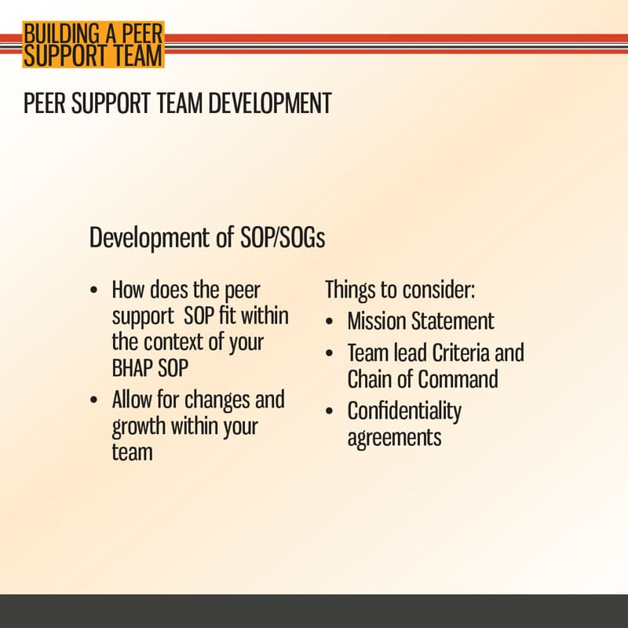

Slide 14
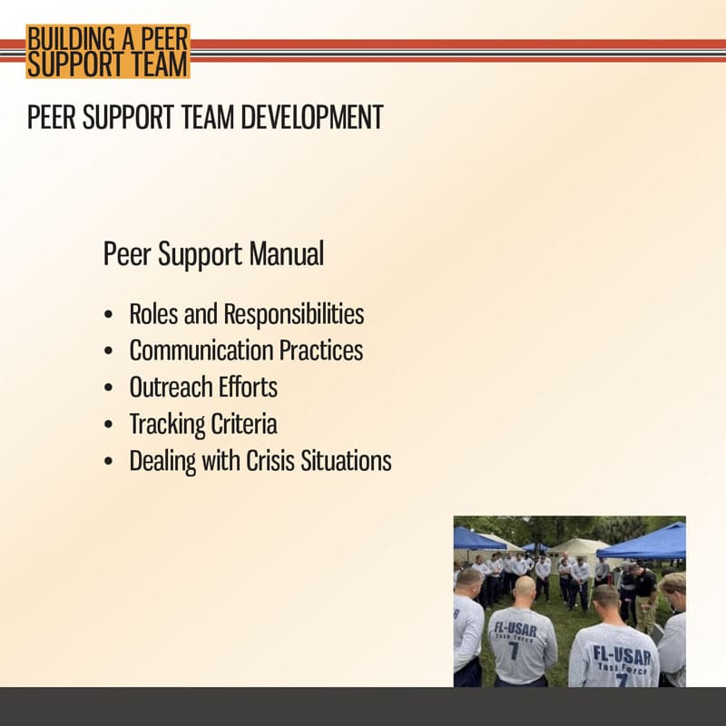

Slide 15
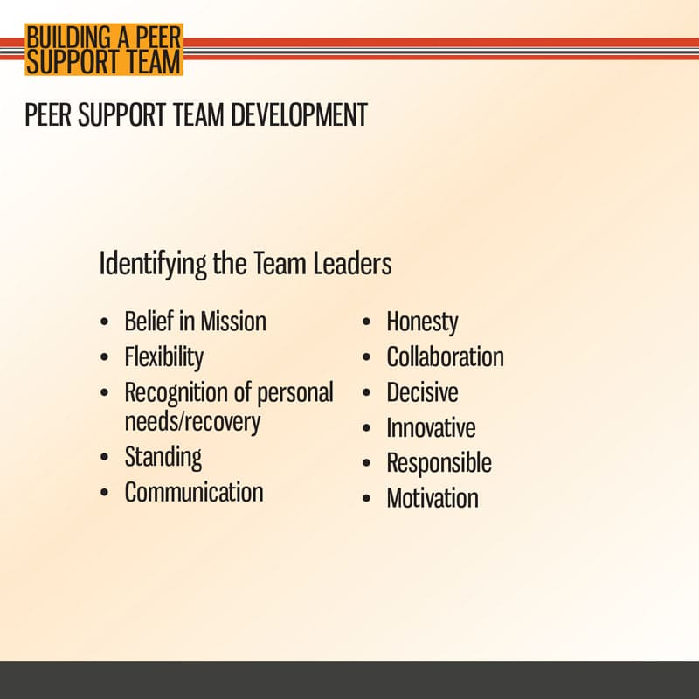

Slide 16
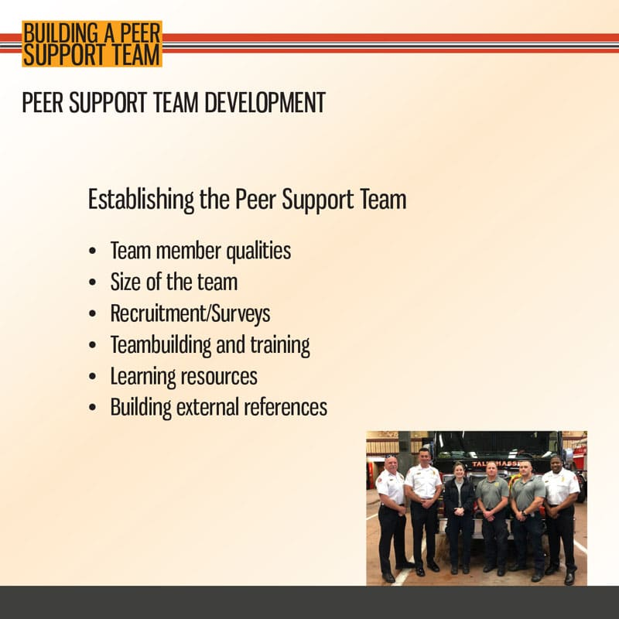

Slide 17
3. Sustaining your Team
Peer Support

Slide 18
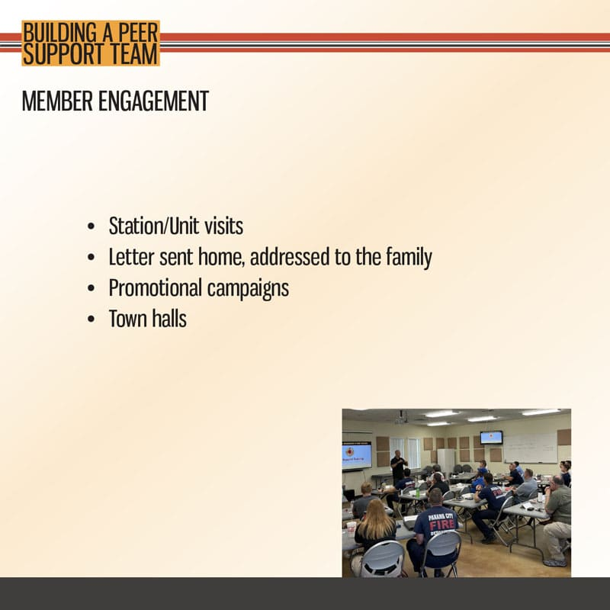

Slide 19
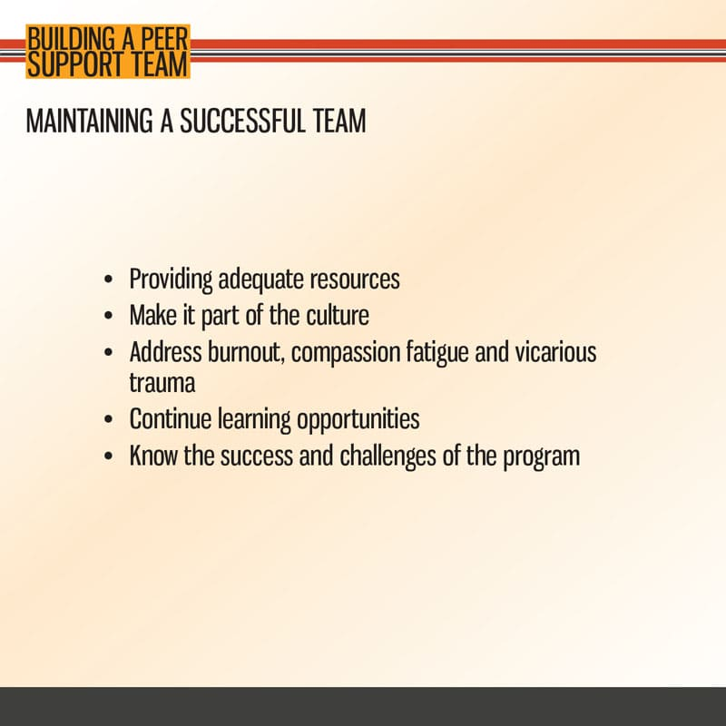

Slide 20
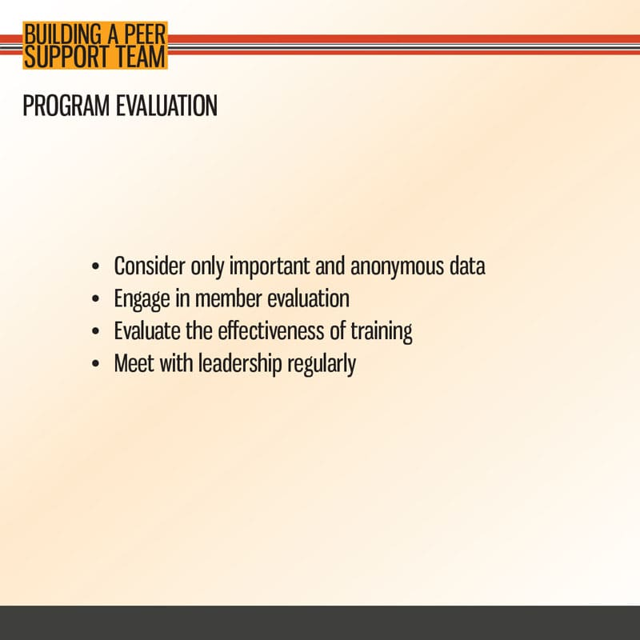

Slide 21
4. Task Book/Resources
Peer Support

Slide 22
