Slide 1

Retiree
Course Chapters - Slides

Slide 2
1. Overview of A Retiree Program
Retiree

Slide 3


Slide 4


Slide 5
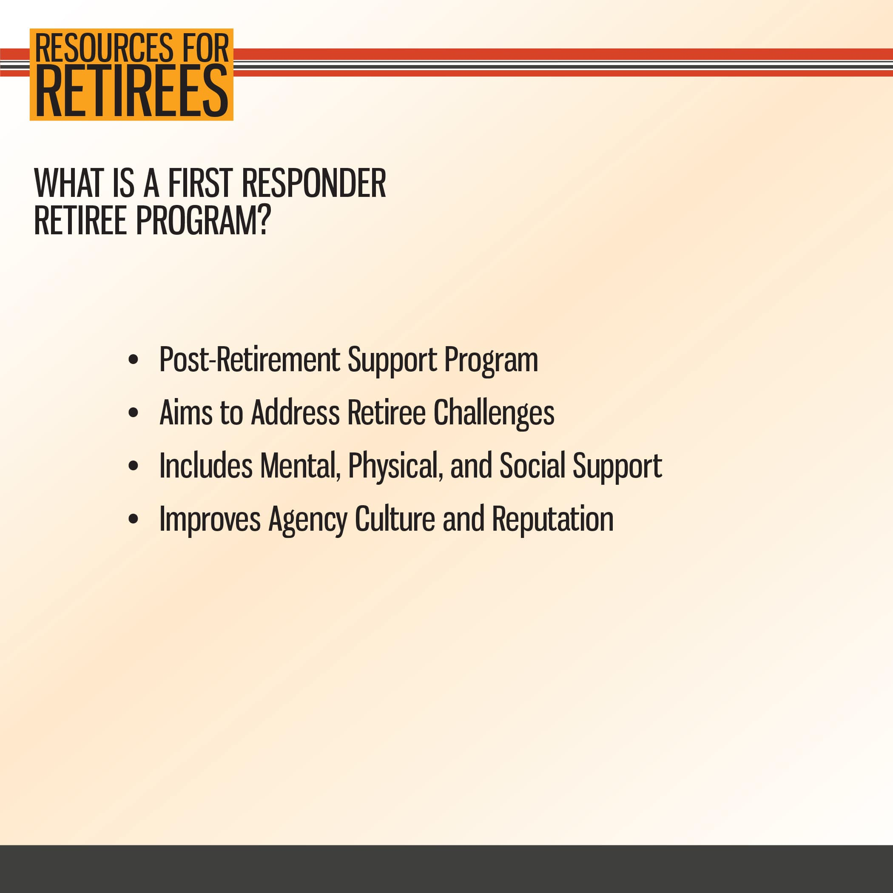

Slide 6
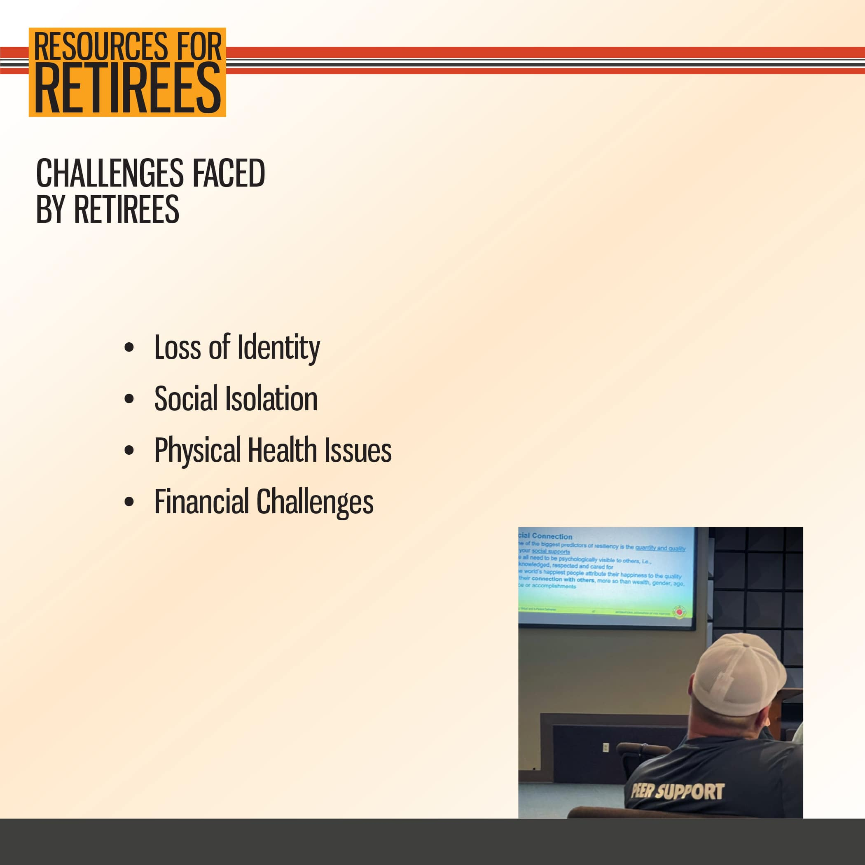

Slide 7
2. Retiree Support
Retiree

Slide 8


Slide 9


Slide 10


Slide 11
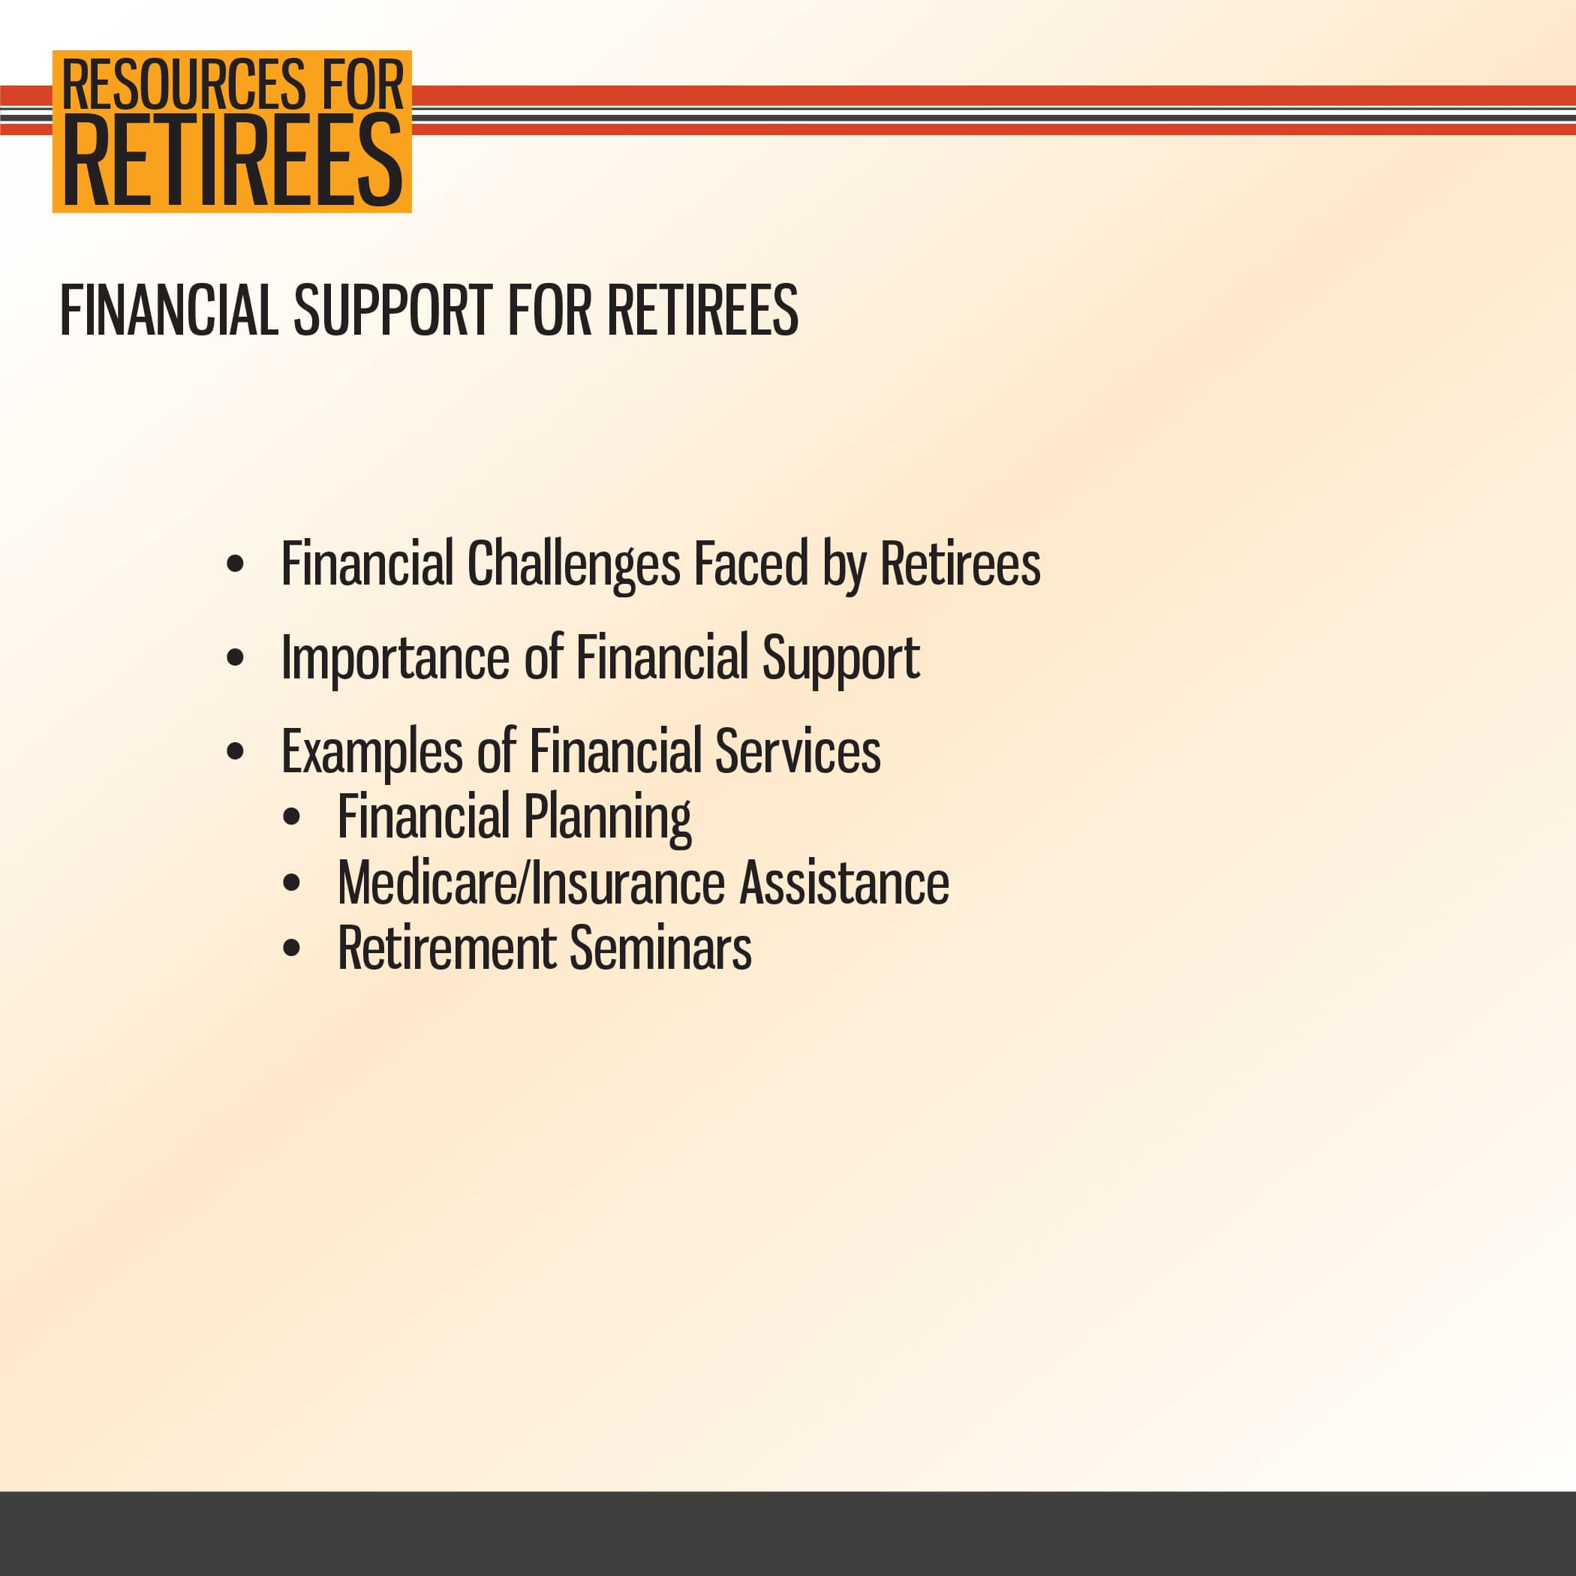

Slide 12


Slide 13
3. Benefits of a Retiree Program
Retiree

Slide 14


Slide 15


Slide 16


Slide 17
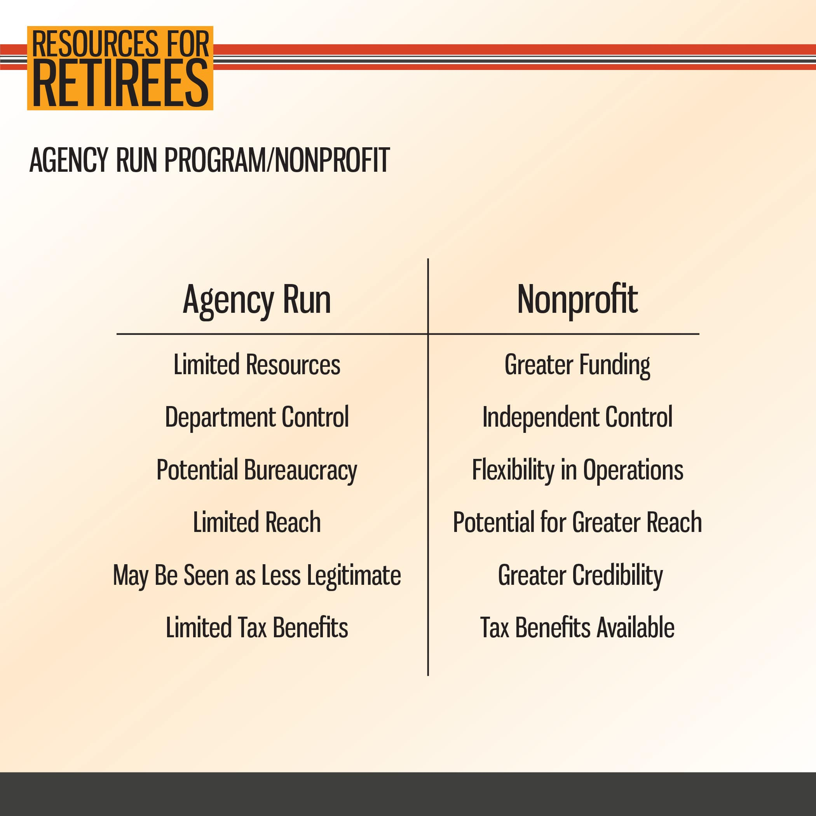

Slide 18
4. Setting up your Retiree Program
Retiree

Slide 19


Slide 20
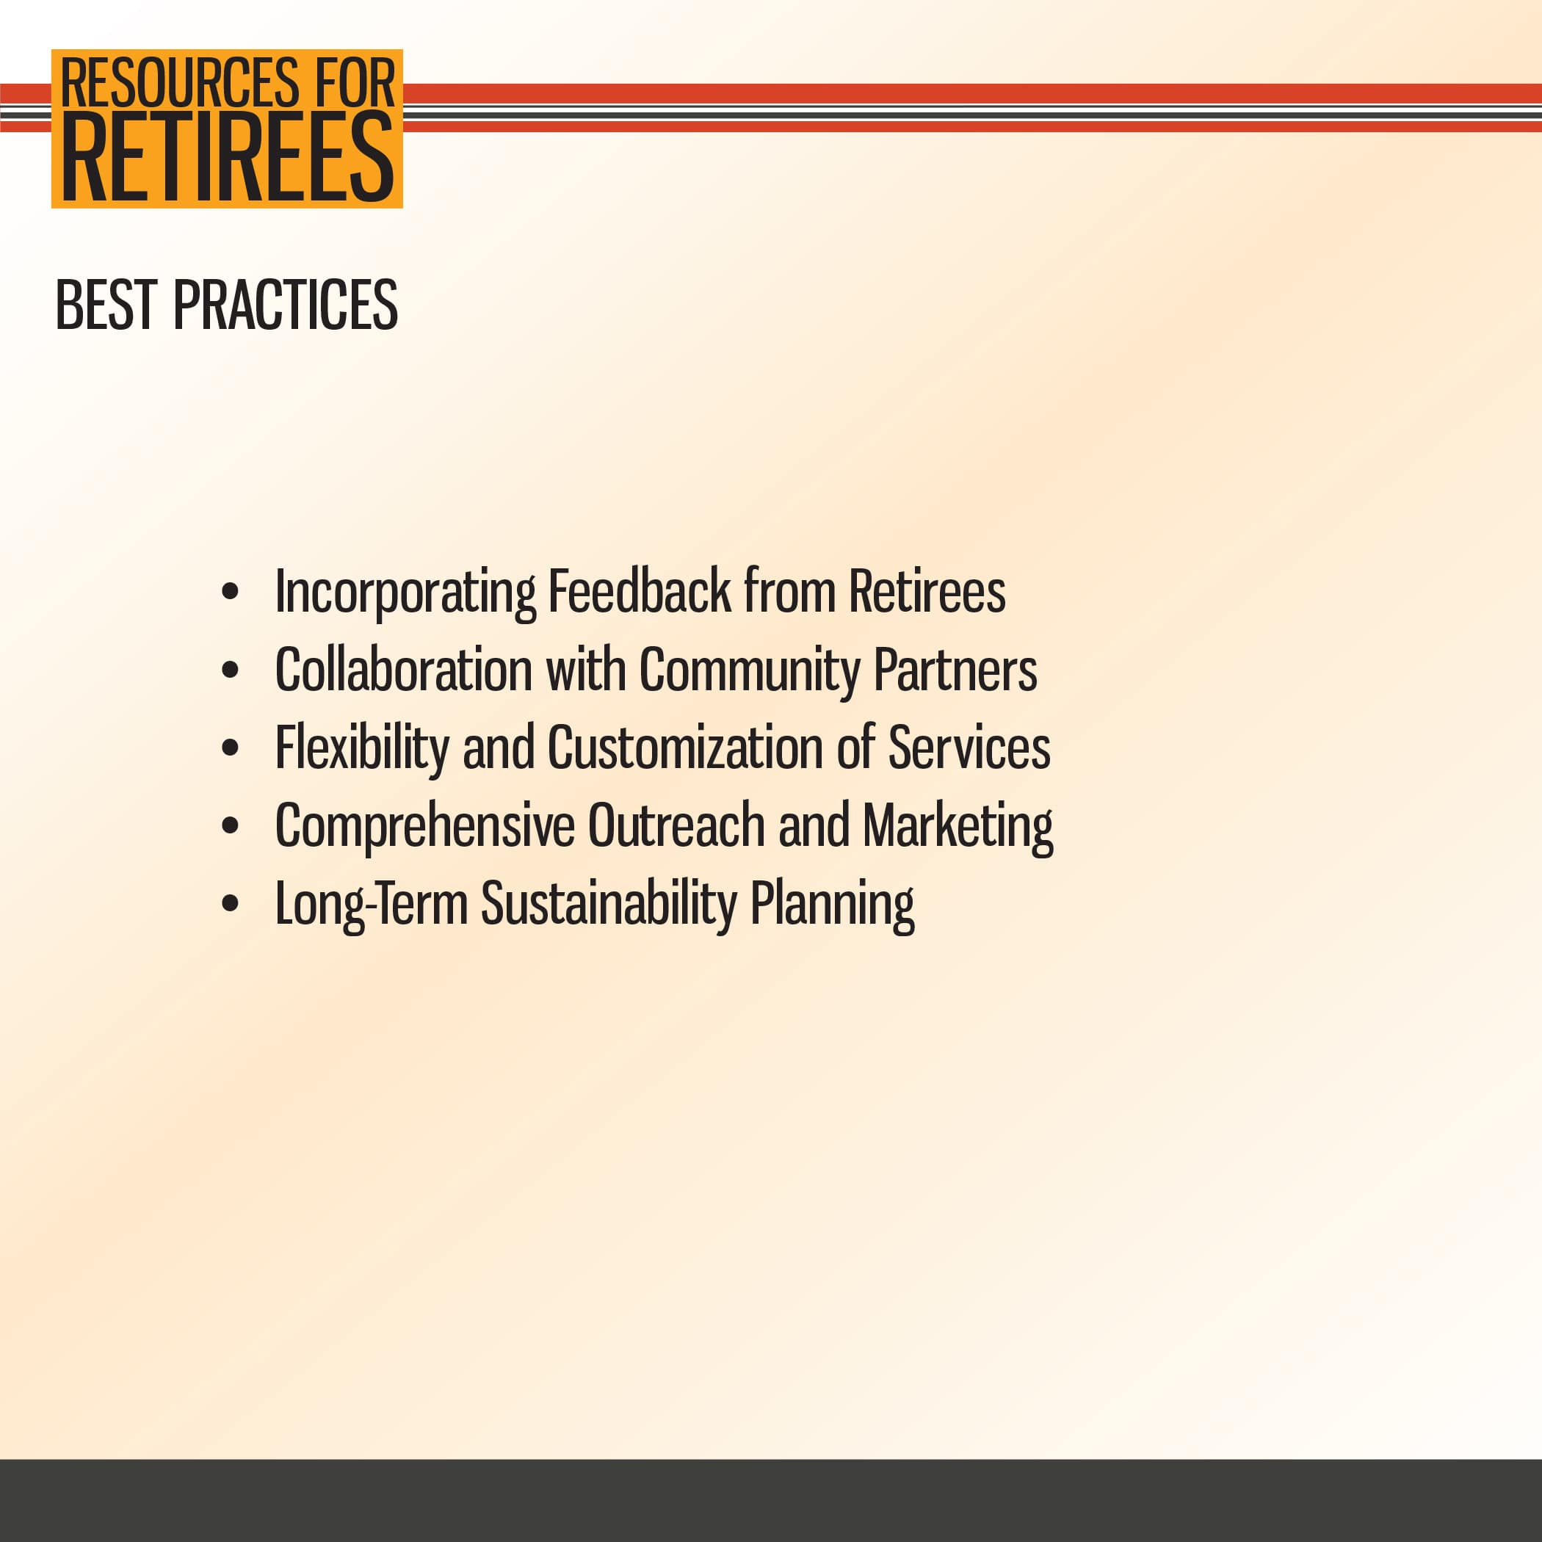

Slide 21
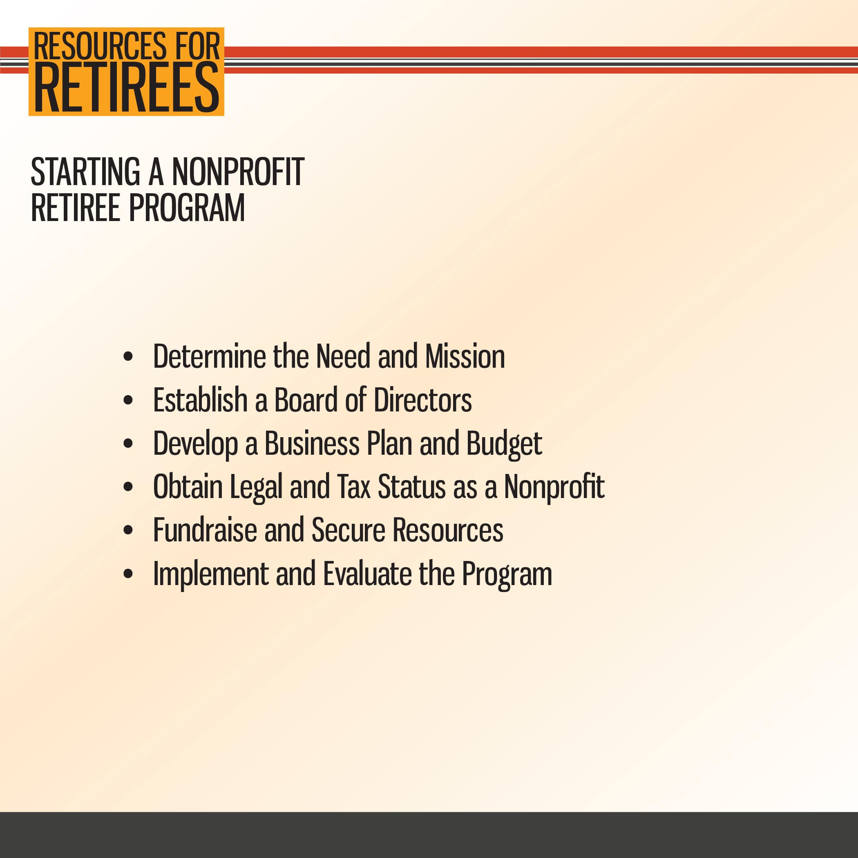

Slide 22
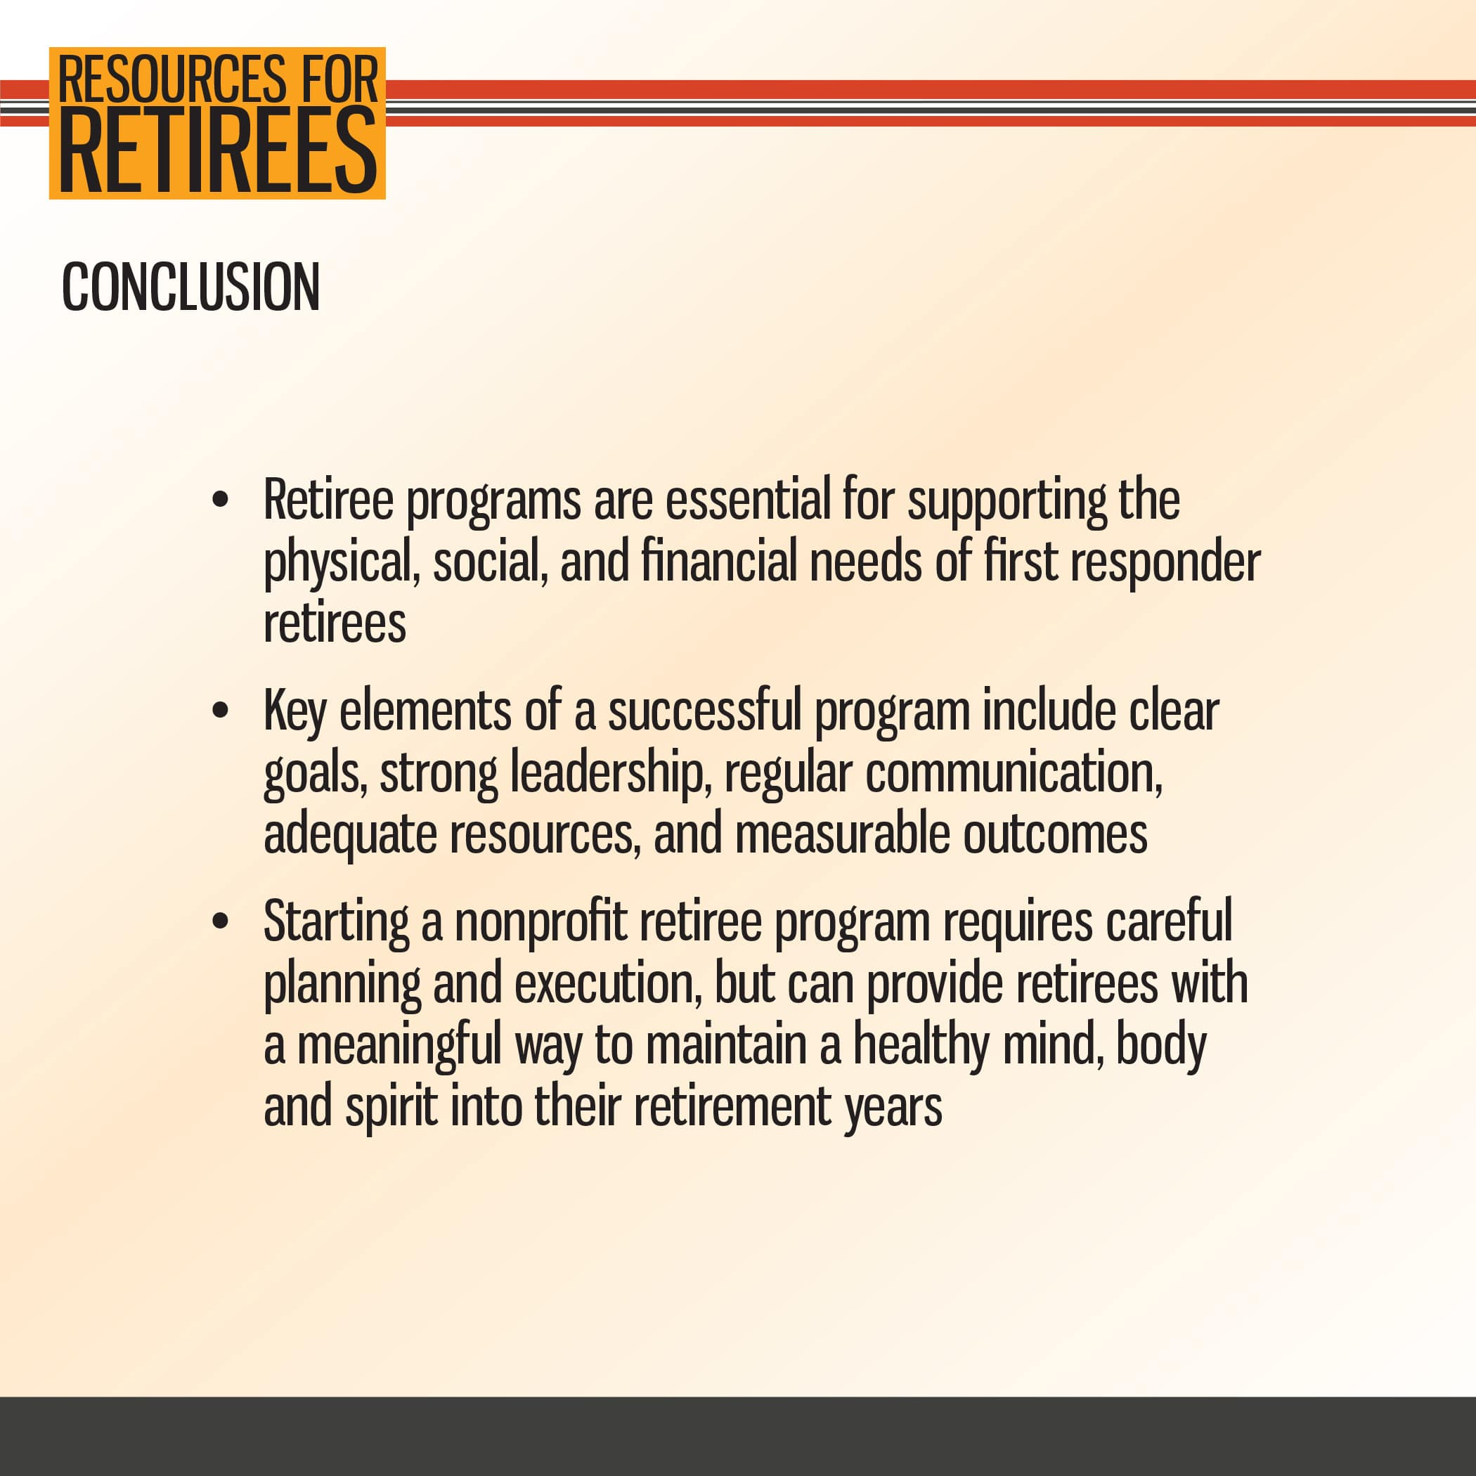

Slide 23
